Slide 1
CEIS 106
Linux on Virtual Machine
Using Arduino IDE
By: Patrick Norris

Slide 2
Introduction
This project was to install a Virtual Machine to run a Linux operating system; then to install Arduino IDE on the OS. Then run a LED light and potentiometer on the Arduino board with RTOS (Real Time Operating Systems).

Slide 3
Inventory
Potentiometer
Arduino Mega Board
Wire(s)
LED
Breadboard
software

Slide 4
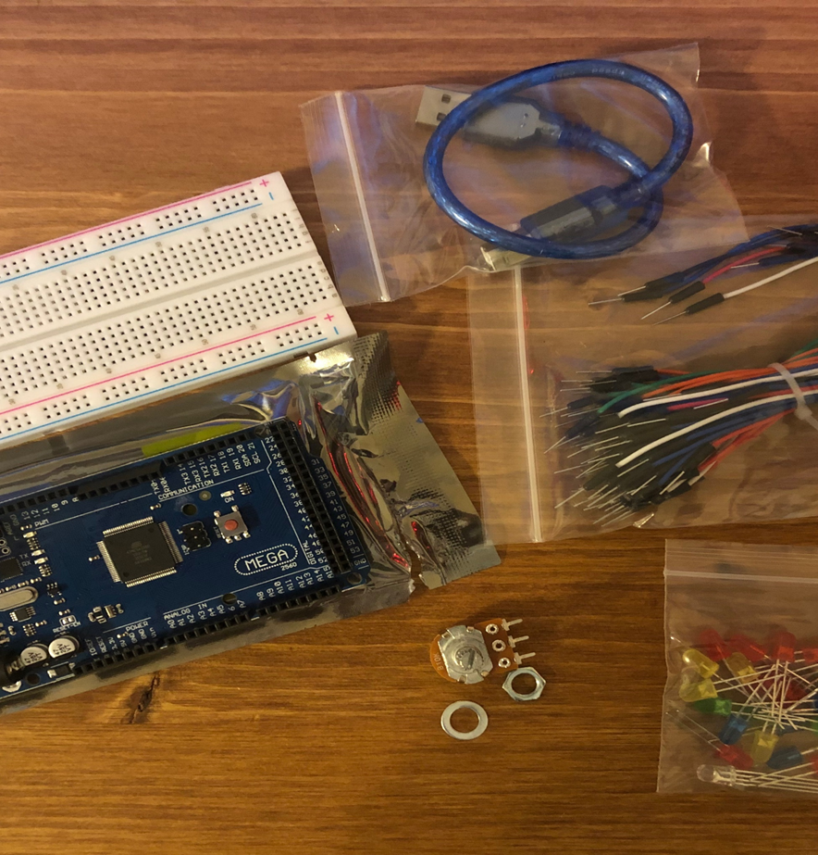
Inventory
This is a picture of the items needed for this project

Slide 5
Planning and Design
When is comes to making a project it is best to make a plan. A flow chart is a great way to show the process and order that a project shall go.

Slide 6
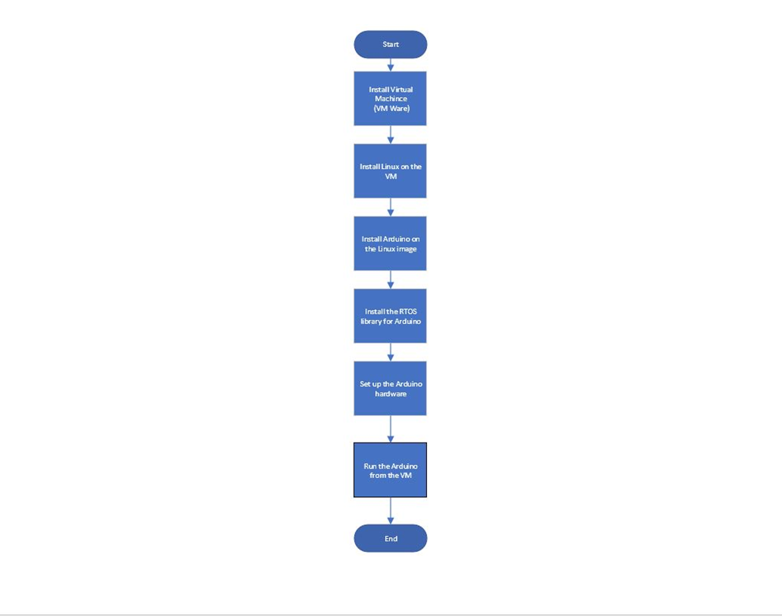
Flowchart
This is a flowchart for the project .

Slide 7
Setup of BIOS for Virtualization
When running a virtual machine on a computer you have to make sure that you have the ability to run the VM
I am using my custom desktop build and with the motherboard that I have F12 is the key to enter the BIOS. For the laptop, the key it DEL to enter BIOS.
SVM(virtualization) is enabled on my desktop. For the laptop I have also enabled it as well.

Slide 8
Install VMware
To install VMware proceed to Google and search VMware
On the site you will see VMware for 64 bit OS select and download

Slide 9

VMware
Screenshot of VMware installed on my desktop

Slide 10
Install Ubuntu on VMware
The next step was to install LINUX ISO Ubuntu on to VMware
Setting allotted for this ISO was 20gb storage, 2 processer, and access to all peripherals that are being used.

Slide 11
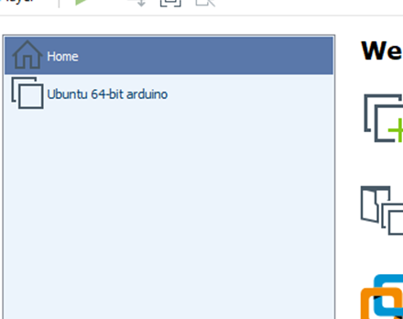
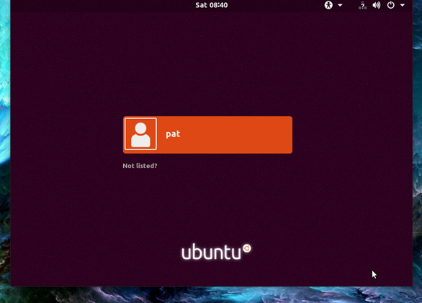
Ubuntu installed on VMware
Ubuntu installed on VMware
Login screen of Ubuntu

Slide 12
Linux Desktop
With Linux OS the terminal is your best friend
To open a terminal, on the left-hand side there is a shortcut to open a terminal, or in the upper-left you can click activities and then search for “terminal” or use the short cut on the keyboard which is “Ctrl – Alt + T”.

Slide 13
Linux Desktop
The Linux OS is a mix of both Windows and Mac in my eyes, it is simple like windows and the interface is like Mac.
The browser that is with Ubuntu is Firefox. For office software there is everything that Microsoft has just called “LibreOffice_______” as Calc, Draw, Writer, and so on.

Slide 14
Install Arduino IDE on Ubuntu
When is comes to Linux the terminal is your best friend like said before
To install the software open Firefox on Ubuntu and search Arduino IDE
Then proceed to the site and you will see Linux 64 select and download
Once downloaded I moved the file to documents and extracted the file as it was .tar this file type is just like a Windows .zip file

Slide 15
Install Arduino IDE on Ubuntu
Once the file is located in document open the file and you will see a install.sh file.
When installing something on Linux you use a terminal rather than a interface that is a point and click like Windows and Mac.

Slide 16
Install Arduino IDE on Ubuntu
Open a terminal and type “sudo sh intall.sh”
A sudo command is an Admin command, sudo standing for “super user do”.

Slide 17
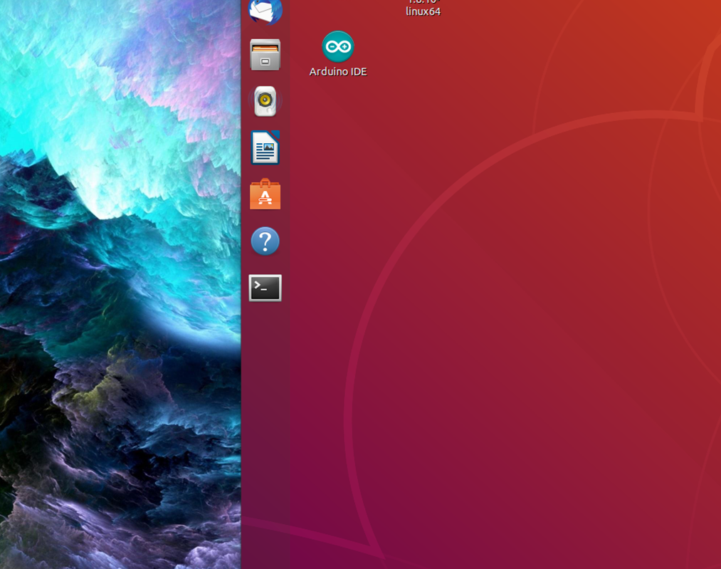
Install Arduino IDE on Ubuntu
Arduino IDE installed on Ubuntu

Slide 18
Installing RTOS to Arduino IDE
RTOS - Real Time Operating Systems
It allows an item to do more then one task at a time. When it comes down to RTOS in IoT it is the consistency and reliability on the timing of task acceptance and completion.
In the Arduino IDE, select tool, manage libraries, search freertos, and install

Slide 19
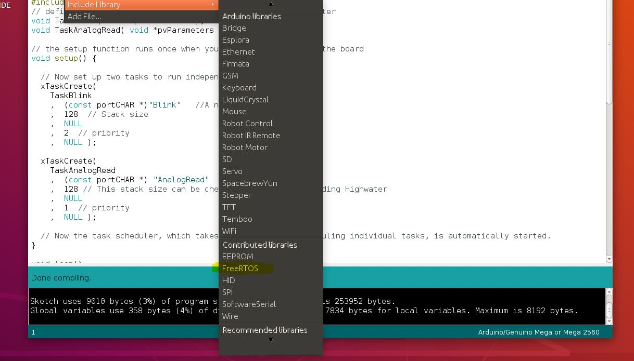
Installing RTOS to Arduino IDE
Screenshot of the FreeRTOS

Slide 20
Serial Monitor
In order to use the serial monitor to see the data that is made; first a directory needs to be man so a terminal needs to be open

Slide 21
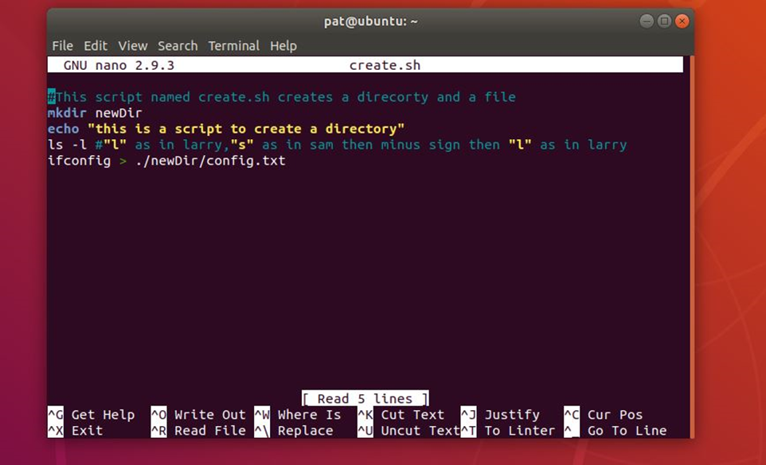
New Directory
Screenshot of script making new directory

Slide 22
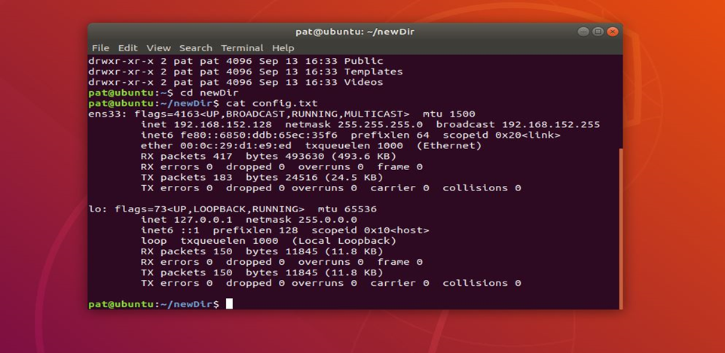
New Directory/Config.txt
Screenshot of config.txt file generated by script and create.sh

Slide 23
VM access to ports
In order to finish the project permission has to be given to use the ports since this is being done on a VM
The command that was used to change permission was ( sudo usermod –a –G dialout pat)
Once this is done the system needs to be restarted to be set in place

Slide 24
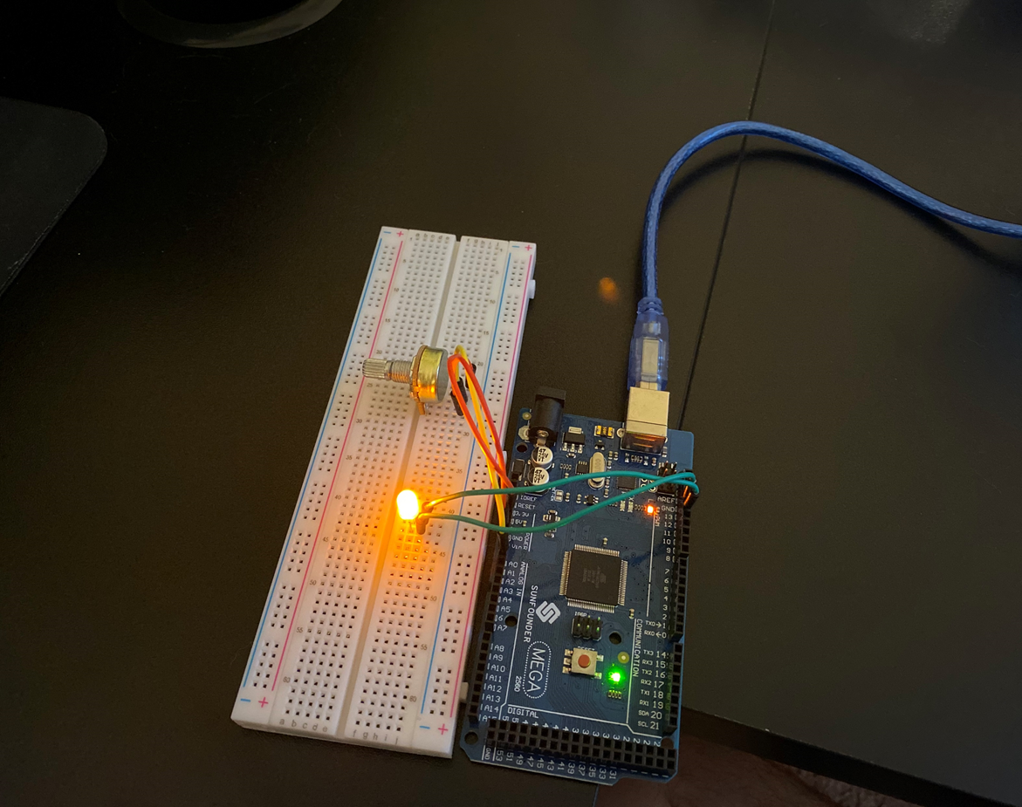
Setup with Arduino
Arduino with LED and Potentiometer

Slide 25
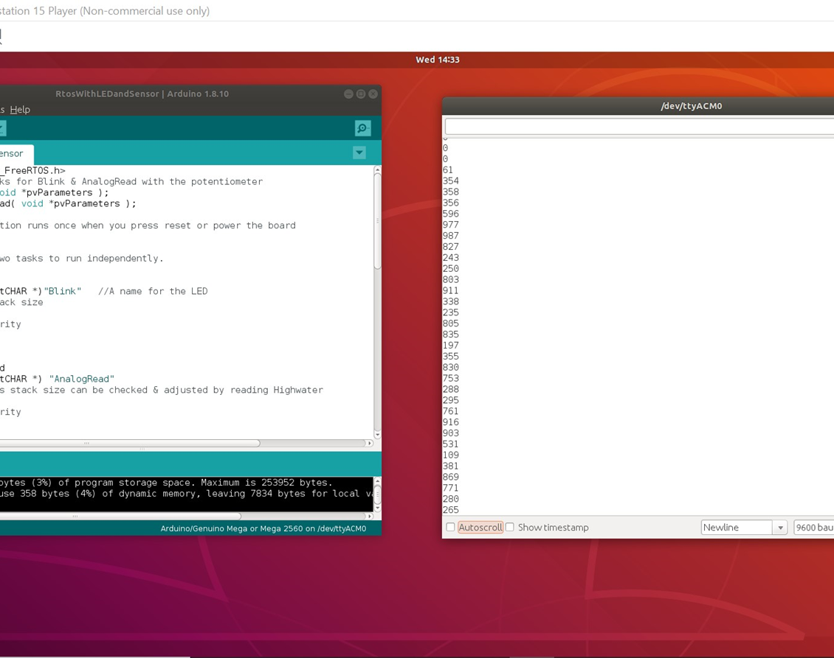
Code with Serial Monitor
Serial Monitor showing potentiometer values

Slide 26
Data
Once the serial monitor is open you can watch the date change as you turn the potentiometer
If you want you could take it a step further if recording the data was needed and add a timestamp within the serial monitor

Slide 27
Challenges
One of the biggest challenges that I had with this project was with granting access for the port
The port I was using was off of my keyboard; the computer recognized the Arduino but I still could not grant
After troubleshooting the problem was with in the VM
To fix this problem I made a new VM and installed Arduino IDE and tried it again and problem was solved

Slide 28
Career Skills
Several Career skills are gained in this project:
  Communication – Using a flowchart to depict the plan and order of the project
  Electronics – (voltage, current) and working with the Arduino Mega Board
  Programming using the Arduino IDE software
  Setting up VM’s
  Linux OS
  IoT

Slide 29
Conclusion
This project covered the fundamental topics of, Linux, IoT, VM’s, and programming.
Building a VM and working with the Arduino provided a hands on learning experience to practice the covered topics.

