Slide 1
Phys204 Project
Patrick Norris

Slide 2
Introduction
When it comes to physics the best way to learn it is to do it. What better way to learn physics than by using technology. Learning the physical principles of how the world, the universe works a long with solving complex logical problems is one way to learn.
This course project is divided in to six parts each with a scientific method. Each part builds off, of the last in a full scientific experiment. Making this project complex and a logical problem.

Slide 3
Material List
Module 1
Purpose:
The first task of the project is to gather and organize the parts and equipment that is needed, to conduct the experiments that will be used to gather data and investigate the different fundamental laws of physics that will be covered over the course.
The most crucial part of any lab report is the material list. It is a very clear and understanding list of what is exactly need for the experiment, so if someone was to study the report that can replicate it if needed. With that have material list it allows the rest of the experiment smoother as the materials have already been established.

Slide 4
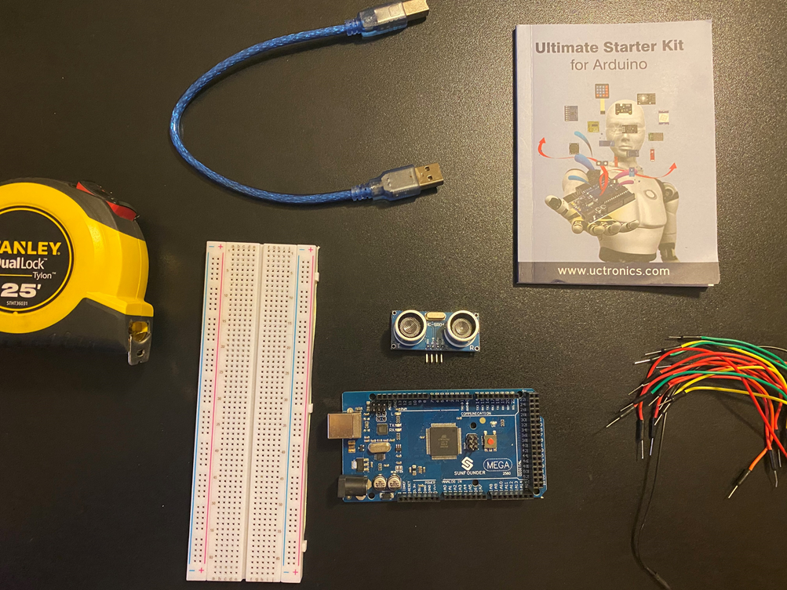
Mega 2560 Board
Ultrasonic sensor HC-SR04
Male to Male Wires
Breadboard
Ruler or tape measurer
Object to act as obstacle and/or undergo free-fall

Slide 5
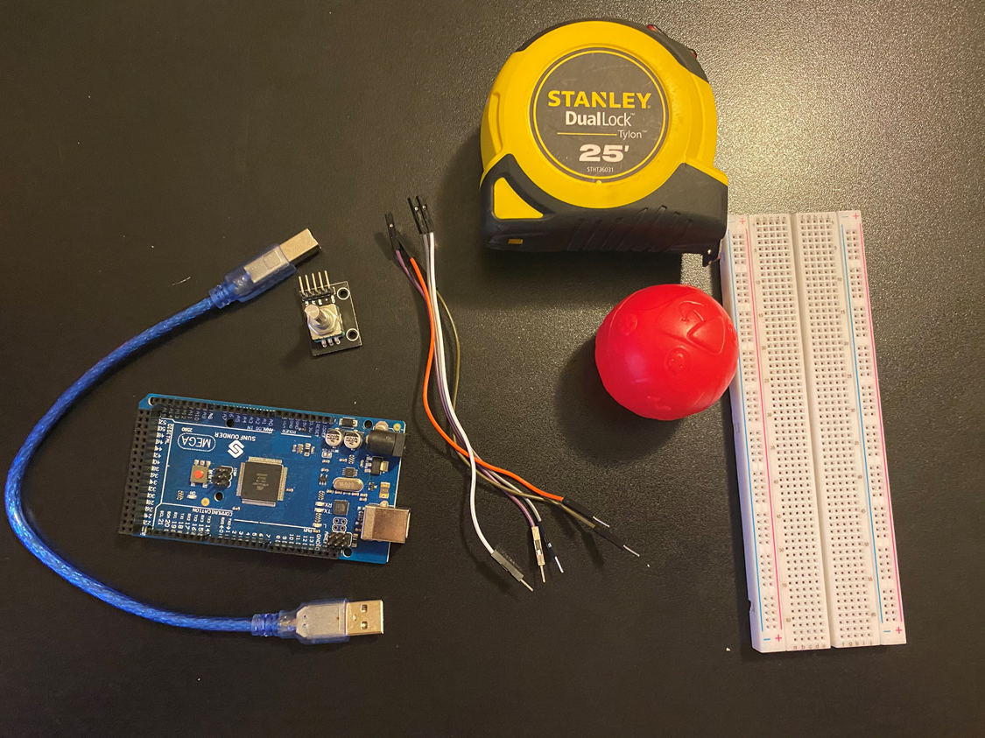
Mega 2560 Board
Rotary Encoder Module KY-040
Male to Female Wires
Object to attach onto rotary encoder
Ruler or tape measurer

Slide 6
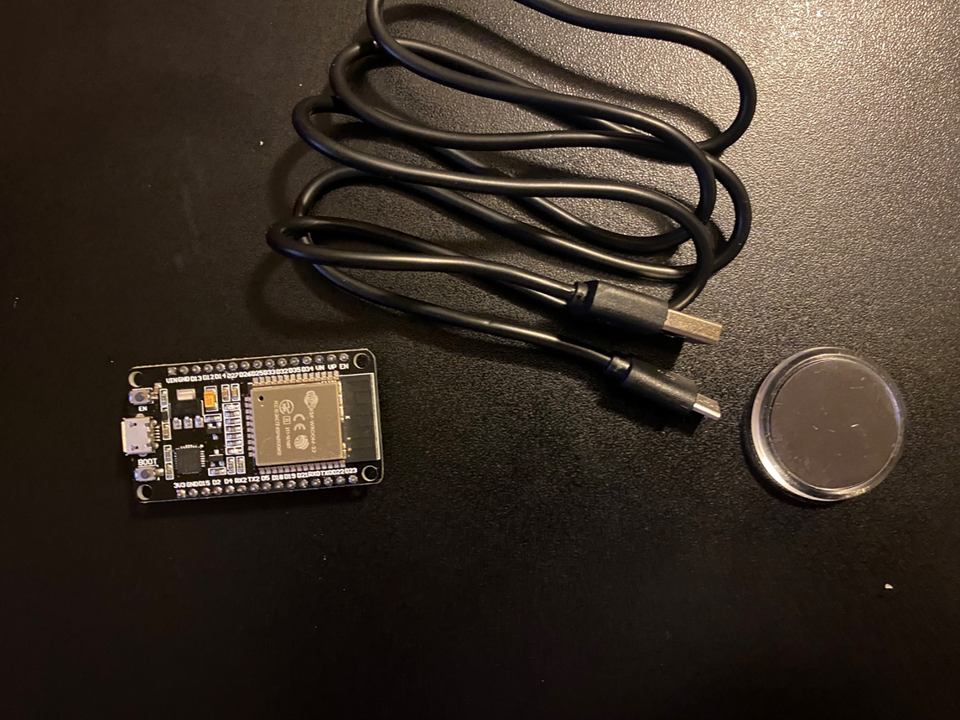
ESP32 microprocessor
Micro-USB to USB cable
Magnet

Slide 7
Precision of ultrasonic sensor
Module 2
Purpose:
This project we applied the knowledge that was learned about numbers and units to determine the precision of an ultrasonic sensor. An ultrasonic sensor is an electronic device with two transducers that are to detect an object within its range. The range of the sensor that was used it from 3cm to 3m.
Finding and determining the precision of the data that was gathered from the sensor is essential to the experiment as the sensor often drift over time. When the sensor does this, it will give off incorrect reading dur to the conditions of the area like humidity, temperature, and component fatigue.

Slide 8
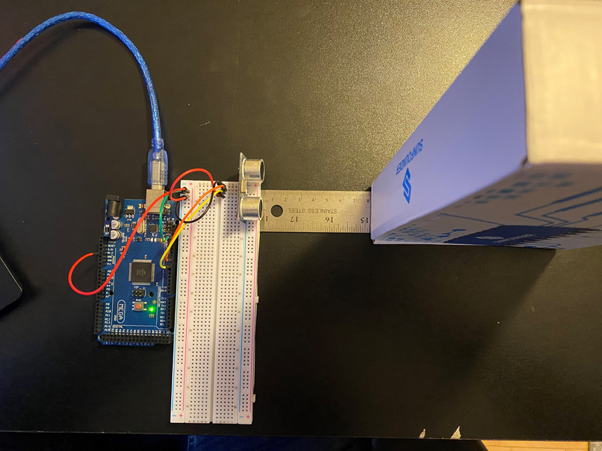
Experimental Set-up
Materials List:
Mega 2560 Board
Ultrasonic sensor HC-SR04
Male to male wires
Breadboard
Ruler or tape measurer
Object to act as obstacle

Slide 9
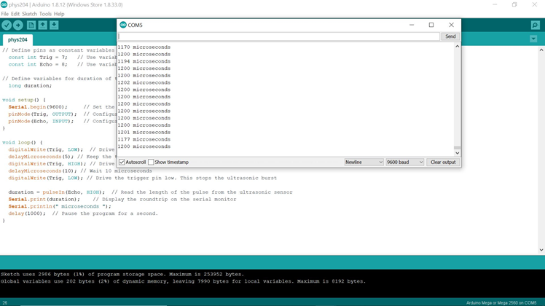
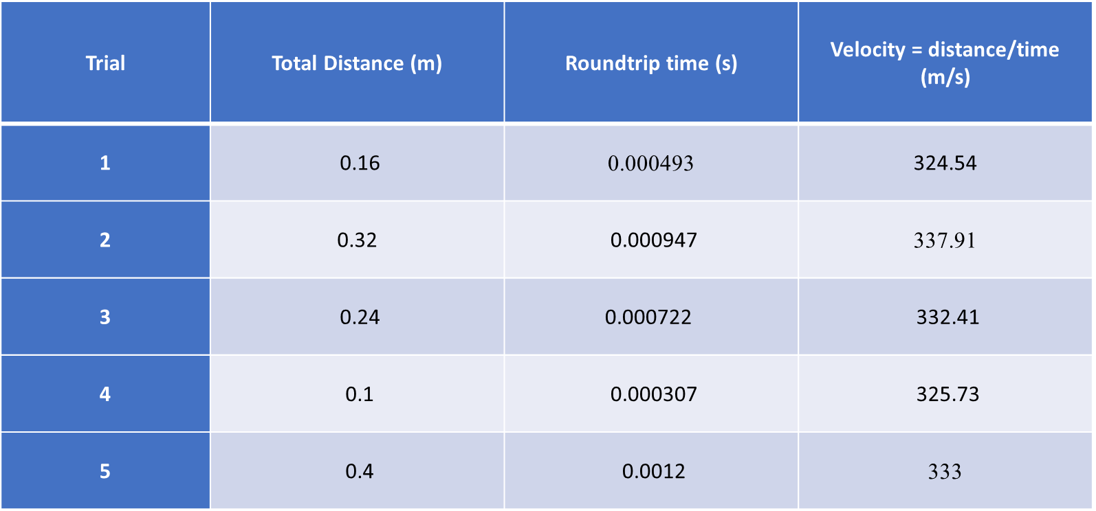
Data
This is the data that was received from Arduino IDE
This is all the data for each trail.

Slide 10
Data Analysis
Average velocity
Percent difference
$$v_{avg}= \frac{324.54+337.91+332.41+325.73+333}{5}=330.72$$
$Percent difference = \frac{\left|330.72−343\right|}{343}×100\%=$ 0.036

Slide 11
Conclusions
Discuss the results and comment on the source of errors.
  Answer:
  The results are slower than the speed of sound. Some sources of error are accuracy of the sensor, the object that was being used, and if we get technical the air temperature.
Elaborate on the skills that you gained during this experiment.
  Answer:
  The skilled that is gained from this is being able to find the average of the speed of sound with the ultrasonic sensor with an object. The other skill is testing the precision of a sensor, collect scientific data, and produce a conclusion.

Slide 12
Gravitational Acceleration
Module 3
Purpose:
This project is applying what was learned about motion as a change of position in order to find gravitational acceleration of a free-falling object with an ultrasonic sensor.
With this project the data that is received will be used to investigate the conservation of energy in the next module.

Slide 13
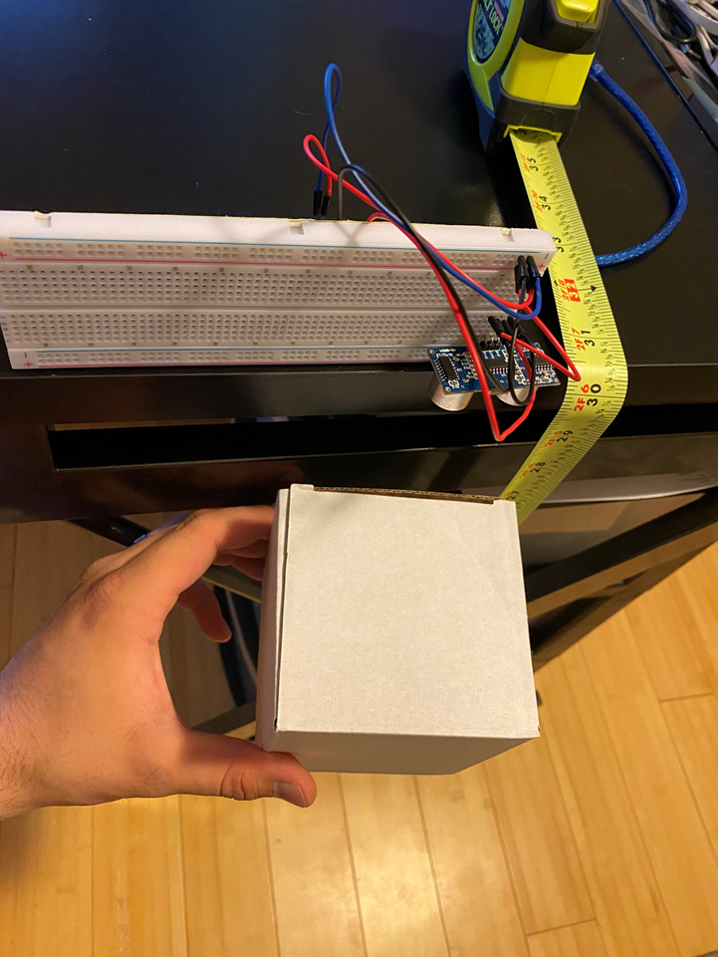
Experimental Set-up
Materials List:
Mega 2560 Board
Ultrasonic sensor HC-SR04
Male to male wires
Breadboard
Ruler or tape measurer
Object to undergo free fall motion

Slide 14
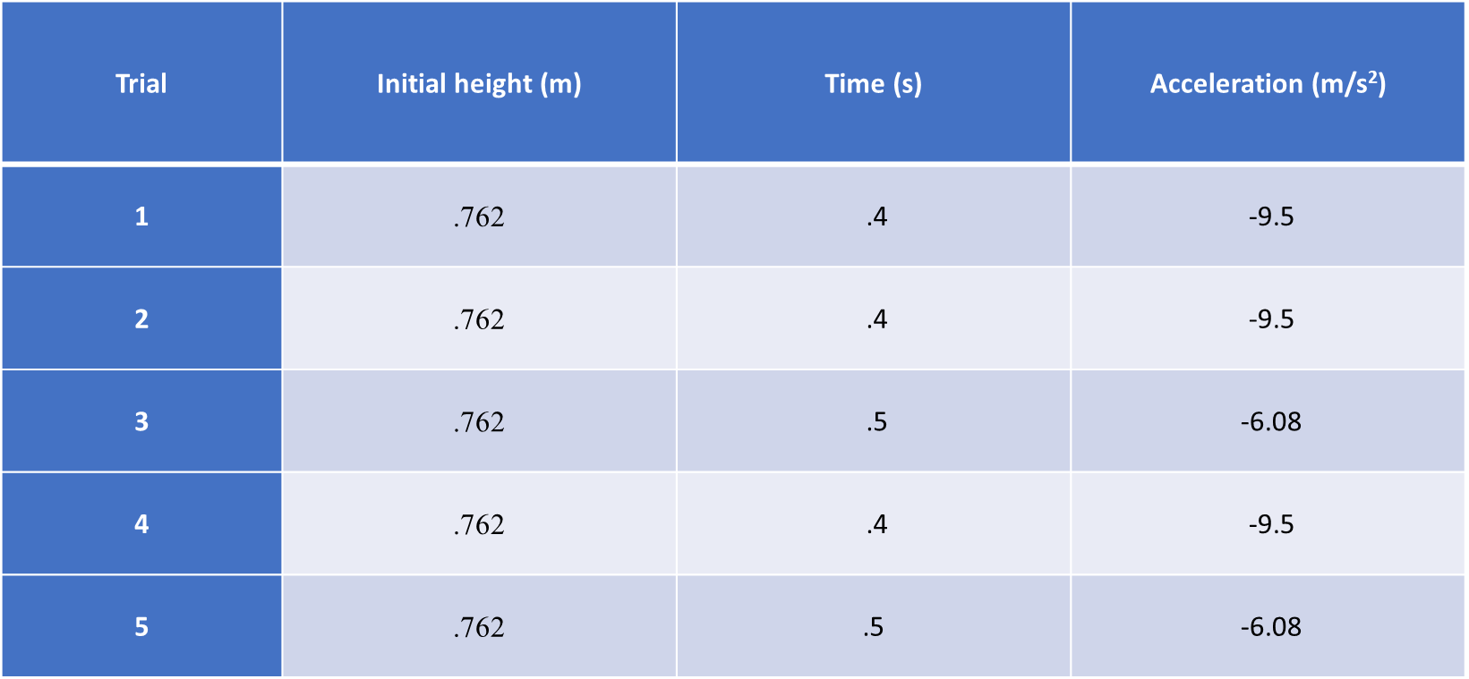
Data Collection

Slide 15

Data Analysis
Average acceleration
Percent difference
$$a_{avg}= \frac{−9.5+−9.5+−6.08+−9.5+−6.08}{5}=−8.132 m/{s^{2}}$$
$$Percent difference =\frac{\left|−8.132−9.8\right|}{9.8}×100\%=17\%$$

Slide 16
Conclusions
Indicate the line of code that outputs the distance. How is this equation determined? What does the 0.0343 represent? Why is the equation divided by 2?
  Answer: distance= duration*0.0343/2, distance is determined form the ultrasonic sensor by the time it takes for the sound to travel to the object and back. 0.0343 is the speed of sound converted from meters per second to centimeter per microseconds. The equation is divided by 2 from the travel down and back up from the object.
How much variation is there from trial to trial? What does this indicate about the uncertainty of the result?
  Answer: There was a slight variation in each trail, this shows that the object did not fall evenly every time or might have bounced back a little. This means that no matter how many times you drop the object you will get different numbers. The only way to fix this would be to have a much more controlled environment.

Slide 17
Conservation of Energy
Module 4
Purpose:
In this course project we applied the knowledge gathered from previous modules, like numbers and units to find quantities of motion. Motion is the change of position. Acceleration and velocity describes important kinds of motion, and analyzing the motion helps introduces the naturel of physics.
With the information that is gathered about motion we can now demonstrate the transformation of energy. Learning about the transformation of energy from one to another it will help us understand the world, and universe that we live in.

Slide 18
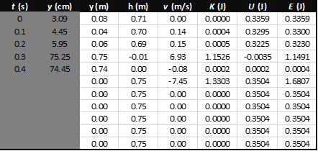
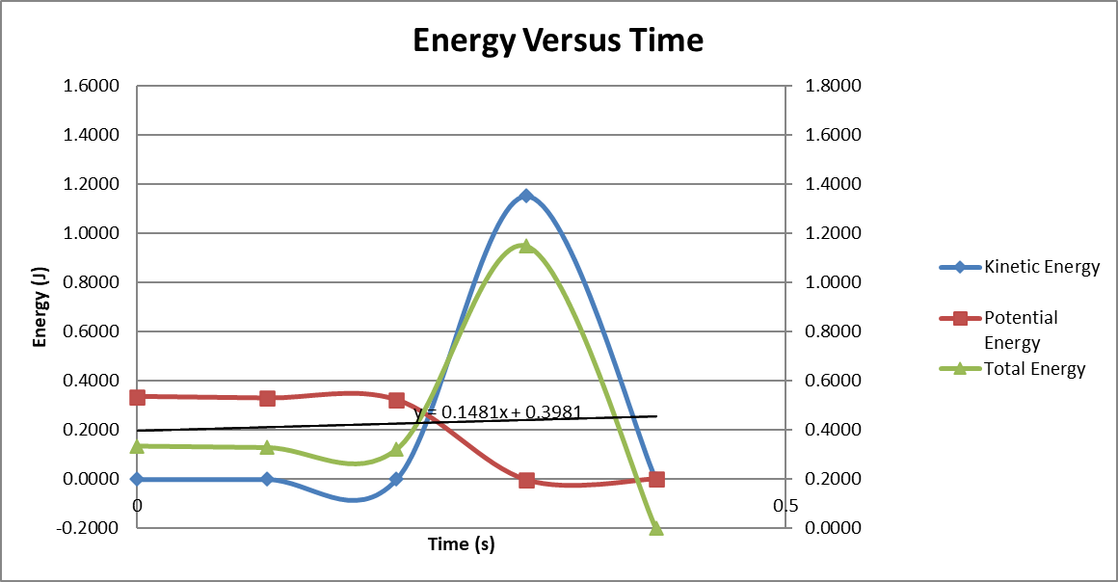
Data Analysis

Slide 19


Data Validation
Theoretical value of final velocity
Percent difference
$v_{f}=\sqrt{2(9.8{m/s}^{2})(0.745)}$ = 3.82
$Percent difference =\frac{\left|3.82−(6.93m/s)\right|}{3.82}×100\%=$81%

Slide 20
Conclusions
Is the total mechanical energy conserved at all times? If yes, how well is it conserved?
  Answer: In theory if we ignore air resistance mechanical energy is conserved at all times, but in practice the box does not conserve mechanical energy as there is air unless conducting in a vacuum chamber.
Discuss the time U = E and the time K = E for an object in free fall. What happens at these points? That is, what are the position and speed at these points?
  Answer: U = E at the point of start, where the object begins to fall the speed is 0 at this time; so U = E when the object is at rest. For K = E, it does not occur but comes close at .3s when the energy has passed maximum and starts to decrease.

Slide 21
Rotational Motion with rotary encoder
Module 5
Purpose:
This project deals with an objects shape, as before the shape of an object was not important as everything was dealt in a straight line.
This project deals with a more complex motion this motion being circular motion. This project deals with the conversion of radial displacement to linear displacement using a rotary encoder with a round object.

Slide 22
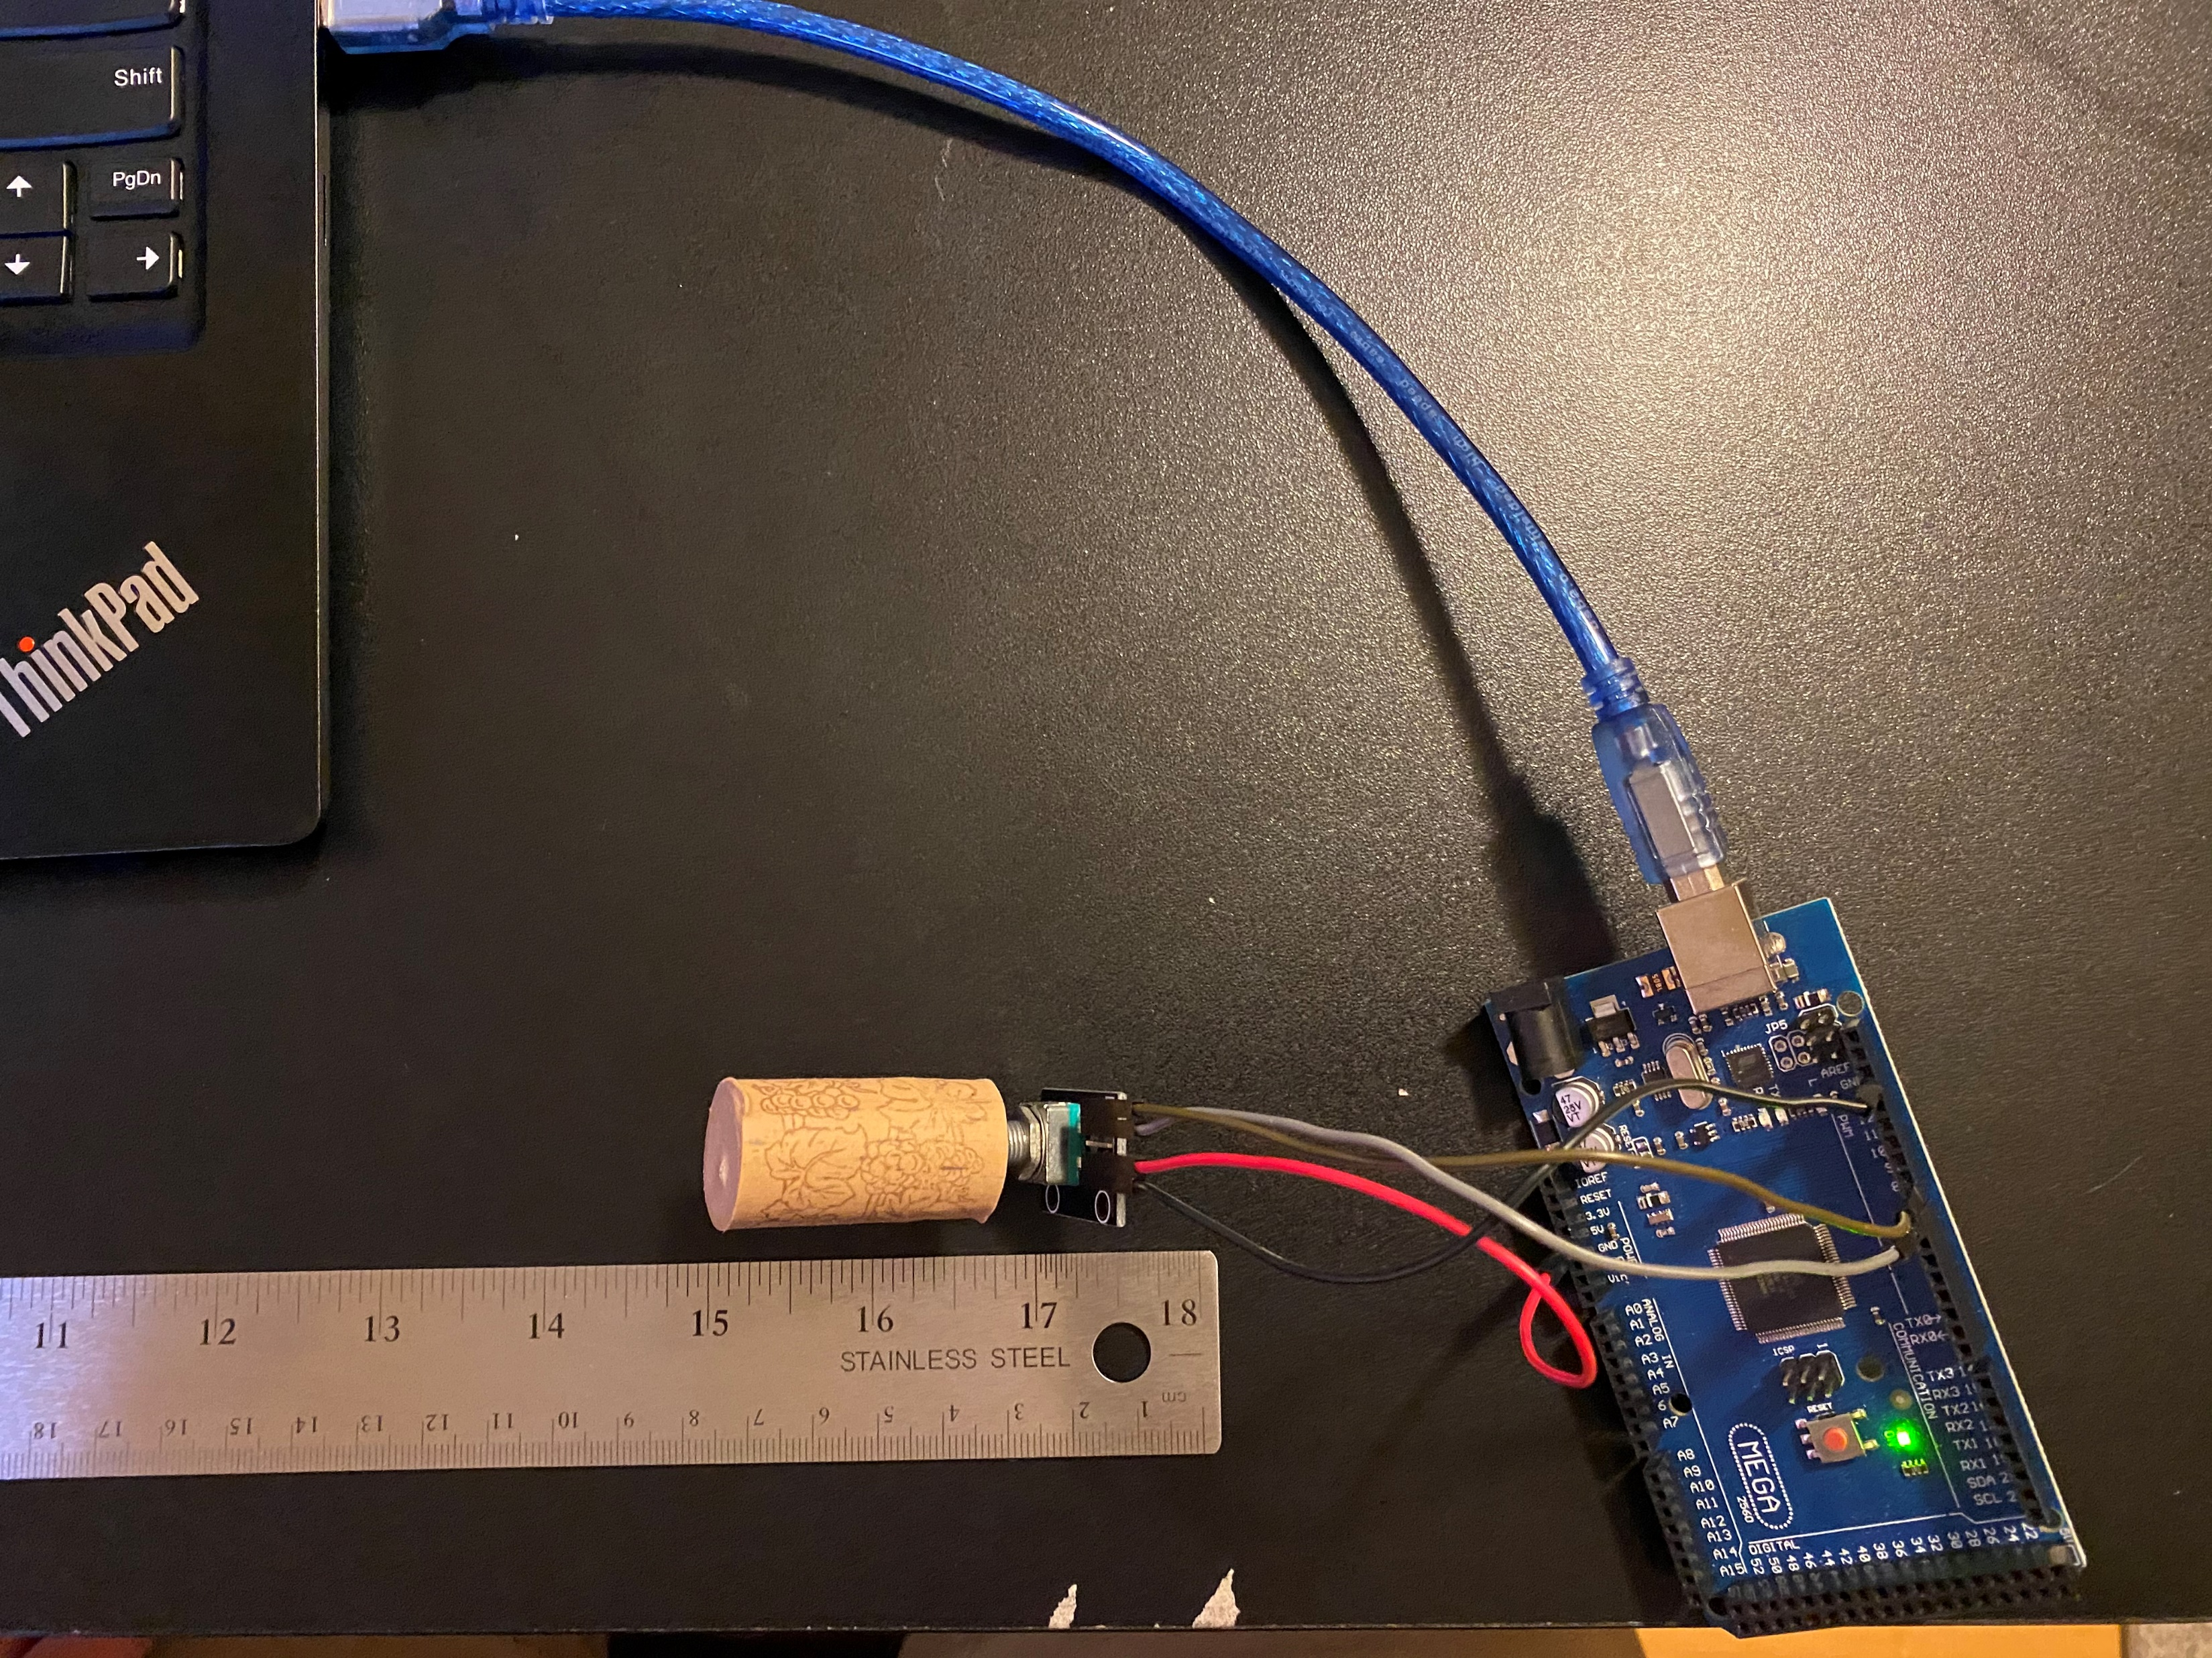
Experimental Set-up
Materials List:
Mega 2560 Board
Rotary encoder module KY-040
Male to female wires
Object to attach onto rotary encoder
(e.g., cork, bottle cap, ball)
Ruler or tape measurer

Slide 23
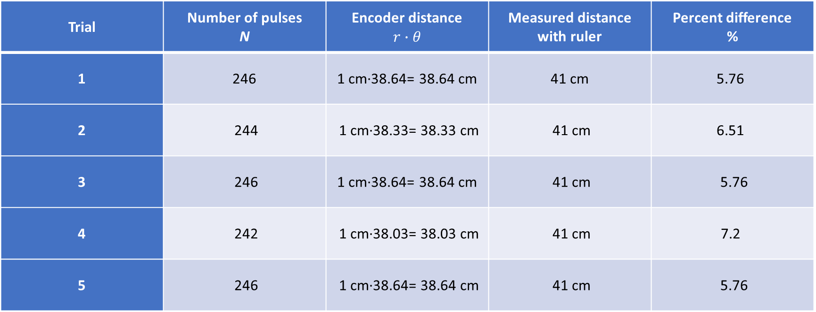
Data Collection & Analysis
Object radius, r = 1cm

Slide 24
Conclusions
Discuss the results and comment on the reasons for errors.
  Answer: The difference is not much but there is a difference in the linear distance and the rotational distance, some of these errors can be from the cork not being a perfect cylinder, therefore make a bigger diameter on one side.
What are some applications of this measuring technique? Could this measuring system be used to measure surfaces that are not flat?
  Answer: When it comes to this measuring technique the thing that comes to mind is a surveyor’s wheel, the wheel and stick that the measure roads with and stuff. As the earth does have curve to it so this would maker it easier.

Slide 25
Hall Effect
Module 6
Purpose:
Waves are everywhere, we are surrounded by them between sound waves and RF waves they are many different types of waves. As there are different types of waves there are also things that we can not see nor hear, like magnetic and electrical fields.
In this project we measure some of the characteristics of waves by viewing the data of the frequencies from a buzzer using a sound sensor module.

Slide 26
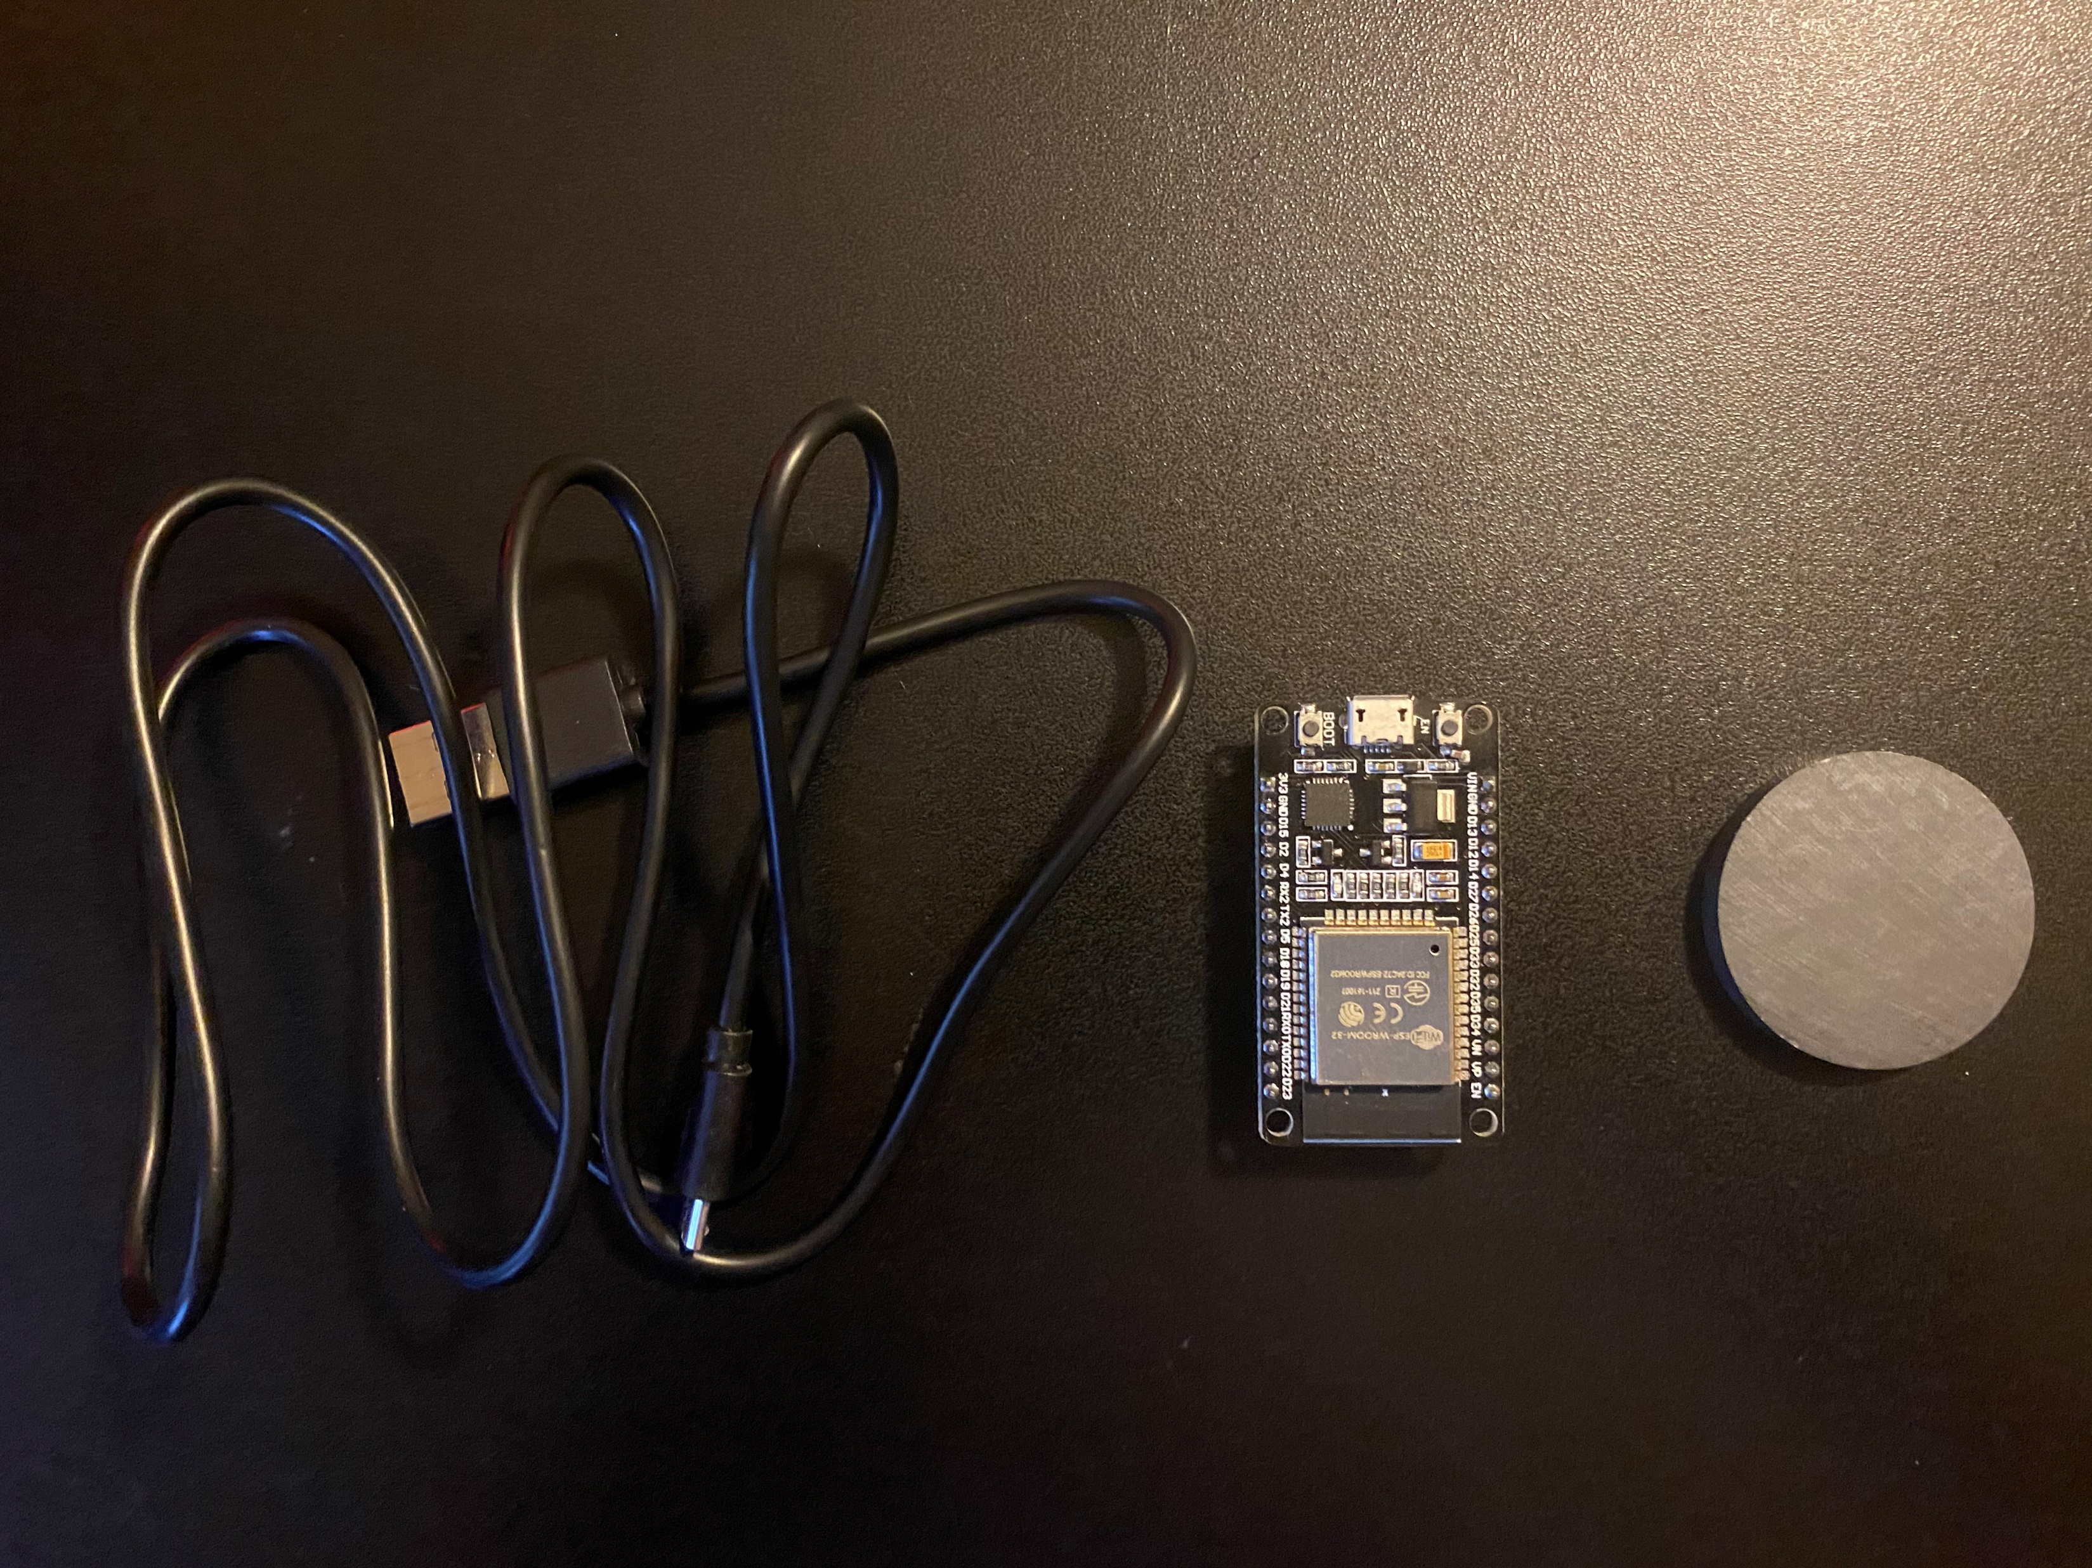
Experimental Set-up
Materials List:
ESP32 microprocessor
Micro-USB cable
Magnet

Slide 27
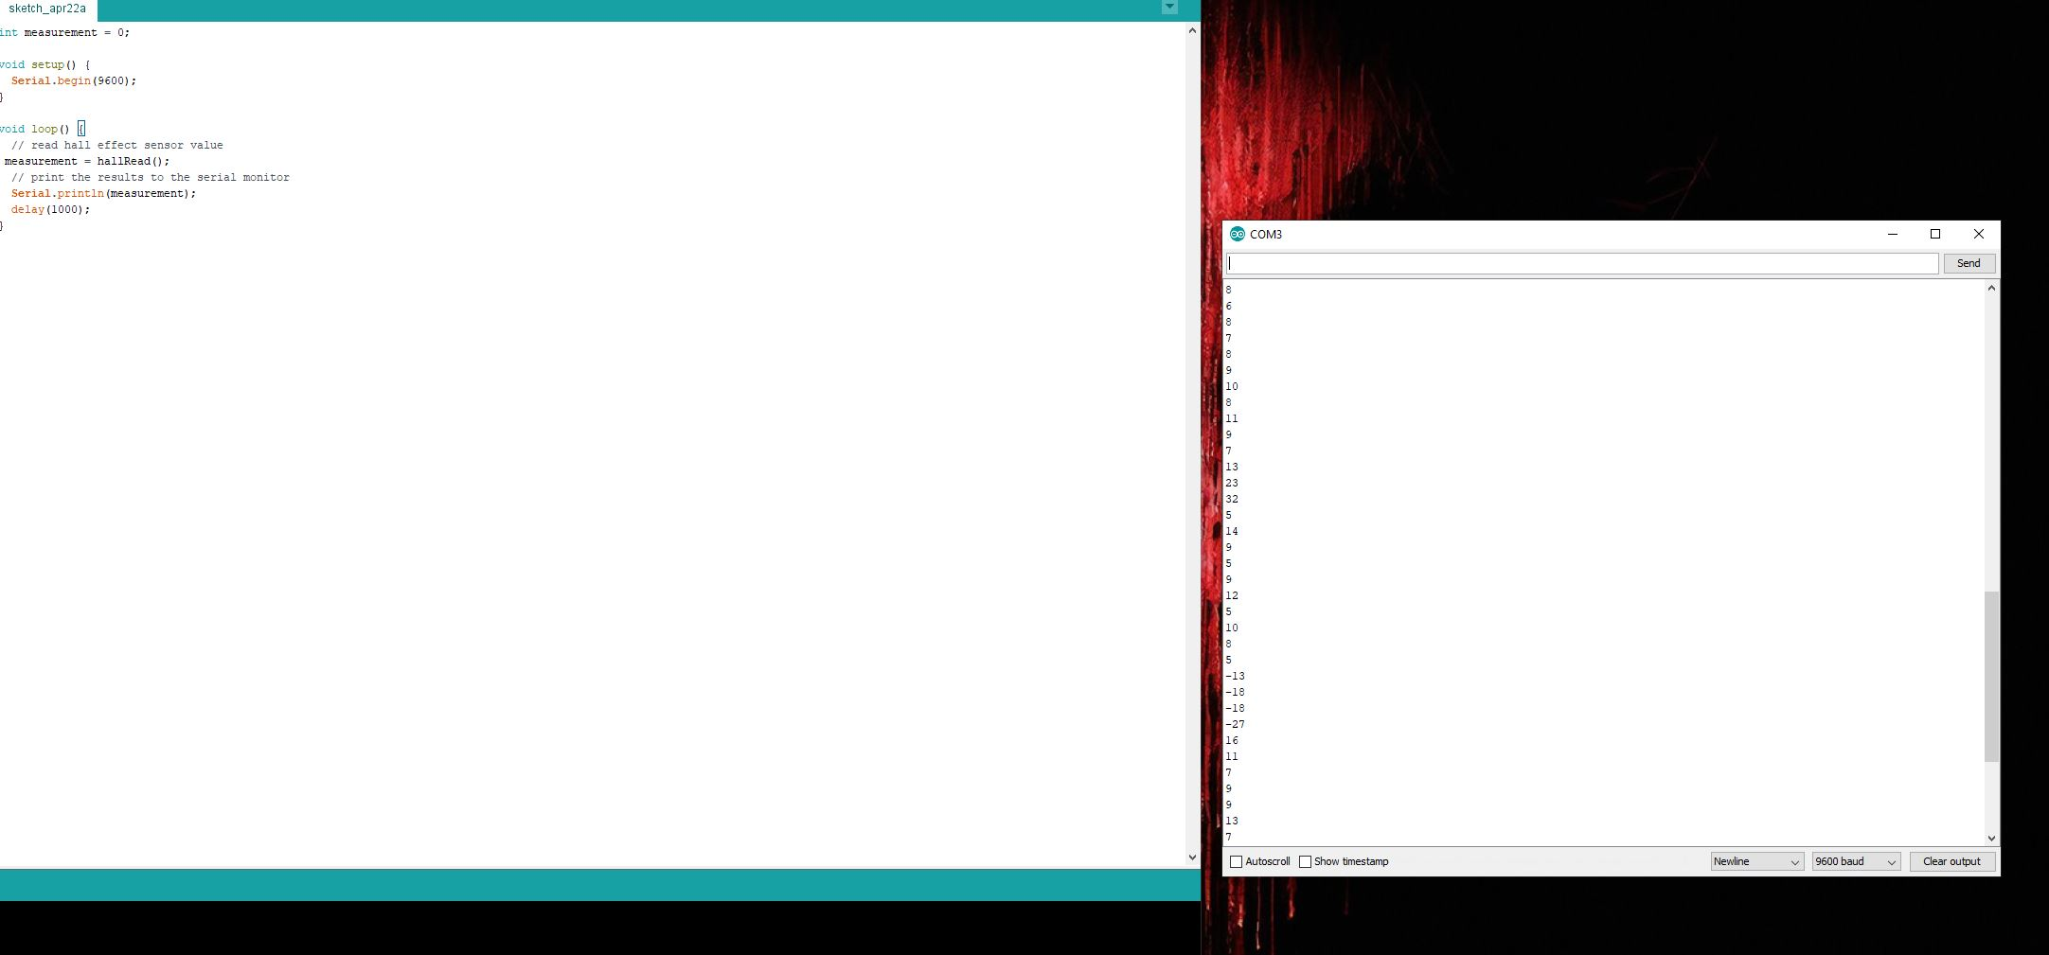
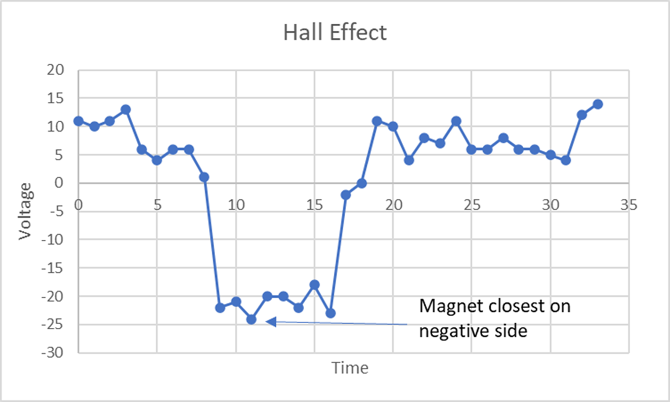
Data Collection & Analysis

Slide 28
Conclusions
How does the Hall sensor work?
  Answer: The Hall sensor detect variations in the magnetic field around it. The stronger the magnetic field, the greater the voltage the that the sensor will have.
What are some practical applications for the Hall effect sensor?
  Answer: The most practical application for the Hall Effect sensor is detecting rotation speed in a vehicle for controlling the anti-lock braking. Another is the seat and the seat beat to active and deactivate the passage air bag.

Slide 29
Project Challenges
One of the biggest challenges is not having a fully controlled environment to conduct these experiments as you have drifts or misreading’s and getting skewed data.
When is came to the free fall motion experiment it showed that object drift and it requires smaller time increments.

Slide 30
Skills Obtained
Development process of experiments, including the complex thinking, hardware setup, and programing of IoT devices.
With each these projects the aspect of the IoT and preparing me for my future career in technology using IoT.

