Slide 1
NETW200
Fundamentals of Information Technology and Network II
Course Project

Slide 2
Project Topics
Importing Virtualized Appliances into VMware
Subnetting and Virtual Local Area Networks (VLAN)
Vulnerability Assessment
Password Assessment
Network Performance Monitoring
IP Routing

Slide 3
Introduction
The purpose of this project is to demonstrate the understanding and use of routing, switching, virtual LANS, access control list security, a long with setting up a local network with a virtual server. Understand the use of Kali Linux and the tools that are available.

Slide 4
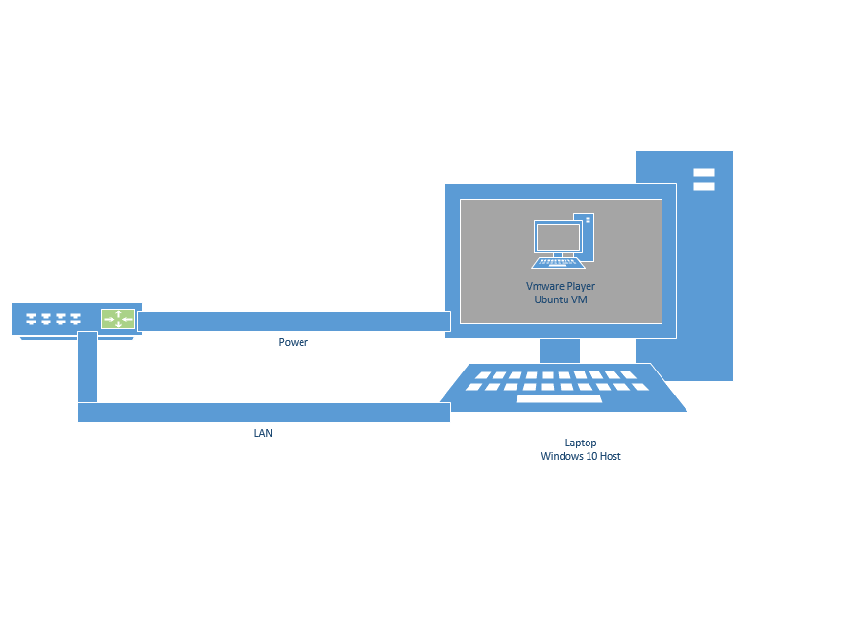
Initial Network Diagram
Initial network is made of a GL-iNET Model Gl-MT300n-V2 router and Laptop running Windows 10 with VMware Player 15, and hosting Ubuntu Virtual Machine.
Along with this later a Kali Virtual Machine was imported into this environment.

Slide 5
Vmware player environment with ubuntu and kail VMs
Ubuntu OS was installed from an ISO image.
The Kali Linux OS was imported as an OVF file provided from a different computer running VMware.

Slide 6
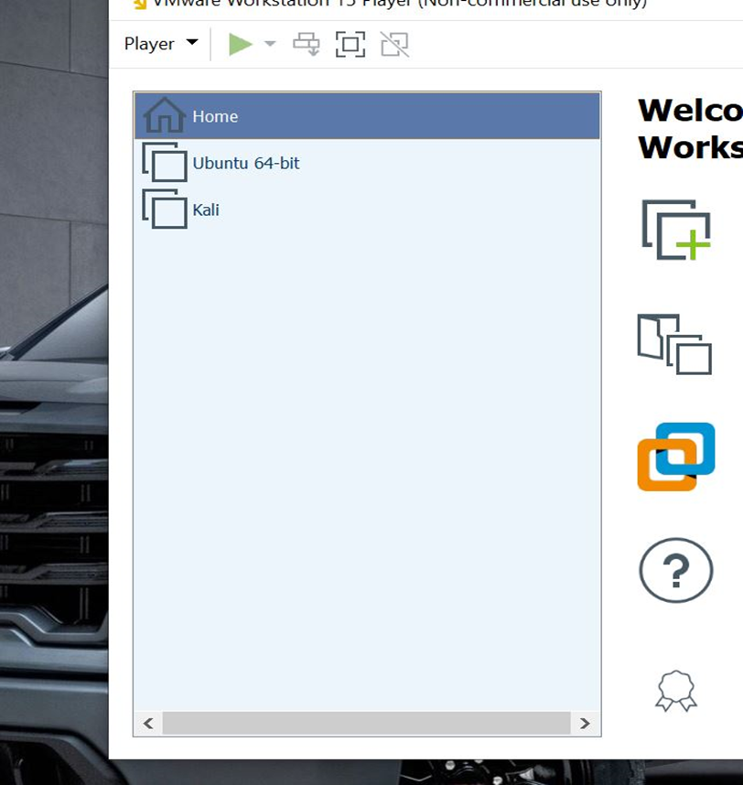
Vmware Player with Ubuntu and kali
This is a screenshot of the VMware environment with Ubuntu and Kali VMs.

Slide 7
Virtual Machines, OVF, and ISO
When it comes to running multiple OS it is best and cost efficient to run them on a VM rather than have a computer that runs them. This allows everything to be portable if it needs to.
OVF- Open Virtualization Format, this is a packaging standard designed to address the portability and deployment of virtualization appliances.
ISO- International Organization for Standardization, This is a digital format of a CD, DVD, or BD.

Slide 8
Checking IP
When setting up the VM the network connection needs to be bridged. Bridging the VMs with the Host PC allows for the VMs to have internet but with its own IP address rather than using the IP of the Host.
The way to check to see if the VMs have their own IP is to check the Host and VMs within Command Prompt or Terminal. With Windows OS to check the IP address type command “ipconfig” in Command Prompt. For Linux systems in a Terminal type “ifconfig”. These commands will give you the IP address of the OS.

Slide 9
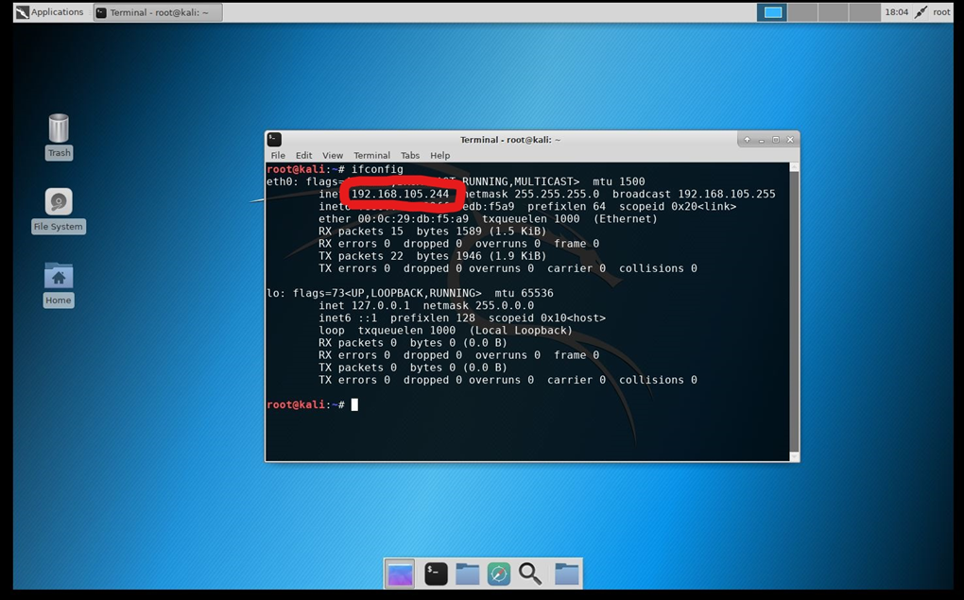
Kali VM IPv4 address
This is a screenshot of the Kali Terminal window with IPv4 address showing connection to the Travel Router.

Slide 10
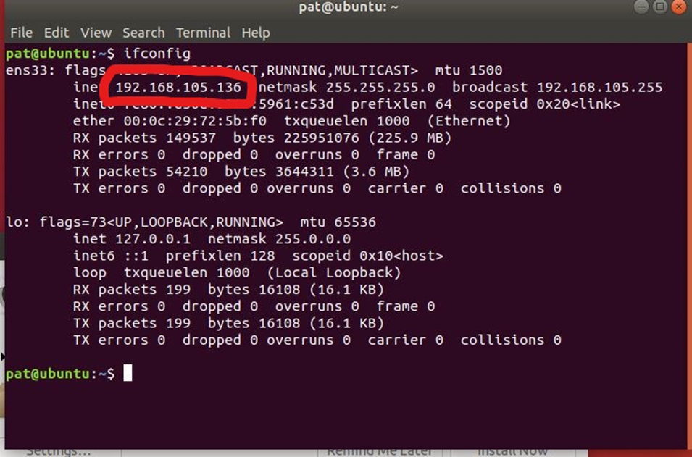
Ubuntu VM ipv4 address
A screenshot of the Ubuntu Terminal Window with correct IPv4 address from Travel Router.

Slide 11
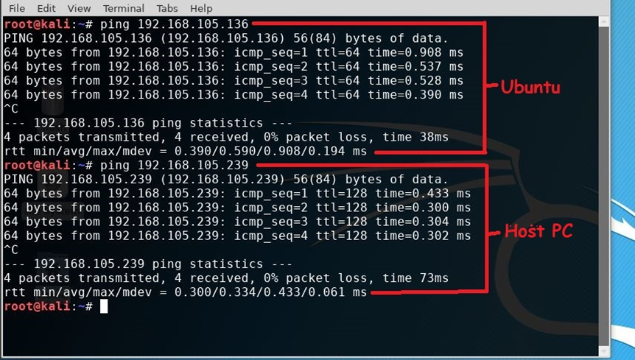
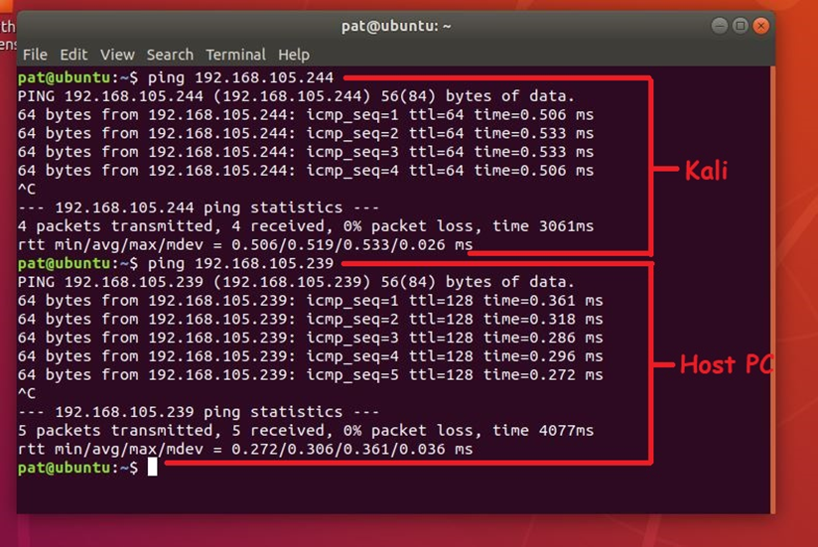
Ping connectivity test
A test is then conducted to check the connectivity between the VMs.

Slide 12
IP subnetting and virtual local area network
What is subnetting?
Subnetting is splitting a single large network into two or more strands, this increases routing efficiency, a long with enhances the security of the network. When it comes to subnetting formula is used to help make these Ips (Number of hosts = 2⁽³² – ^{n)} – 2) this is the Formula.

Slide 13
Subnetting
List of four /26 networks, including network addresses, first usable addresses, last usable addresses, and broadcast addresses.
 | Network Address x.x.x.x/x | First Usable Host Address | Last Useable Host Address | Broadcast Address
First subnet | 192.168.2.0/26 | 192.168.2.1 | 192.168.2.62 | 192.168.2.63
Second subnet | 192.168.2.64/26 | 192.168.2.65 | 192.168.2.126 | 192.168.2.127
Third subnet | 192.168.2.128/26 | 192.168.2.129 | 192.168.2.190 | 192.168.2.191
Fourth subnet | 192.168.2.192/26 | 192.168.2.193 | 192.168.2.254 | 192.168.2.255

Slide 14
Subnetting Cont.
List of two /27 networks, including network addresses, first usable addresses, last usable addresses, and broadcast addresses.
 | Network Address x.x.x.x/x | First Usable Host Address | Last Useable Host Address | Broadcast Address
First subnet | 192.168.2.64/27 | 192.168.2.65 | 192.168.2.94 | 192.168.2.95
Second subnet | 192.168.2.96/27 | 192.168.2.97 | 192.168.2.126 | 192.168.2.127

Slide 15
Subnetting cont.
List of four /29 networks, including network addresses, first usable addresses, last usable addresses, and broadcast addresses.
 | Network Address x.x.x.x/x | First Usable Host Address | Last Useable Host Address | Broadcast Address
First subnet | 192.168.2.96/29 | 192.168.2.96 | 192.168.2.102 | 192.168.2.103
Second subnet | 192.168.2.104/29 | 192.168.2.104 | 192.168.2.112 | 192.168.2.111
Third subnet | 192.168.2.112/29 | 192.168.2.112 | 192.168.2.118 | 192.168.2.119
Fourth subnet | 192.168.2.120/29 | 192.168.2.120 | 192.168.2.126 | 192.168.2.127

Slide 16
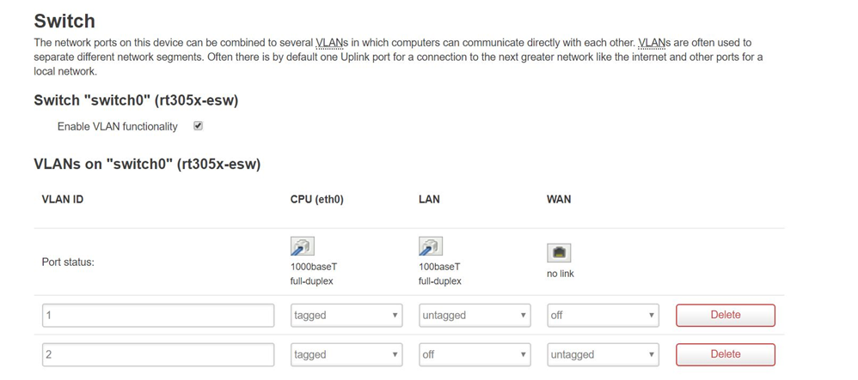
Travel router vlan configuration
A screenshot of currently configured VLANs on the GL-MT300N-V2 Travel Router. VLAN is a virtual LAN, it is any broadcast domain that is partitioned and isolated in a computer network at the data layer. Tagged and untagged are settings that control the ports, tagged is to pass traffic for multiple VLAN’s, and untagged or also know as “access” is for single VLAN.

Slide 17
Vulnerability Assessment
When it comes to setting up a network it can be easy, but there is more work to do. After the network has been setup a vulnerability test needs to be done so you can find the weak points to be able to strengthen them. To find these I used programs within Kali like JohnRipper, Nmap, and Greenbone Security Assistant to name a few.

Slide 18
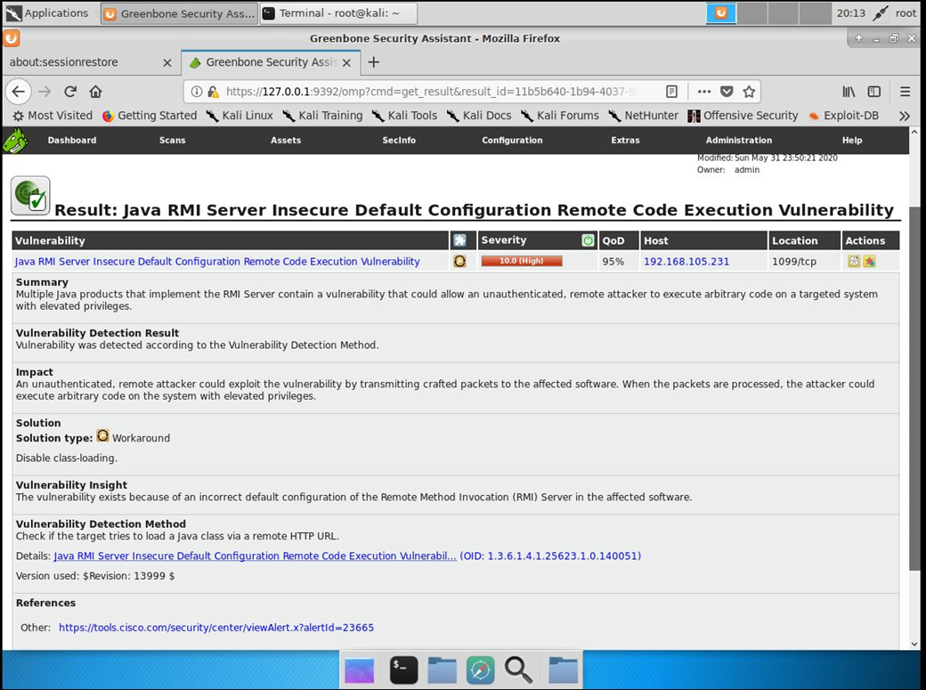
Vulnerability rating
With the Greenbone Security Assistant, the program will run a vulnerability test. It will give severity results and ways to fix them.
This is a screenshot of a high severity rating.

Slide 19
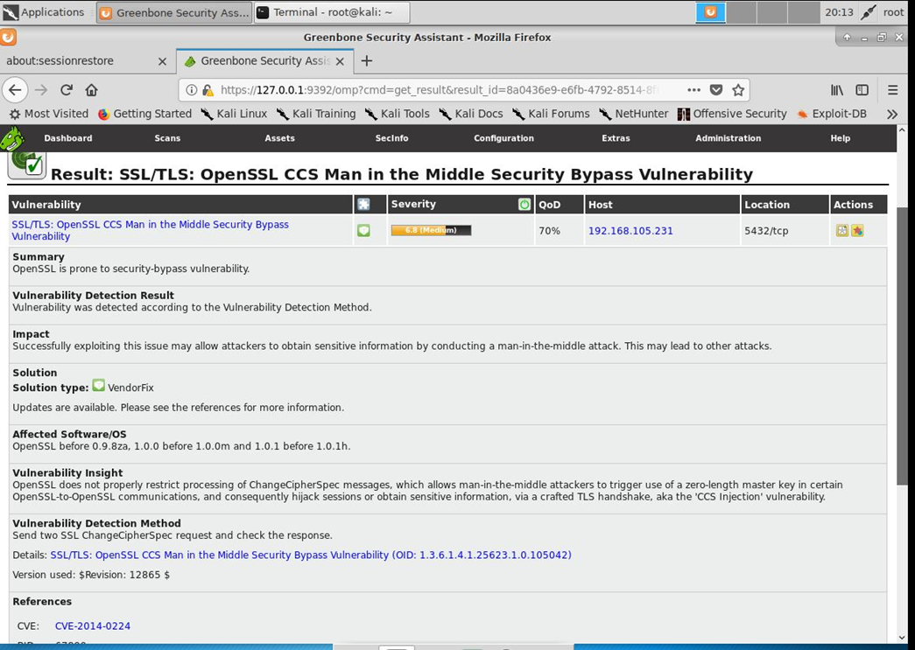
Vulnerability Rating
This is a medium rating and the results to fix the issues.

Slide 20
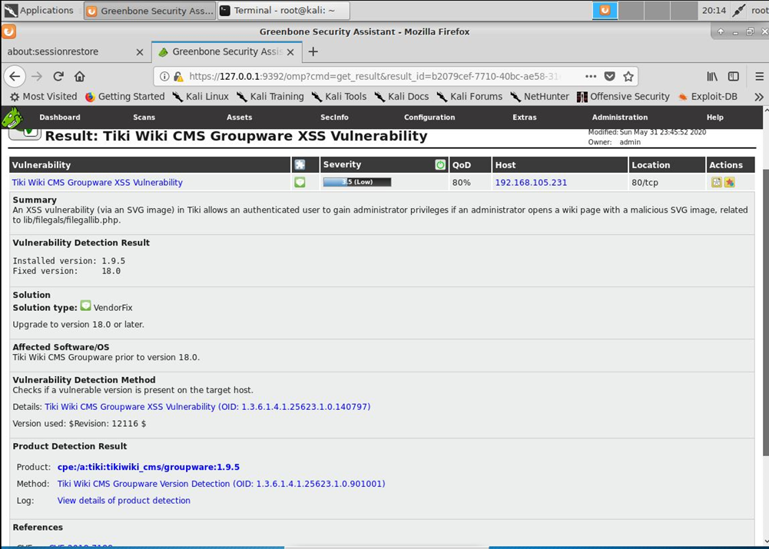
Vulnerability rating
This is a screenshot of the low severity rating showing the results and a way to fix the issue.
When it comes to ranking the vulnerabilities by severity level it puts the issues in a priority list to what needs to be done first.

Slide 21
Password Management
With vulnerability test password management is another thing that needs to be taken care of. With password management a program known as Johnripper is used to crack user passwords.

Slide 22
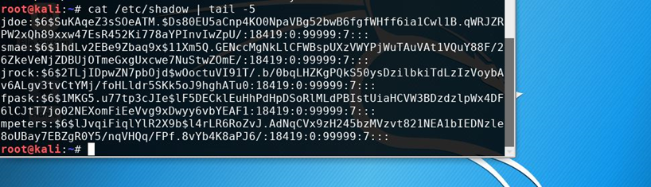
Password Management
This is a screenshot of the command /etc/shadow file, including password hashes of the last five user accounts.
When it comes to the two users jdoe and jrock having the same passwords but different hashes in /etc/shadow file is because they were salted different so the hash will be different.

Slide 23
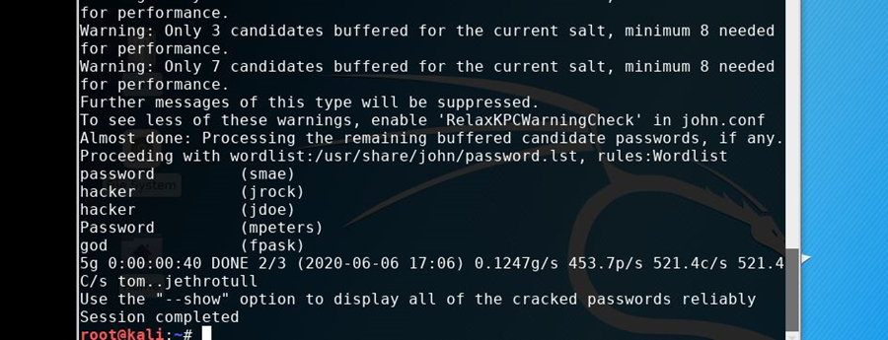
Password management
This is a screenshot of the cracked user passwords by using John the Ripper security tool.

Slide 24
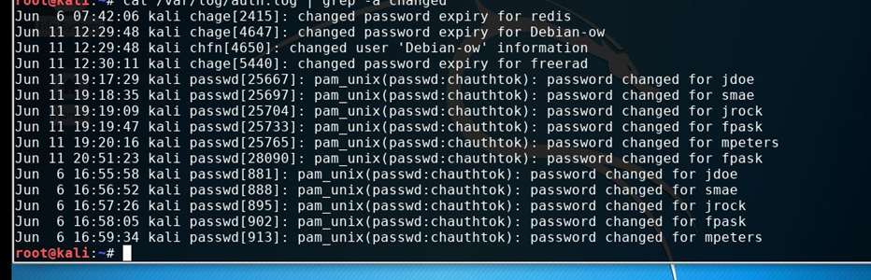
Password management
This screenshot is of /var/log/auth.log file with information on account modification.

Slide 25
Network performance monitoring
Once the network is up and running, it is best to monitor the performance to make sure it is keeping up with the demand that is needed of it. The application that is used for this is EtherApe which will show the performance of the network along with the traffic flow in a graphical display. Another application that is used is Monitorix that graphical load and usage on the server. The last application Wireshark to track the timing of the network.

Slide 26
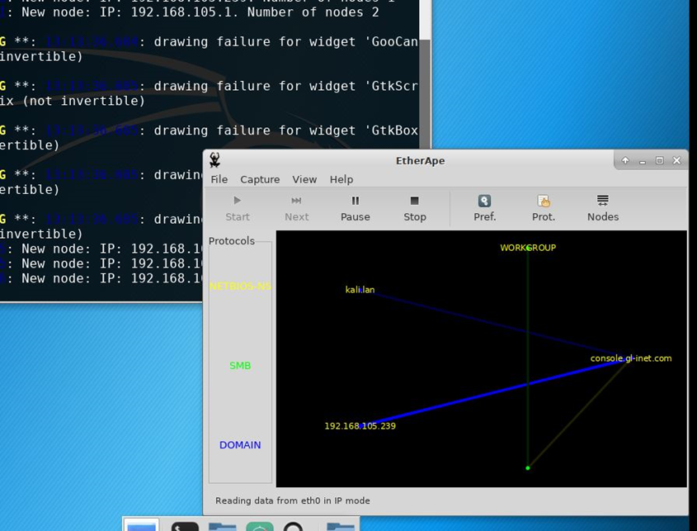
Network performance monitoring
This is a screenshot of the EtherApe graphical screen.

Slide 27
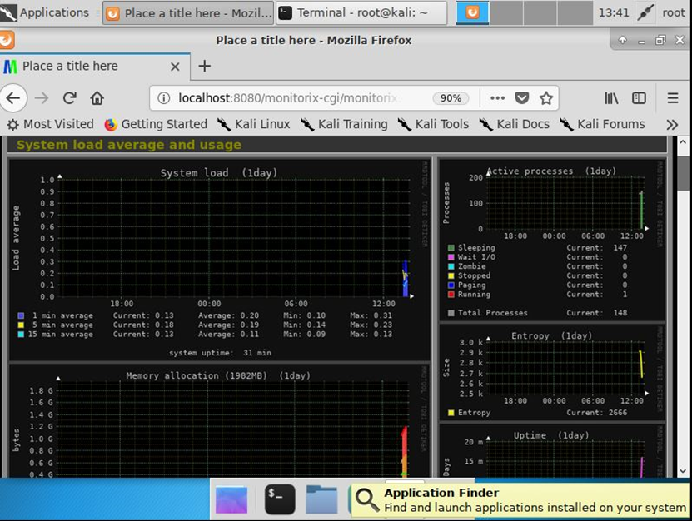
Network performance monitoring
This is a screenshot of Monitorix System Load Average and Usage screen.

Slide 28
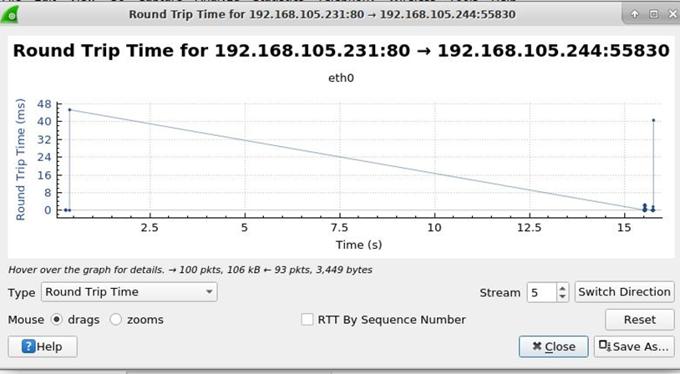
Network performance monitoring
This is a screenshot of the Round Trip Time of the HTTP traffic between the Kali VM and the Linux-Server VM.

Slide 29
Network performance monitoring
The connections shown are all with in one computer and running off one CPU and set of ram. All the VM’s are using virtual ethernets from the host computer. The data that is shown, shows mild usage but once applications and the VM’s are connected to the internet you can find that it will slow down and have some bottle neck in the network. In a short answer the data that is shown is the VM’s and host computer talking to each other (checking connection i.e.).

Slide 30
IP Routing
IP routing is being able to send packets from a host on one network to another host on a different remote network.

Slide 31
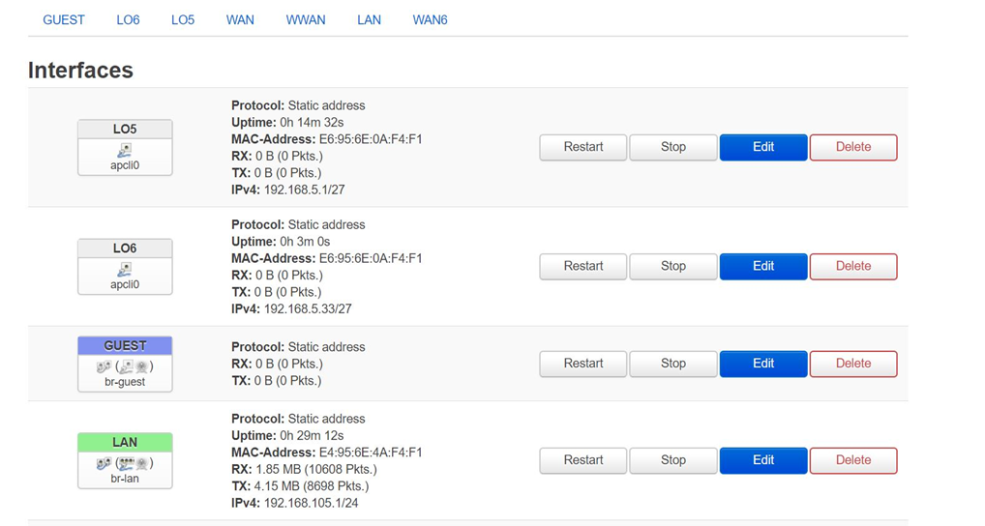
IP routing
This is a screenshot of Loopback 5 and Loopback 6 interfaces on the GL-MT300N-V2 Router.

Slide 32
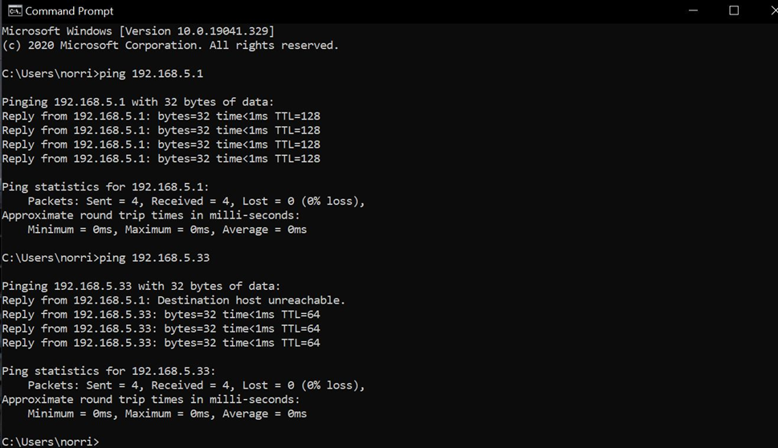
IP routing
This is a screenshot of a ping result from the host to the two Loopback interfaces that were made.

Slide 33
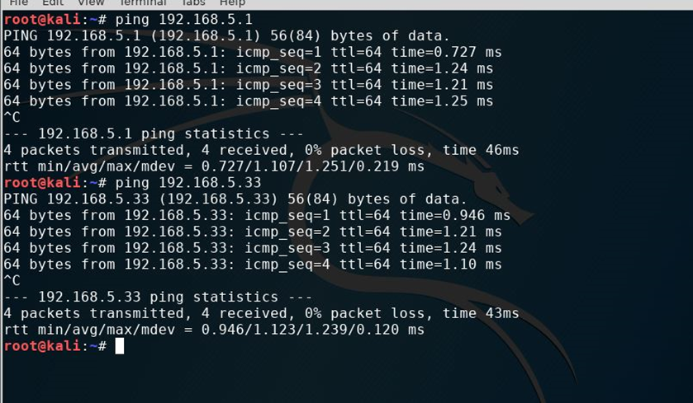
IP routing
Screenshot of the ping results from the Kali VM to two of the Loopback interfaces.

Slide 34
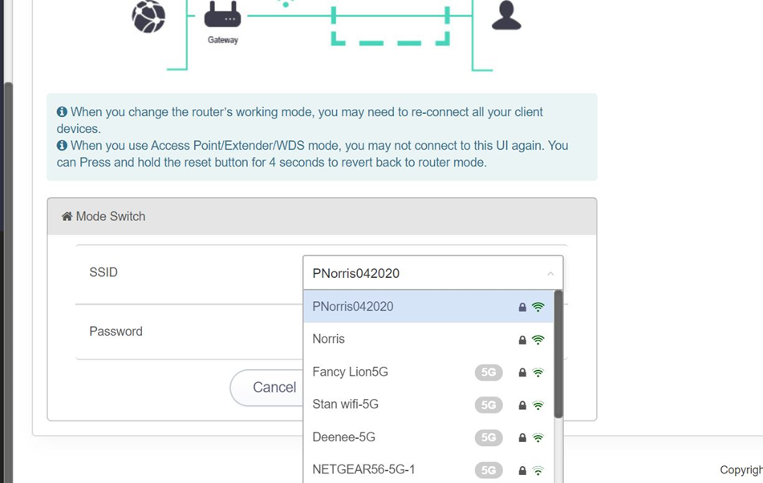
IP routing
This screenshot is of WLAN SSID of the GL-MT300N-V2 router shown in the extender configuration window of the GL AR-750 router

Slide 35
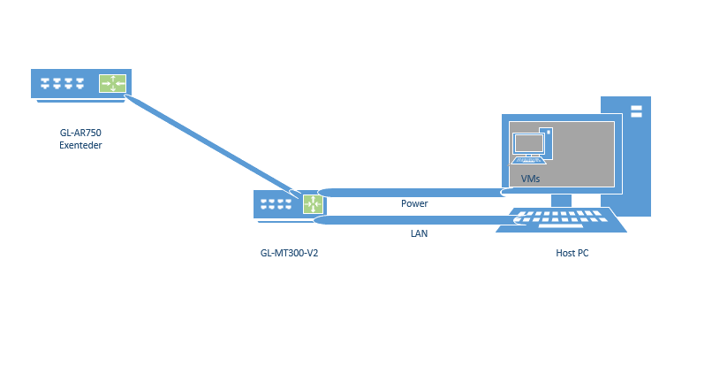
Diagram
This is a diagram of what the network looks like once the project is finished

Slide 36
Challenges
One of the challenges that I ran into is understanding the virtual network when using EtherApe as it was a little busy to understand.
With that I also had an issue with my yellow travel router not population an IPv4 at first but a simple reformat and I was good to go.

Slide 37
Career skills
Several career skills are gained in this project:
  Networking - setting up a local network
  Security – setting passwords and cracking them with John the Ripper.
  Virtual Server – setting up a virtual server and monitoring the traffic

Slide 38
Conclusion
This project covered the fundamentals of setting up and local network and running performance, security, and monitoring assessments.
Setting up this network provided me with a hands-on learning opportunity to put into practice as this is knowledge best learned with doing it rather than reading it.

