Slide 1
SEC285 Final Project
DeVry University
By: Patrick Norris

Slide 2
Course Summary
The course covers the fundamentals of network security. Internal and external threats were presented, to use techniques and methods to reduce and mitigate those threats. IOT security device was built to simulate a home security system device.
Topics Covered
Electrical circuits and ESP32 Microprocessor
Python and Hypertext
Vulnerability Assessment
Stateful Firewall and Multi Factor Authentication (Google Authenticator)
Bring Your Own Device (BYOD) Security Policy
Asymmetric Key Encryption and Password Enforcement Policy

Slide 3
Objective-
SEC285
Module 1
Light Control System
To build a functional ESP32 driven circuit to control LED lights via a Web Browser (SMART Light System). This would be a centralized home lighting system.
topics-
ESP32
Electrical Circuit Concept
Python
Hypertext

Slide 4
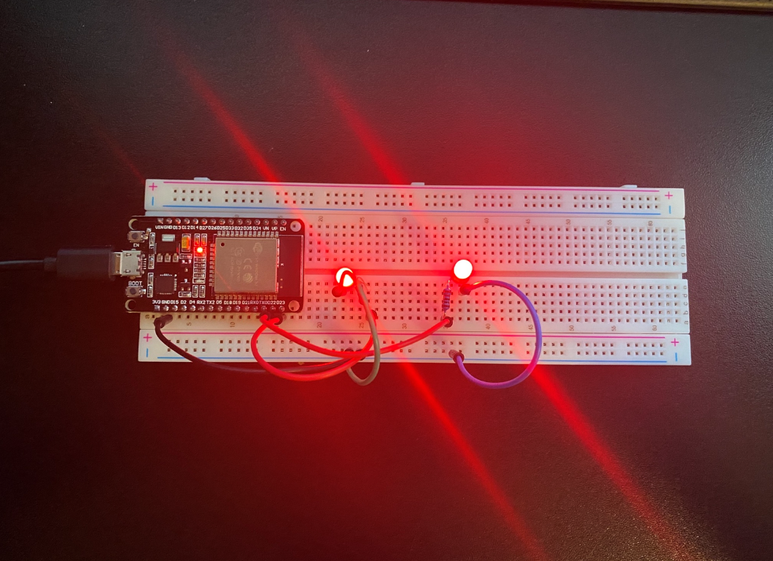
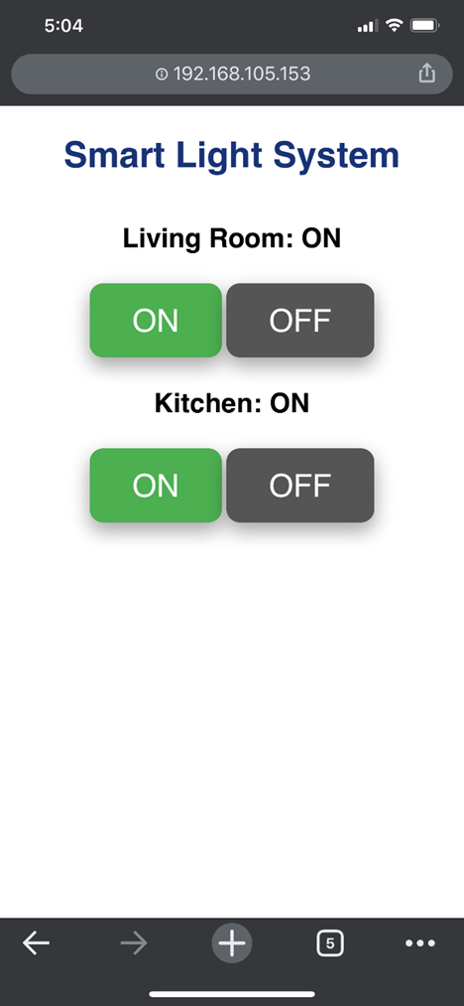
2-light Breadboard Layout
2-light Control Web Interface
The picture should show:
ESP32
Two LEDs
Two Resistors
Wires
The screenshot should show:
1. two sets of buttons to control two lights.
2. both lights being switched on.
3. IP address in the browser URL.

Slide 5
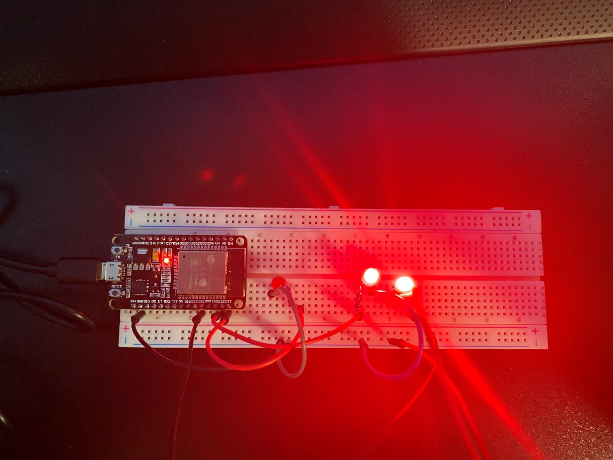
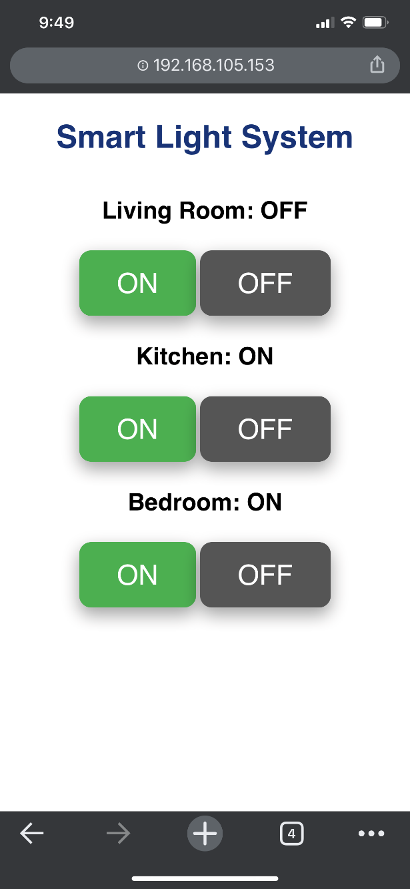
3-light Breadboard Layout (challenge)
3-light Control Web Interface (challenge)
The picture should show:
ESP32
Three LEDs
Three Resistors
Wires
The screenshot should show three sets of buttons to control three lights.

Slide 6
Challenges Encountered and other potential uses
LED failed to light, LED code in three light system rewrite. LED used was bad.
System could be used as a foundation for an alarm system, using motion sensors, and buzzers.

Slide 7

Objective-
Learn how reconnaissance is conducted on a network to determine host addresses, open ports, and services.
Use software and tools to identify critical vulnerabilities and secure the device.
Tools used
NMAP
Nessus

Slide 8
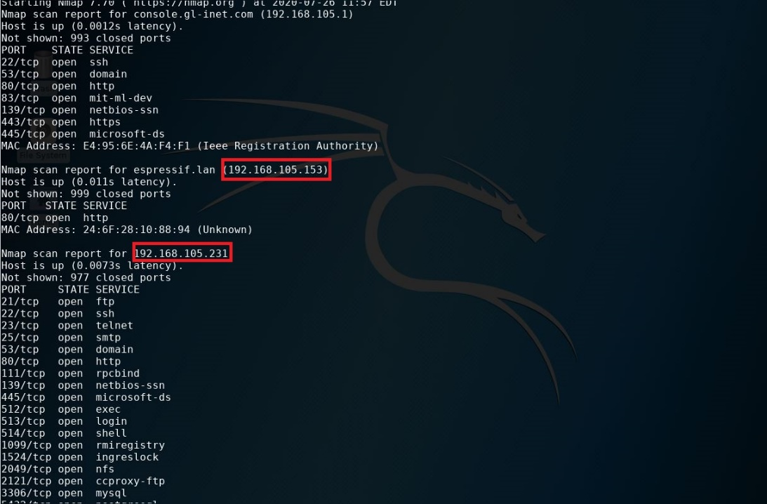
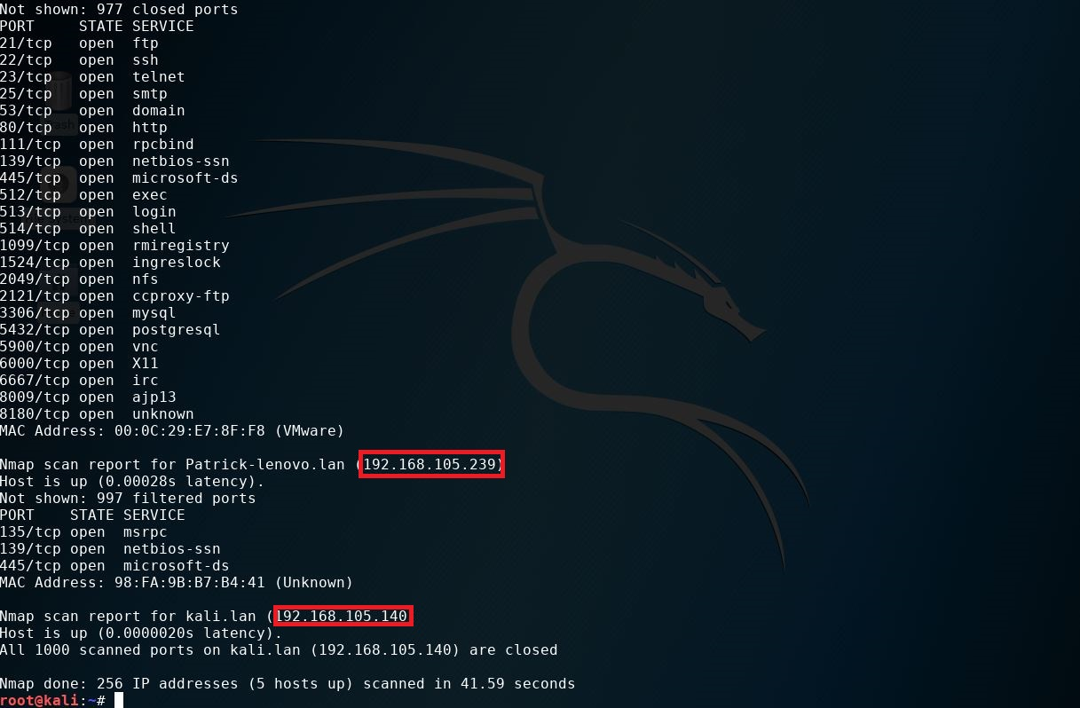
nmap scan
The screenshot should include the IP addresses of the host, Linux-Server VM, Kali VM, and Home Light Control System.

Slide 9
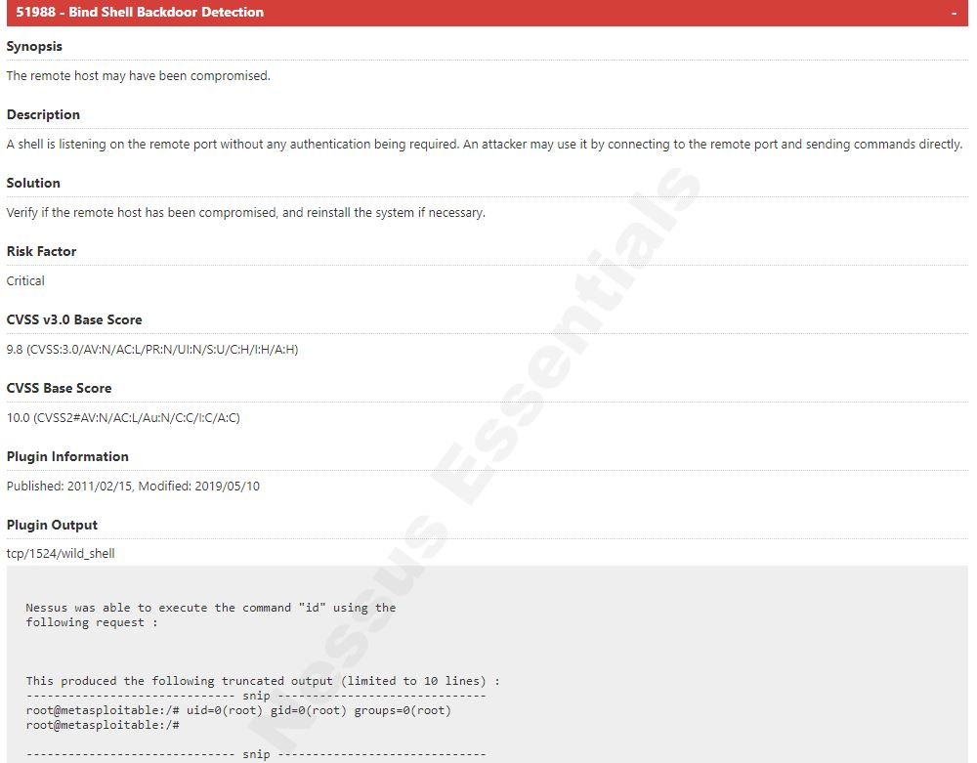
a vulnerability of critical severity rating
The screenshot should include the Plugin name, risk factor, and other vital information that attackers can use to exploit the system.

Slide 10
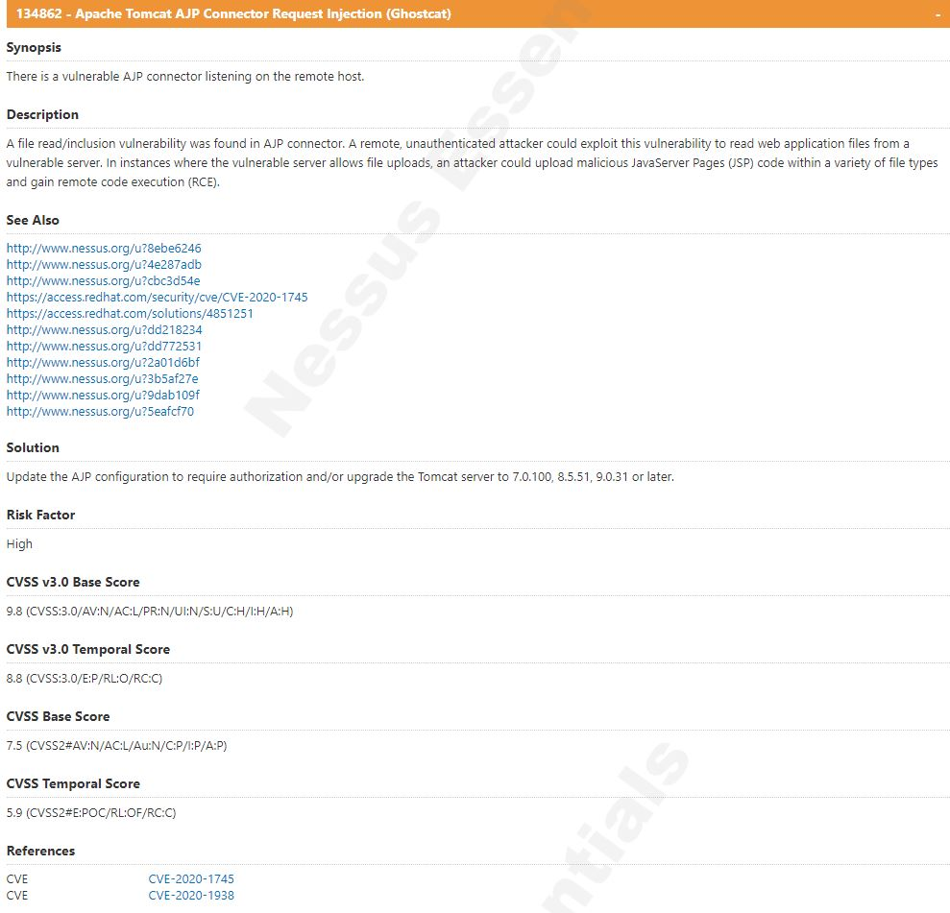
a vulnerability of high severity rating
The screenshot should include the Plugin name, risk factor, and other vital information that attackers can use to exploit the system.

Slide 11
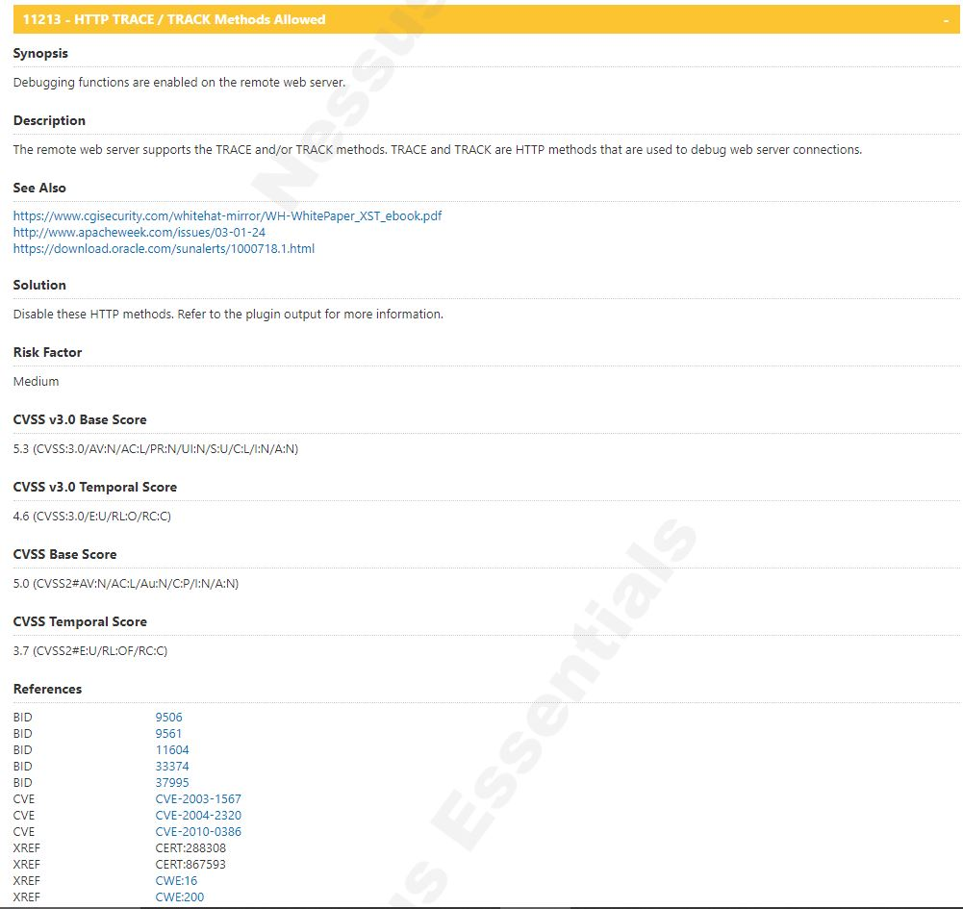
a vulnerability of medium severity rating
The screenshot should include the Plugin name, risk factor, and other vital information that attackers can use to exploit the system.

Slide 12
Questions
What is the significance of ranking the vulnerabilities by severity level?
The significance of ranking the vulnerabilities by severity level is to show where you have the weakest points that need to be fix first so you can strengthen and patch the weak areas.
What is the significance of the Executive Summary in the Nessus Essentials report?
Executive Summary in Nessus Essentials report is an overview of the Nessus scanners environment. It show how fast the scanners preform, along with what the version, and what network ranges are being scanned. This allows you to stay update with the scanner and performance.

Slide 13
Challenges Encountered and other potential uses
No challengets
To find Vulnerabilities and secure them.
Learned NMAP can be used to identify open ports and Nessus is a good source of information for providing suggests to correct and improve vulnerabilities and weak points.

Slide 14

Objective-
Understand firewalls using iptables and explore the use of multifactor authentication.
topics-
NMAP
IPTables
Google Multifactor Authenticator

Slide 15
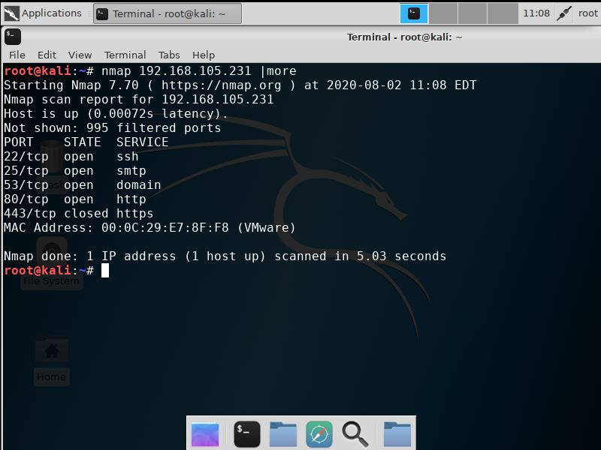
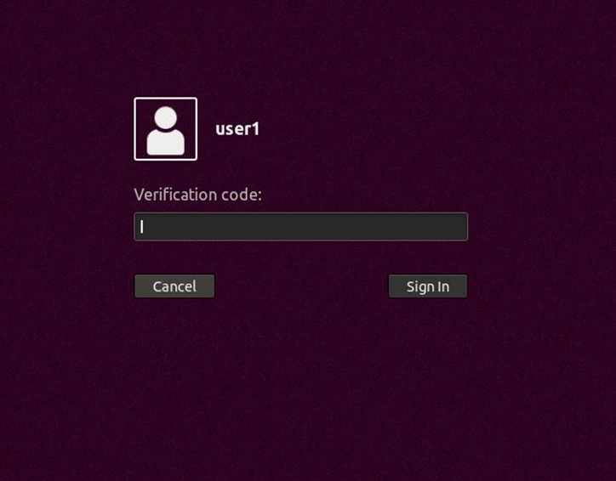
Nmap scan result
The screenshot should only show a small number of open ports.
User1 logon screen
The screenshot should show the prompt for the verification code.

Slide 16
Questions
In what practical use case would the command sudo iptables --policy INPUT DROP be used? What effect does this command have on access to computing resources?
Answer here: The number one case that I can think of to use this command is when setting up firewalls and access to the server. This command shutsdown all port to the system.
What is the difference between iptables -A and iptables -I? When would you use the -A option as opposed to the -I option?
Answer here: -A is to append and –I is to insert, you would use –A when adding something in. As for –I is when you are inserting a new command.

Slide 17
Challenges Encountered and Learned
No challengets
Iptables requires thoughtful planning to work
Multifactor Authenticator will improve password security

Slide 18

Objective-
To develop a Bring Your Own Device (BYOD) Policy for a company.
tools-
SANS Security Policies
Internet

Slide 19
Overview section of the security policy
Smart devices are becoming more popular in the workplace. With these devices being in the workplace it opens up new threats to our organization. This policy with will lay a foundation to help mitigate the threats.
Purpose section of the security policy
The goal of this policy is to minimize all security threats to this organization This will be done by identifying devices that have vulnerabilities, to be able to reduce risk. Threats can be serious to the organization, as lost of data or a data breech. Threats will be located, assessed, and handled before damage is done.

Slide 20
Scope section of the security policy
At no time when on company grounds will personal devices be connected to organizational network. Personal device include but are not limited to laptops, smartphones, smartwatches, and or a device that can be connected to a network and pose a threat to the organization. A sperate network has been made for uses for employees during breaks. While on the “guest” network company website and/or data shall not be accessed. For access to this network approval shall be obtained from management and IT department.

Slide 21
Policy section of the security policy
Any device that connects to “guest” network will be connected to the VPN that is provided to gain access to the network. Along with that the device shall be up to date with the latest software. If the device has a firewall, this must be turned on. After this is done you will login to the site provided to you by the IT department to scan the device to make sure the device is with in policy and regulations. If not, the device will not be grained access. If multiple attempts are tired to access the network and failed; thus person(s) will attend IT security training.

Slide 22
Questions
In what way does risk assessment impact the development of Program (security) Policies?
With risk assessment, it helps detect common risk that can occur. This helps the security policy be built around the risk assessment.
When is it appropriate to review an organization's Issue-specific (security) Policy?
It is appropriate to review an organization’s issue-specific (security) policy when you start to work at the organization. It is also appropriate to review it when a reasonable doubt about and issue cross the mind pertaining to the topic.

Slide 23
Lessons Learned
Sans is an excellent resource for security information.
Management must support the policy
Security Policy must cover overview, scope, purpose, and policy.

Slide 24

Objective-
To build a functional ESP32 driven circuit to detect motion using a proximity detector. This could be used as a centralized home security system.
topics-
ESP32 Microprocessor Functions
Electrical Circuit Concept
Python
Hypertext
Infra-red proximity detector

Slide 25
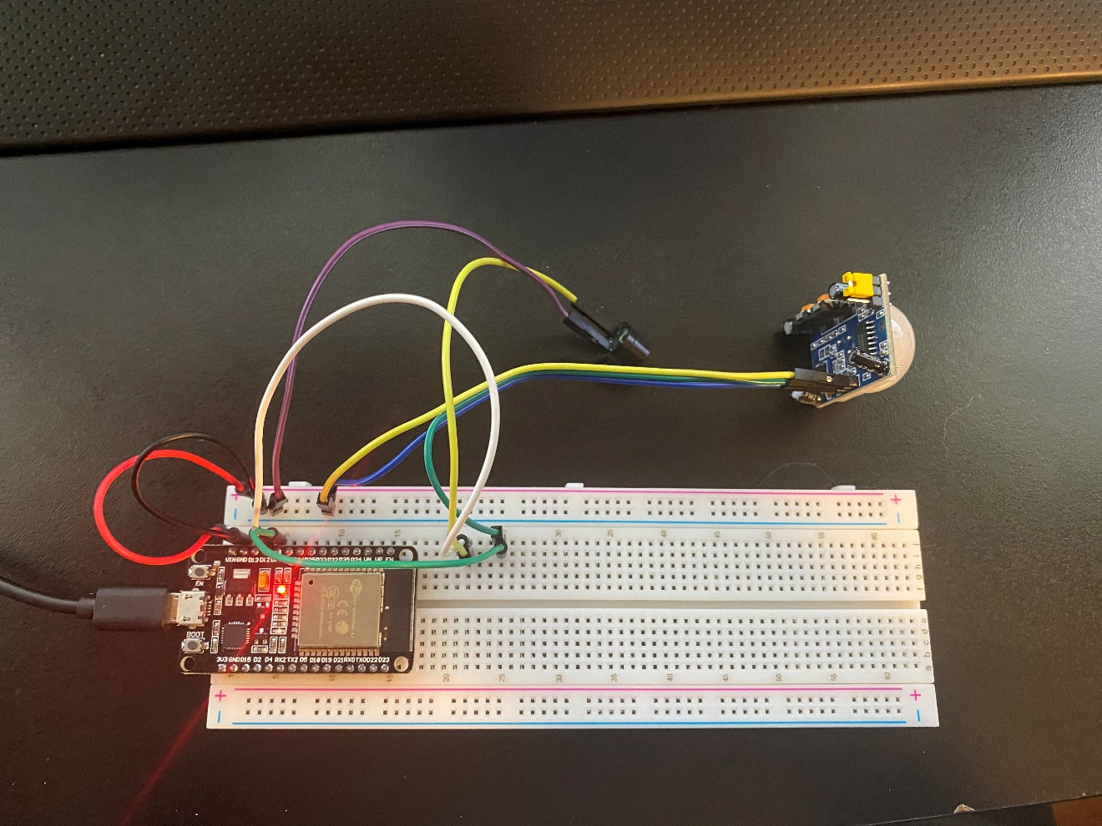
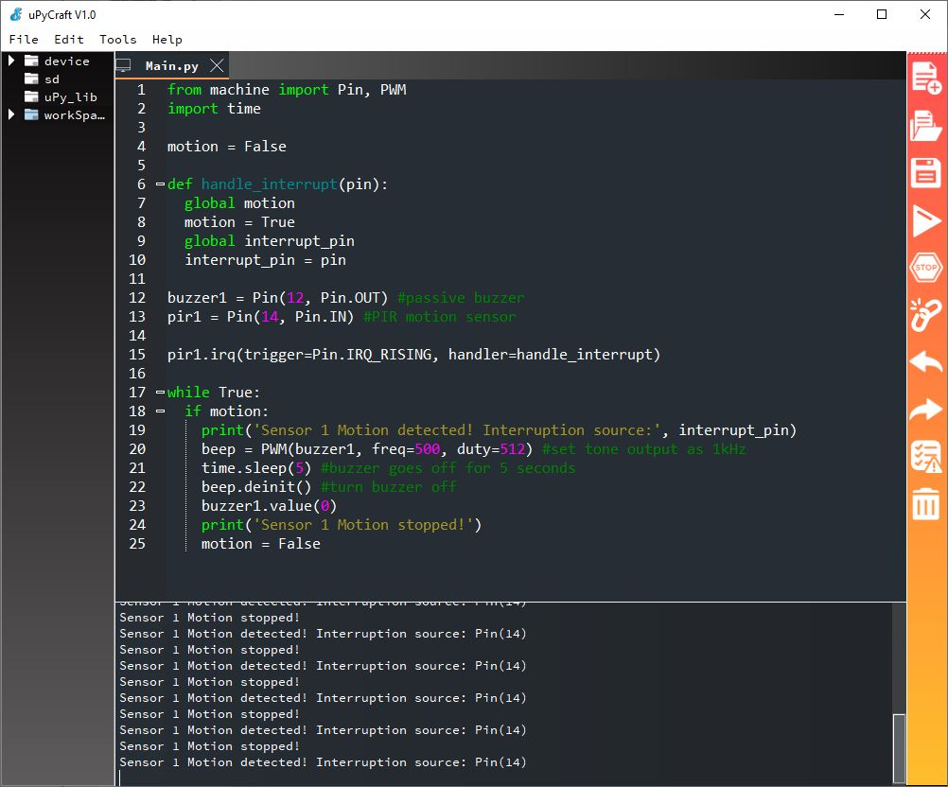
Passive buzzer breadboard layout
Passive buzzer system output
The picture should show:
ESP32
Passive buzzer
Motion sensor
Wires
The screenshot should show:
1. “Motion detected” message
2. Interruption source
3. “Motion stopped” message

Slide 26
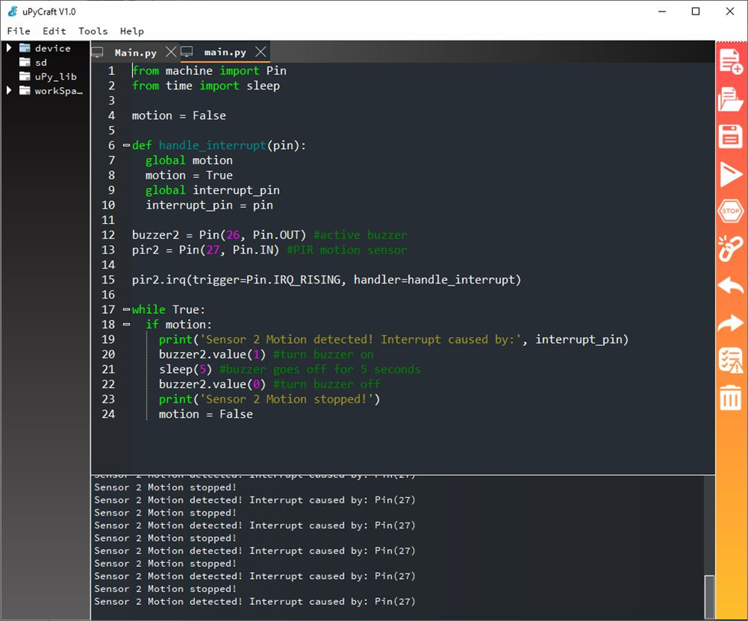
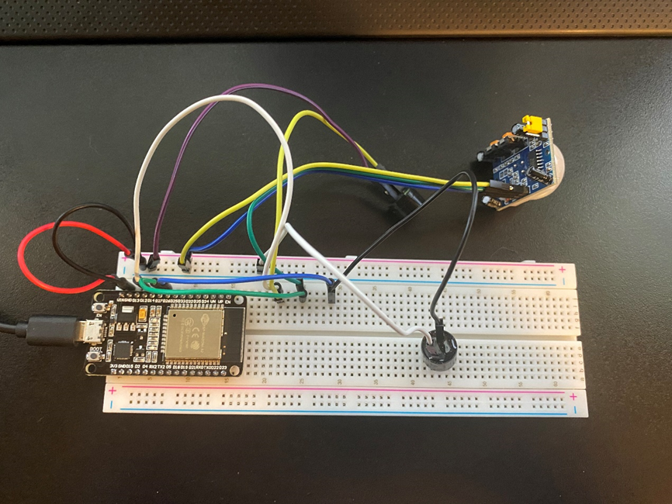
Active buzzer breadboard layout
Active buzzer system output
The picture should show:
ESP32
Passive buzzer
Active buzzer
Motion sensor
Wires
The screenshot should show:
1. “Motion detected” message
2. Interruption source
3. “Motion stopped” message

Slide 27
Challenges Encountered and Learned
Proximity detector sensitivity setting was too low. Adjustment made on device.
IR detector works better in dim light.
IR detector can be messed with other IR devices.
ESP32 is a device that can be used for a lot of things.

Slide 28

Objective-
To build a functional ESP32 driven circuit to detect motion using a proximity detector. This could be used as a centralized home security system.
topics-
GnuPG (GPG) for file encryption and decryption.
Linux commands requires a password policy

Slide 29
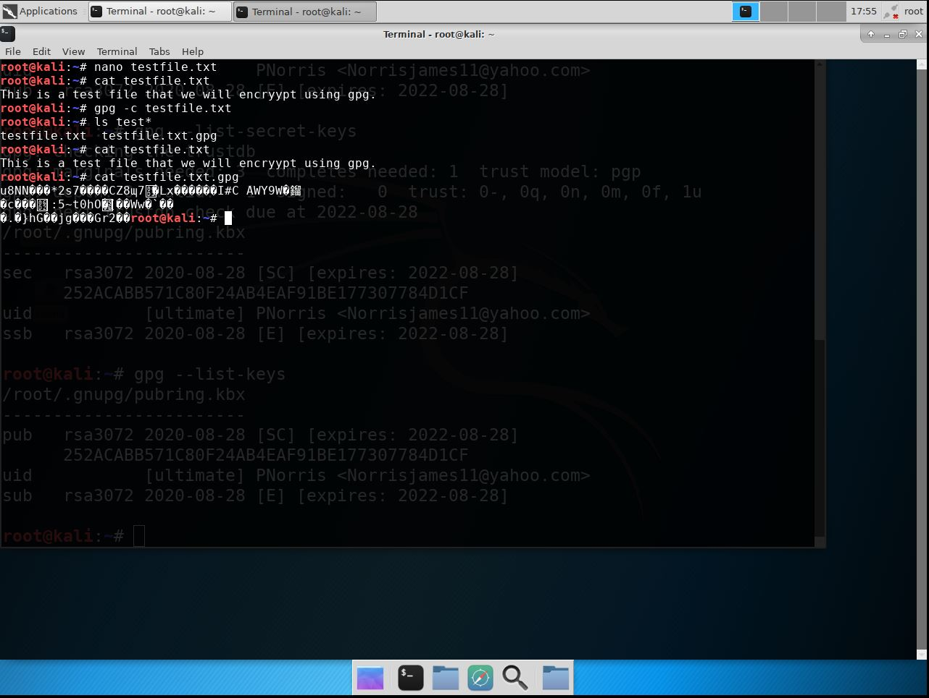
File encryption
The screenshot should show:
content of the plaintext file
content of the encrypted file

Slide 30
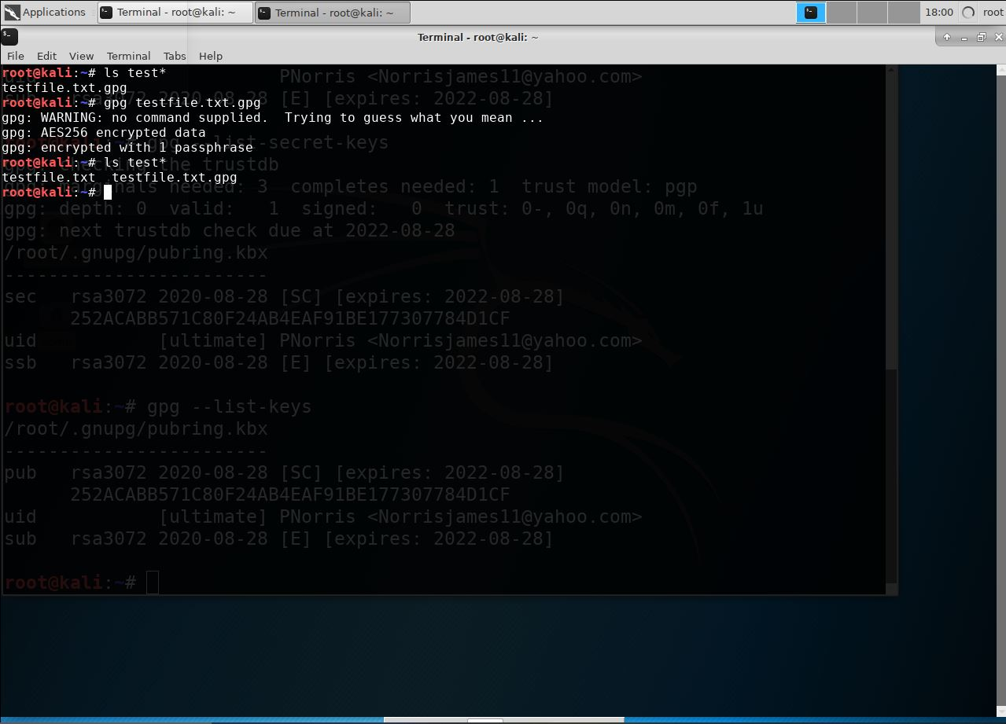
File decryption
The screenshot should show:
1. the single encrypted file being listed
2. the decrypting process
3. both the encrypted file and the original plaintext file being listed.

Slide 31
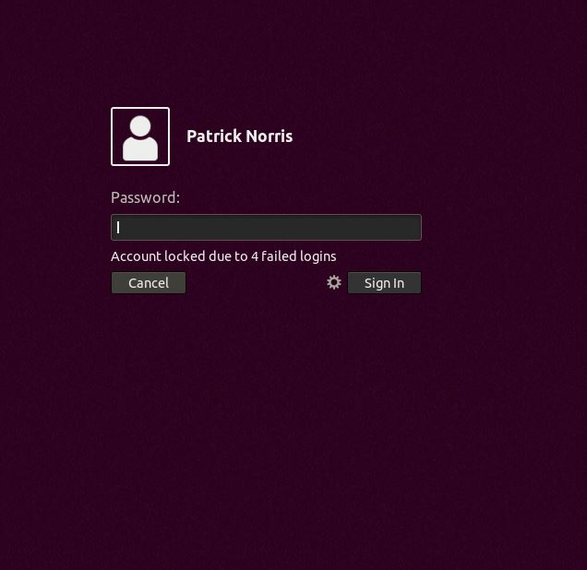
Account lockout screen
The screenshot should show the “Account locked out due to x failed logins” message.

Slide 32
Challenges and lessons learned
Trouble with password enforcement
Retraced steps found fault
Encryption is one of many was to protect files
Command in Linux can be used to reduce and mitigate the chance someone can gain access by hacking the password.

Slide 33
Conclusion
There are many was to attack networks and devices to comprise and whole system or network. This class has shown how data, systems, and device can be compromised. Steps must be taken to protect all of these.
It is crucial to investigate potential vulnerabilities. The projects that were conducted were examples of this and were experience on real world task that can be used in the work force.

