Slide 1
Netw190
Introduction to networks project

Slide 2
Netw190 introduction to networks project
The purpose of the project was to design , build, and verify the connection of a small wired and wireless network using both IPV4 and IPV6 addressing.
The network was built using a small travel router and a computer with Microsoft operating system with a Linux virtual machine installed on VMware player.
Ethernet cables (cat 5.e) were also made according to 568B EIA/TIA standard for use in the project

Slide 3
Planning
The first step in this project is to plan it out and make a diagram so it will be easier to understand what is going to be taking place.
A Visio Diagram of the Network is made.

Slide 4
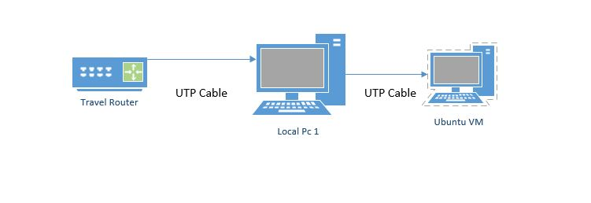
GL-iNet
GL-MT300N-V2
Network Diagram with cable connections

Slide 5
The next step in the project is to change the IPv4 and IPv6 from the original .
Ipv4 is a 32 bit IP address and the IPv6 is a 128 bit IP address

Slide 6
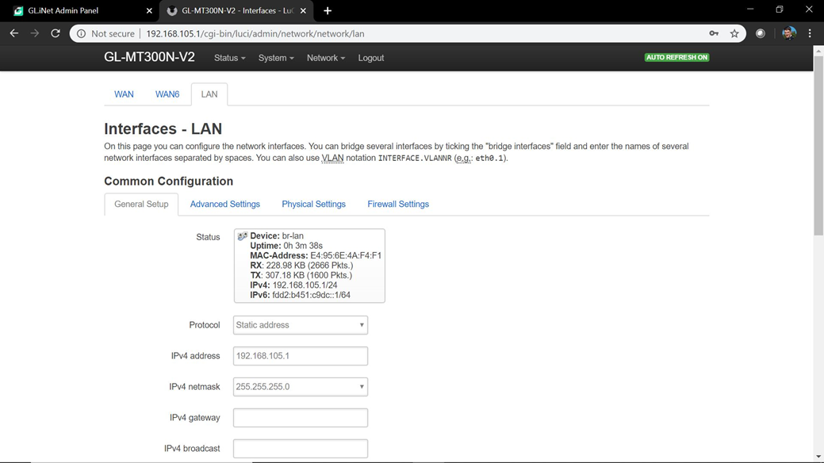
The default IPv4 address of the router was 192.168.1.1.
By using the administrator screen of the router accessed through a web browser, the IPv4 was changed to 192.168.105.1.
The change was confirmed by using web browser to with the new IPv4.
The changed configuration screen of the router is shown on the right.

Slide 7
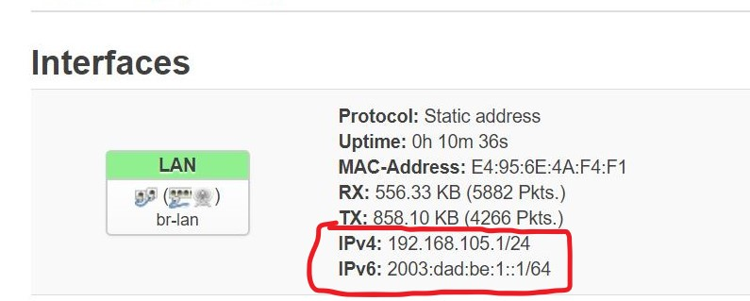
The default IPv6 address of the router was FDF6:DBE9:4CDZC:1/64 and changed to 2003:dad:be:1::1/64.
The change was verified in the same manner that the IPV4 was.
The changed address of the router is on the right.

Slide 8
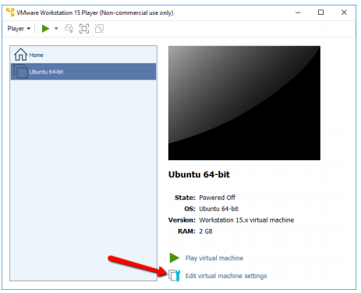
ENABLE BRIDGING
Selecting the network adapter in VMware

Slide 9
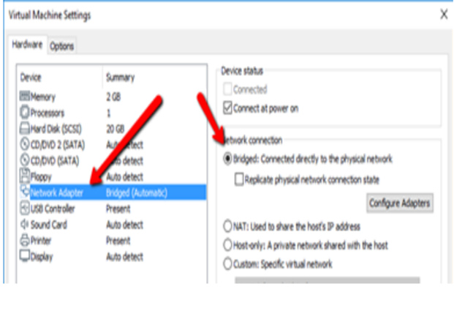
Allow bridging screen

Slide 10
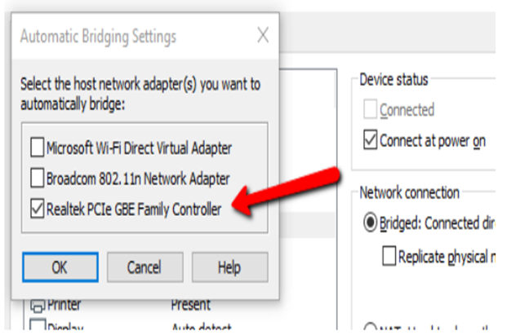


Slide 11
Bridging allow the VM to obtain its own IPv4 and IPv6 address from the router rather than share the same IPv4 and IPv6 address as the Host Pc.

Slide 12
Once the bridging is enabled the router will give unique IPv4 and IPv6 addresses to host computer
To verify the bridging is working as expected the IP address of the machines must be checked
For Windows, the ipconfig command is used as shown on the right for IPv4 is the 192.168.105.0/25 network and 2003:dad:be:1::1/64 for IPv6.
The next picture show the results.

Slide 13
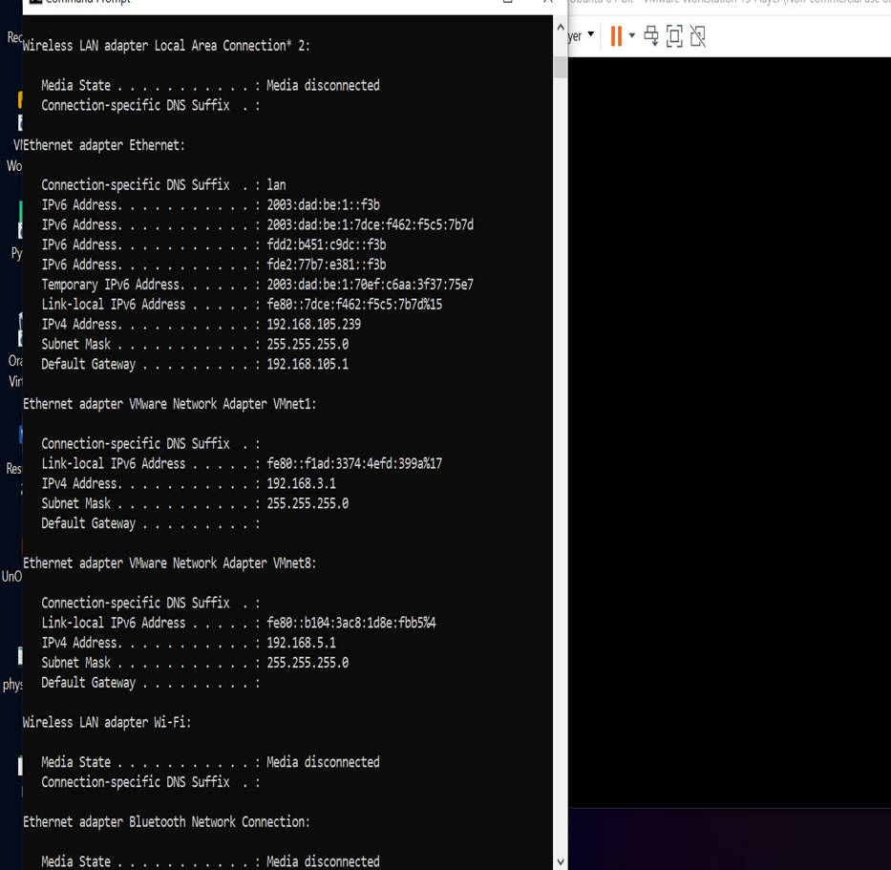

Slide 14
To verify the bridging has changed in the virtual machines, the VM should have its own unique address compared to the host computer.
The command in Linux to complete this task in Linux is net-tools is installed “ifconfig” can be used.
Once this is done the IP address should be different from form the VM and the Host.
The next picture shows the results.

Slide 15
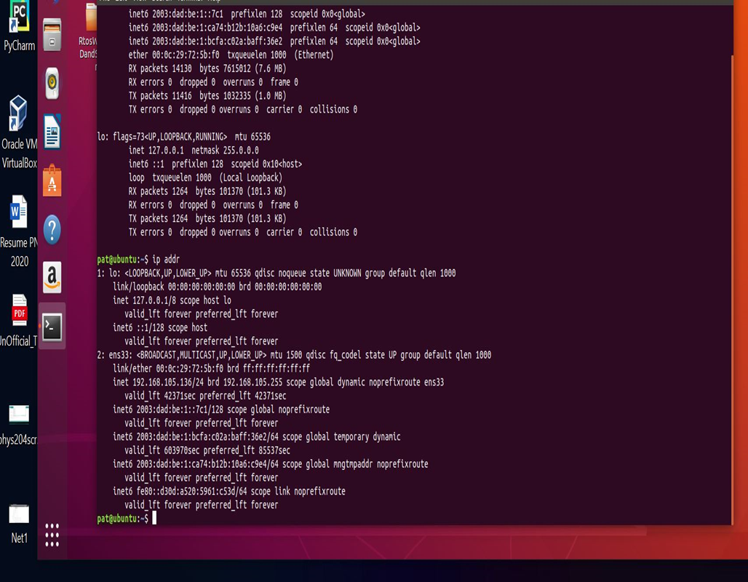

Slide 16
The next step in the project is to make ethernet cable from cat 5e UTP cable

Slide 17
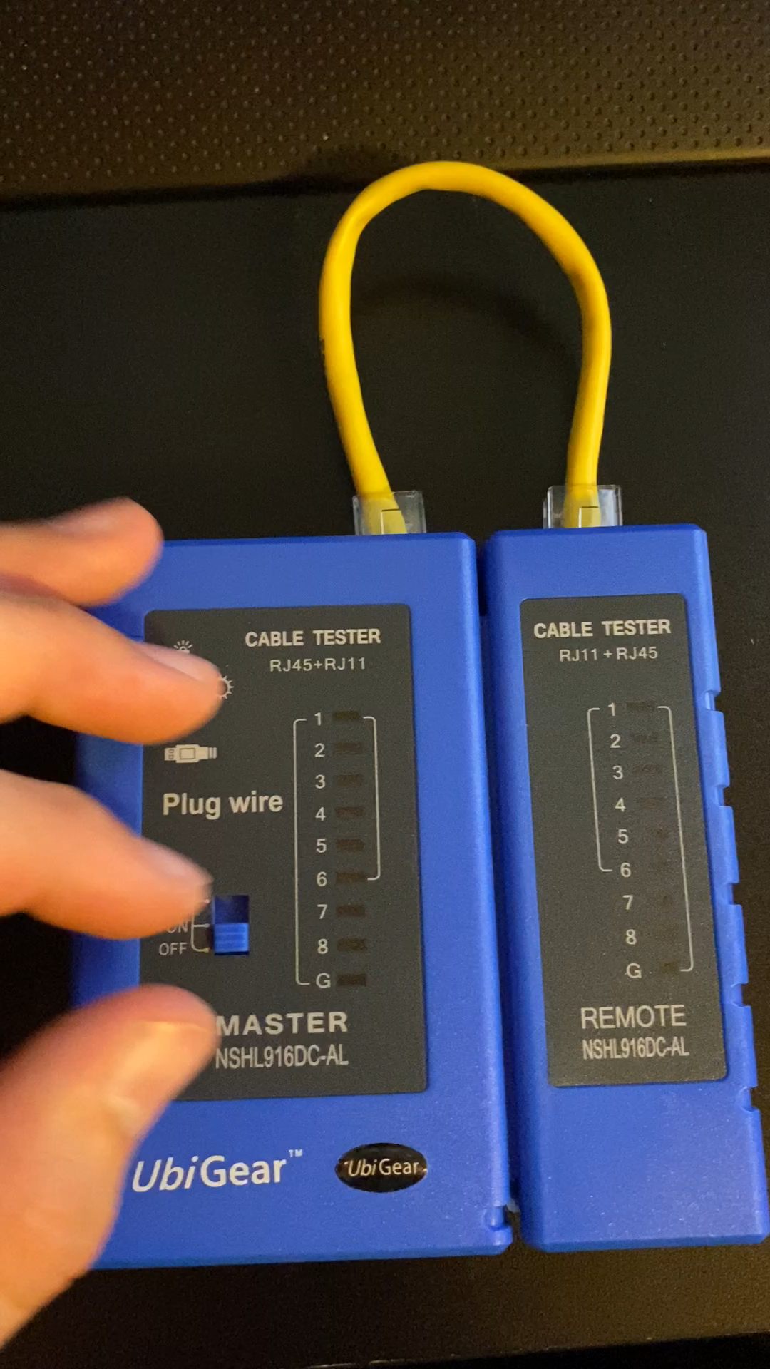
The network designed in this project is using a physical ethernet cable to connect the host pc and router.
The cable is also known as a straight trough ethernet cable.
Other cables are called crossover or roll over.

Slide 18
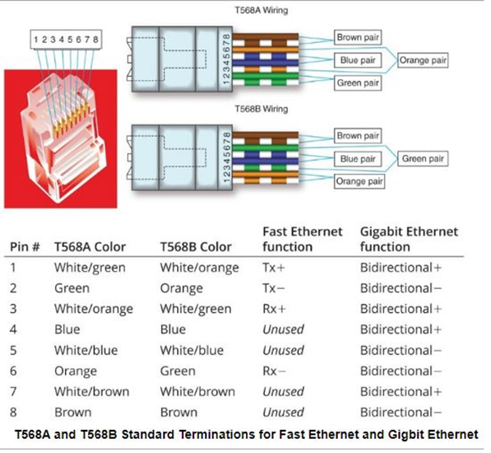
The picture shows different wiring for ethernet cable.

Slide 19
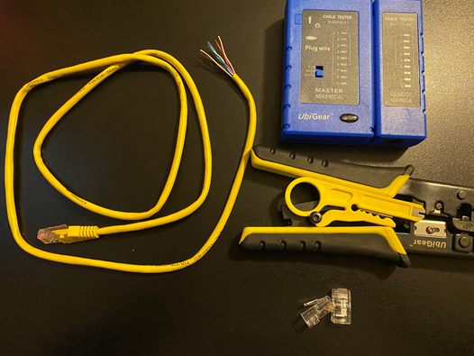
Ethernet cable cat 5e, RJ45 connector, UbiGear cable tester, and wire cutter and crimper

Slide 20
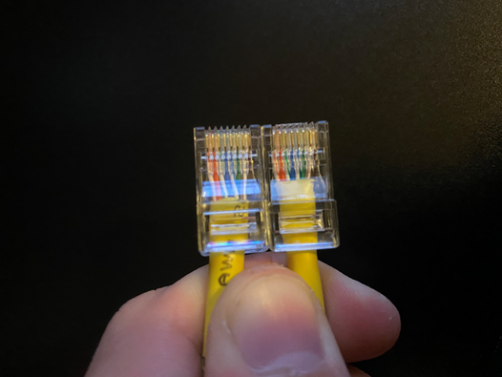
This is a picture of the ethernet cable completed.

Slide 21
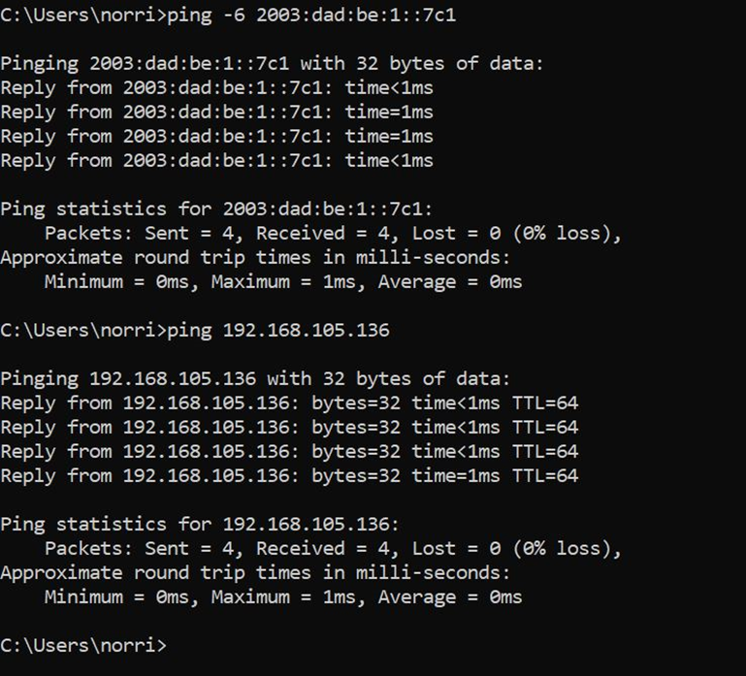
Connectivity Test
Once the cable has been made and tested. It was time to put the network all together and test it.
To test the network a connectivity test was conducted.
Command prompt was open in windows and using the command ping followed by the IPv4 address I could see that there was a connection and same for the IPv6.
The photo to the right is a screenshot of the connectivity test from Host PC to Ubuntu VM.

Slide 22
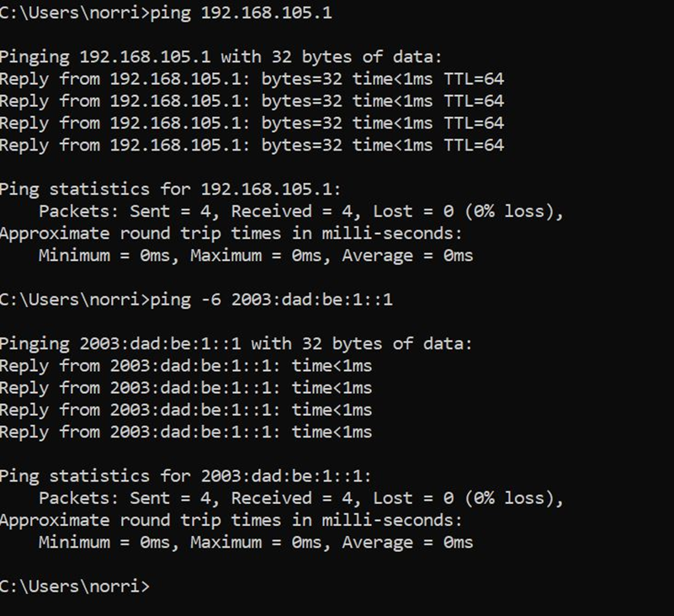
Doing the same steps I pinged IPv4 and IPv6 from the Host PC to the Travel Router which is shown on the right to test connectivity.

Slide 23
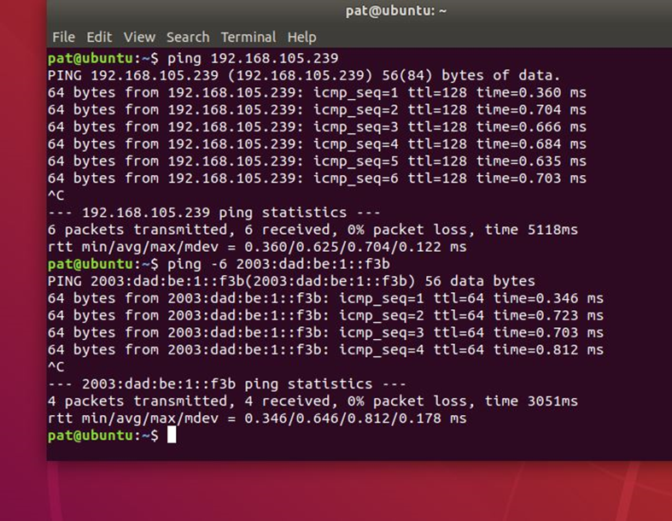
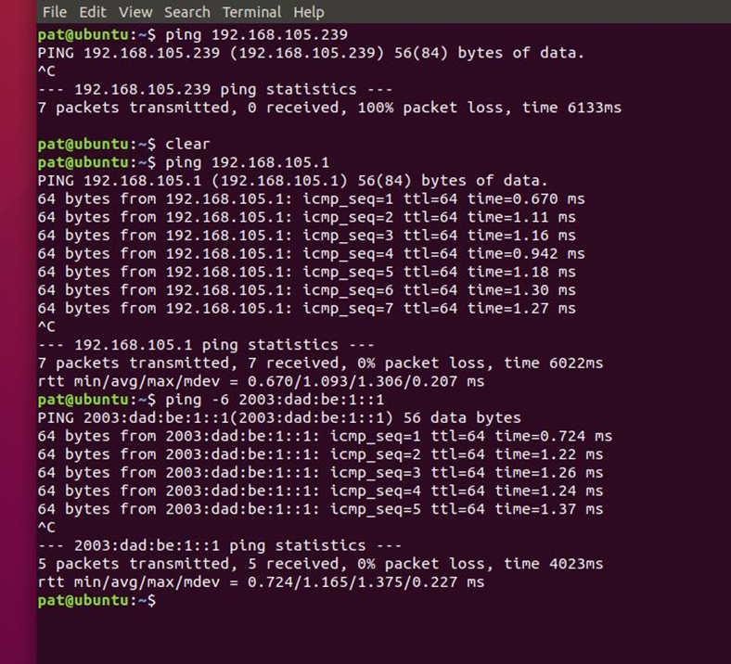
Again the same test was done on the right is Ubuntu VM to Host PC.
And on the left is Ubuntu VM to the Travel Router.

Slide 24
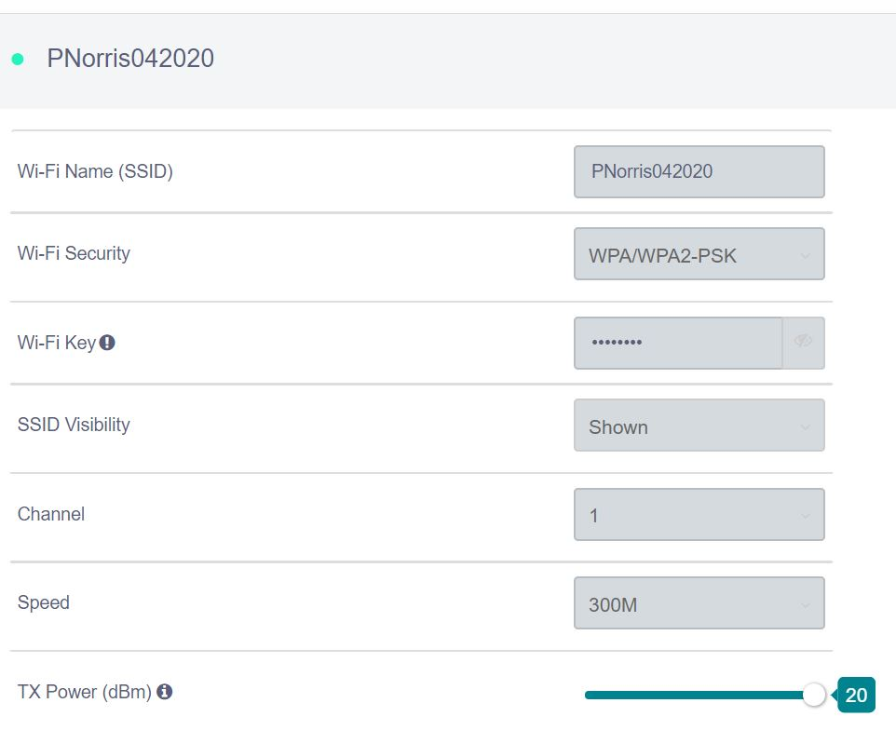
The last step in the project was changing the SSID which was changed to PNorris042020.
The next thing to do is to check to make sure the changes have taken.

Slide 25
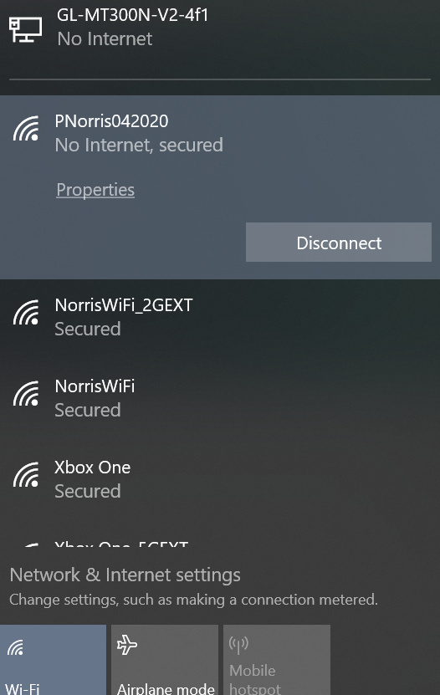
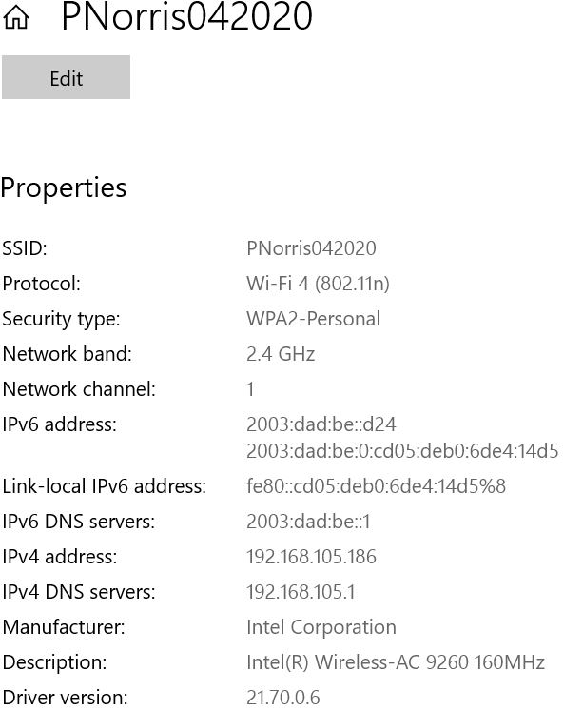
On the left is the SSID showing the IPv4 and IPv6 to verify that it is the Travel Router.
On the right is the SSID that was changed and other SSIDs that are available.

Slide 26
Conclusion
This is the conclusion for the project of, which was design, build, and verify the connection of small wired and wireless network using both IPv4 and IPv6. Along with cut, trim, and connect RJ45 connectors to ethernet cat 5e UTP cable and test it.

Slide 27
Challenges
One of the major challenges that I ran into was with my travel router not populating IPv6, I then had to reformat the device and reinstall the operating system to it. Another challenge that I ran into is with making the ethernet cable as the wires are small and were moving around when I would slide on the connector, this was fixed when I made the wires a little longer.

Slide 28
Skills obtained
Troubleshooting
Ethernet Cable testing and making
Planning
Testing connectivity between Host PC and VM
Addressing IPv4 and IPv6
Pinging connetions

