Slide 1
Final Course Project
SEC290
Fundamentals of Infrastructure Security
By: Patrick Norris

Slide 2
This course project is design to secure, detect, and run vulnerability test over different systems.
The course project also goes over Azure cloud environment.

Slide 3
Module 1 Firewall
This section goes over three different firewall settings time-based access, dynamic NAT, and brute forcing of SSH logins.
Along with making sure they are configured sucessfully

Slide 4
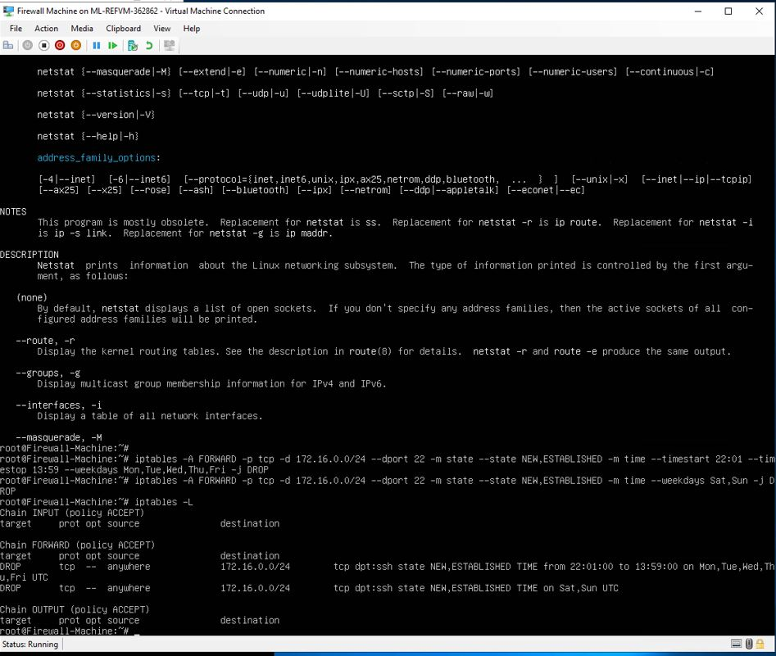
Time-based access
Take a screenshot of the output in Part 1 Step 28.
It should show two time-based access rules in the FORWARD chain.

Slide 5
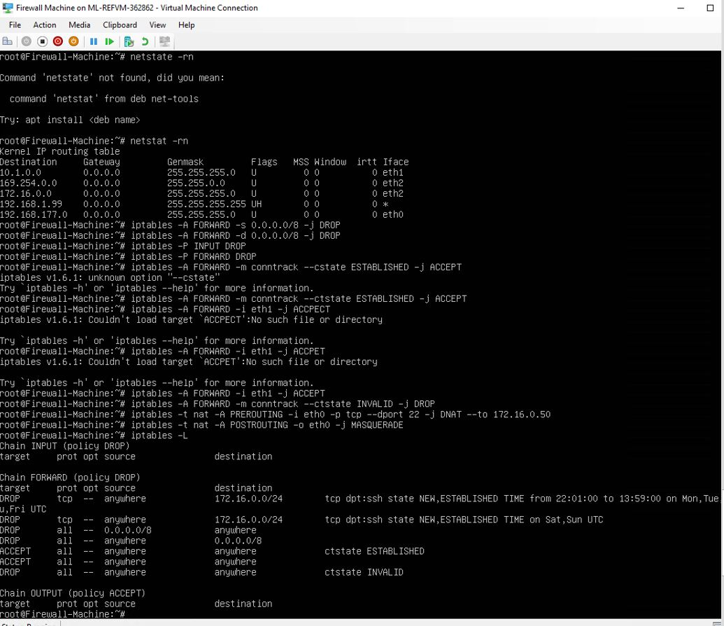
Dynamic NAT
Take a screenshot of the output in Part 5 Step 3.
It should include prerouting and postrouting rules.

Slide 6
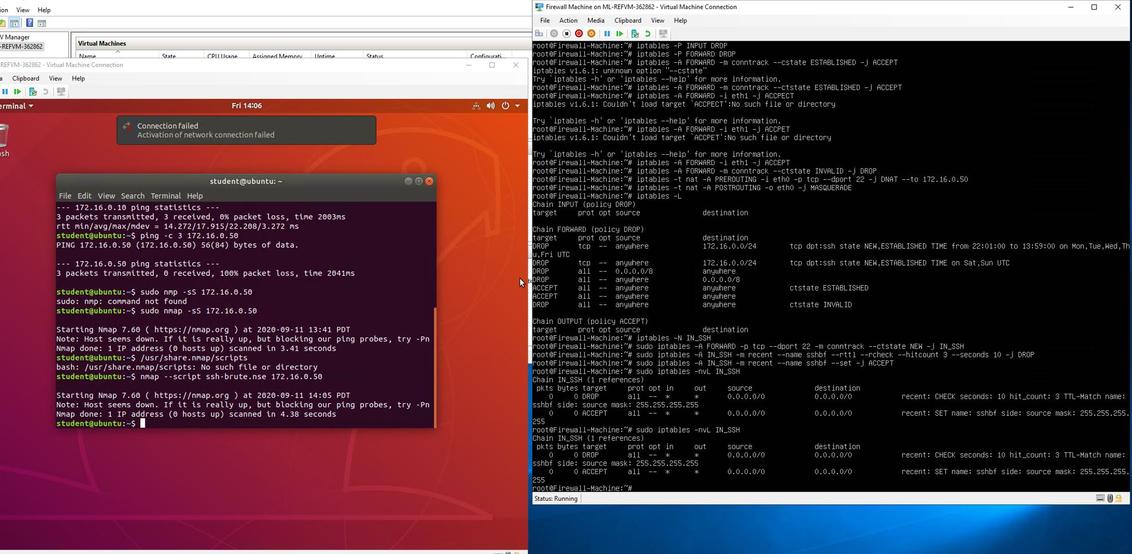
Brute forcing of SSH logins
Take a screenshot of the output in Part 6 Step 7.
It should show the dropped SSH packet count.

Slide 7
Module 2 Snort
This project section goes over Snort, how it work and what it can be used for.
The activities that were done were testing Snort rules and making Snort rules.

Slide 8
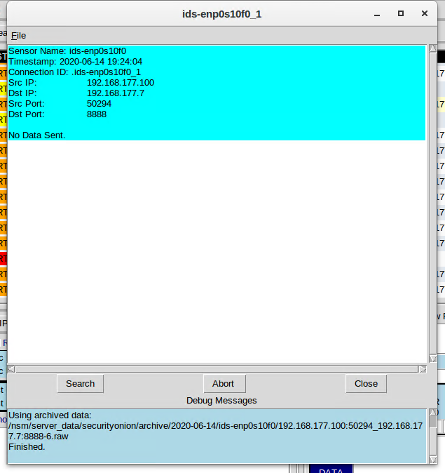
Testing Snort rules
Take a screenshot of the output in Part 1 Step 8.
It should show the transcript of the XMAS scan alert.

Slide 9
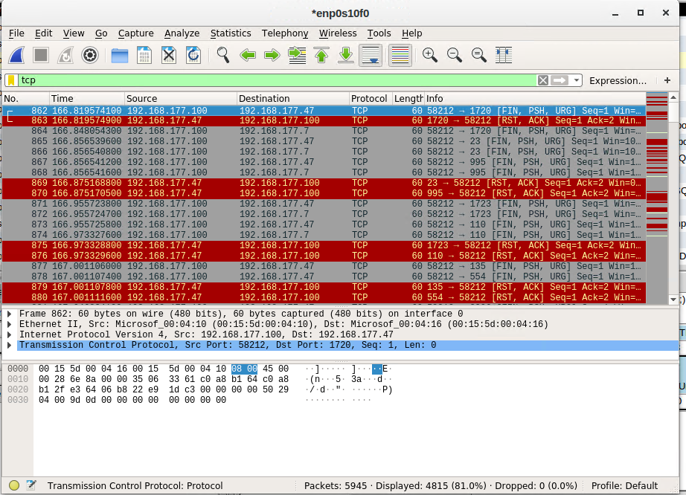
Testing Snort rules cont’d
Take a screenshot of the output in Part 1 Step 10.
It should show the TCP packets generated by the XMAS scan.

Slide 10
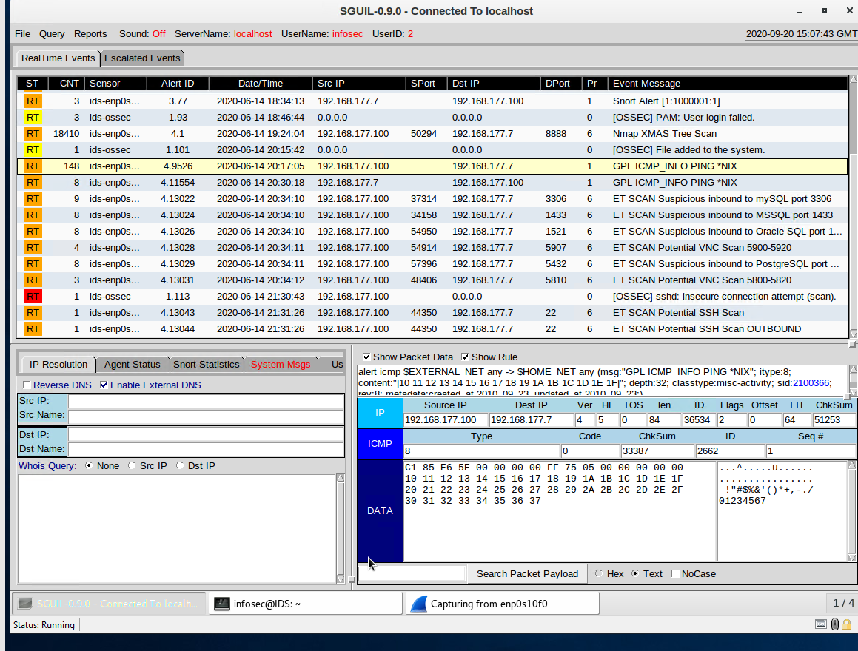
Creating Snort rules
Take a screenshot of the output in Part 2 Step 5.
It should show the ping activity alert.

Slide 11
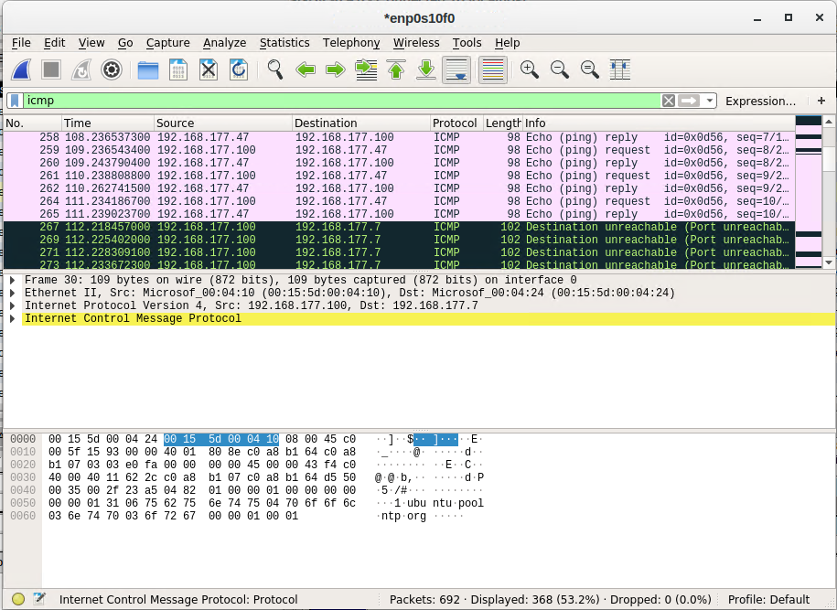
Creating Snort rules cont’d
Take a screenshot of the output in Part 2 Step 6.
It should show the ICMP packets generated by the ping activity.

Slide 12
Module 3 Open SSL
This section was on how to create and test an SSL file.
Cryptography is important and SSL is a standard for everything that is on the web.

Slide 13
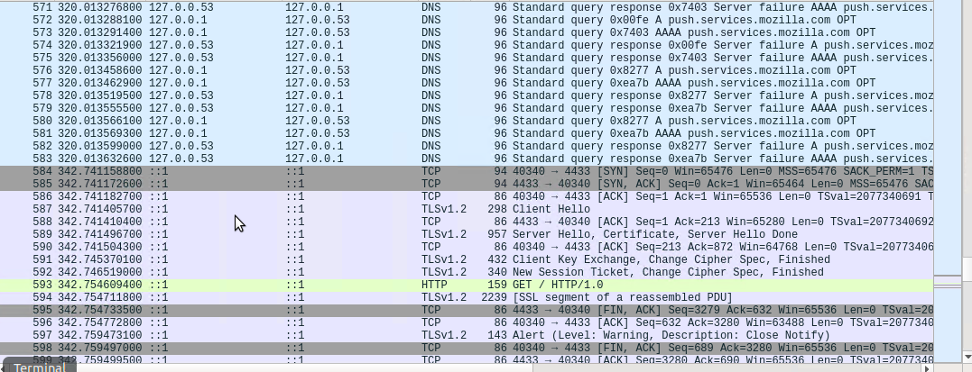
Creating and testing an SSL/TLS file
Take a screenshot of the output in Step 10.
It should show the GET request in the Info column.

Slide 14
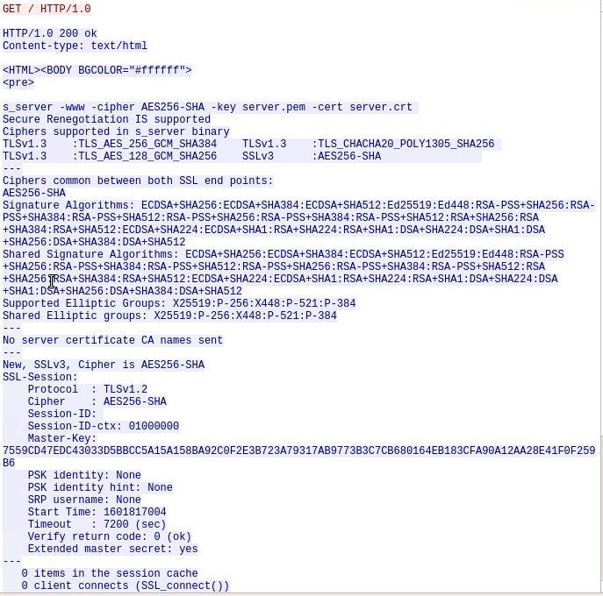
Creating and testing an SSL/TLS file cont’d
Take a screenshot of the output in Step 13.
It should show the decrypted SSL stream.

Slide 15
Module 4 Intrusion Analysis
These actives show task of intrusion and how to detect.

Slide 16
Basic attack analysis
Look at packet no. 20 and packet no. 22. They are both ICMP traffic, but what are the differences between the packets? The Flags are different, along with the checksum, as well as the IP source and destination.
Why do you see the differences do you think? It is because they are different Operating Systems.
Review packet no. 37 and beyond, what do you think is taking place here? A Scan of the machine to see what ports and Software is running
Look at packet no. 14520 and 22486 and compare the packets, is there anything suspicious about these packets? Ports Src and Dst are unused ports and they are different.
Are there different destinations being targeted? Yes there are two different destination ports being attacked within the same machine.

Slide 17
Web attack and advanced analysis
1. What web attack(s) is/are identified as successful within the trace? Yes it looks like that attacker has excued a reverse shell
2. Locate packet no. 4, do you see anything of interest in the packet session? Yes the fact that the attack made a request to an executable with in the web Dir.
3. Locate packet numbers 31-40, what is interesting there? The attacker is trying to open the machine shell through a web request.
Is there any indication of possible compromise? It does not look like that machine was compromised, as in packet 32 object not found.
4. Locate packet numbers 57-64, what is interesting there? The attacker was able to execute a command to get information about the C drive.
5. Take 5-10 minutes and examine the trace. Identify all possible compromises here.
It looks like the attack was able to obtain remote access.

Slide 18
Web attack and advanced analysis cont’d
We have uncovered quite a bit of information in this trace, but have we identified anything of compromise thus far?
Answer here:
6. Open the advancedattack1.pcap file, by clicking on File | Open in Wireshark. Once the trace loads, look at the traffic.
a. What does it appear is taking place in the first series of packets? Network Scan IP
b. What hosts respond to the ARP requests? 192.168.25.50
c. Starting at packet no. 402, what does it appear is taking place now? It looks like a port scan from 192.168.25.200 on 192.168.25.50
7. In the filter window enter the following: tcp.flags.syn == 1 and tcp.flags.ack == 1
a. Create a listing of the ports that are open for host 192.168.25.50: Ports-25, 80, 135, 139,443, 445, 1025, 5800, 5900.
b. Create a listing of ports that are open for host 192.168.25.1: Ports-53, 81, 441
c. Based on information above, what ports are well known for attack attempts? Port 80, 81, 443, and 53 are the most common.

Slide 19
Web attack and advanced analysis cont’d
9. The process would be to see if we can find any attempts at leveraging this service. We will do that now. Clear the Wireshark filter. Enter the following into the filter window: ip.src == 192.168.25.50 and tcp.port == 25. Take a few moments to review the packets. In this case there is nothing further to record.
10. Look at the traffic of open ports for the host 192.168.25.1 identified in Step 7. Is there anything of interest here? Nothing stands out other than what was already found.
11.Navigate to packet no. 14584 and right-click and select Follow | TCP Stream. Do you see anything of interest in this session? The version of dns but nothing really.
12.Is there anything of interest in the resulting trace? Yes, it is telling all the information of the webserver.
We have uncovered quite a bit of information in this trace, but have we identified anything of compromise thus far? Yes as you can say that most of the information that was found could be data leaks and could be used to generate and attack.

Slide 20
Module 5 Vulnerability Analysis
These actives show vulnerability analysis tasks.
This analyze problems utilizing mathematical and scientific methods, software, and/or equipment

Slide 21
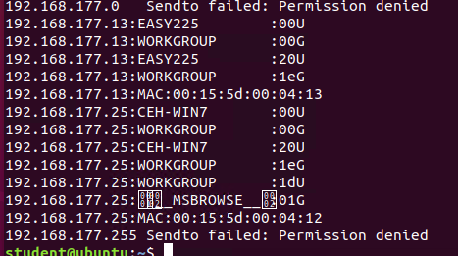
Manual vulnerability discovery
Take a screenshot of the output in Part 1 Step 3.
It should show the IP addresses of the VMs.

Slide 22
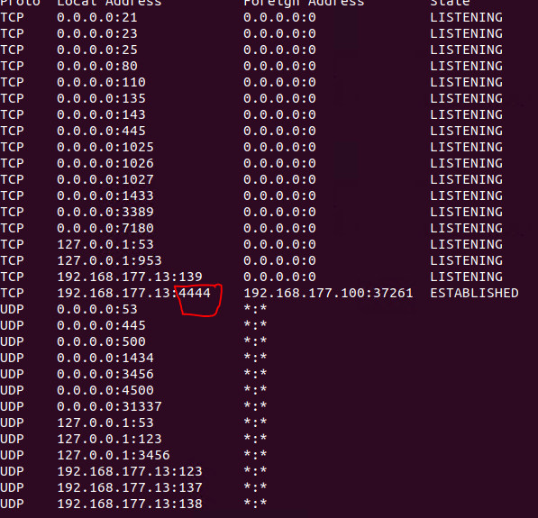
Vulnerability exploitation
Take a screenshot of the output in Part 4 Step 6.
It should show the default port (i.e., 4444) that Metasploit uses.

Slide 23
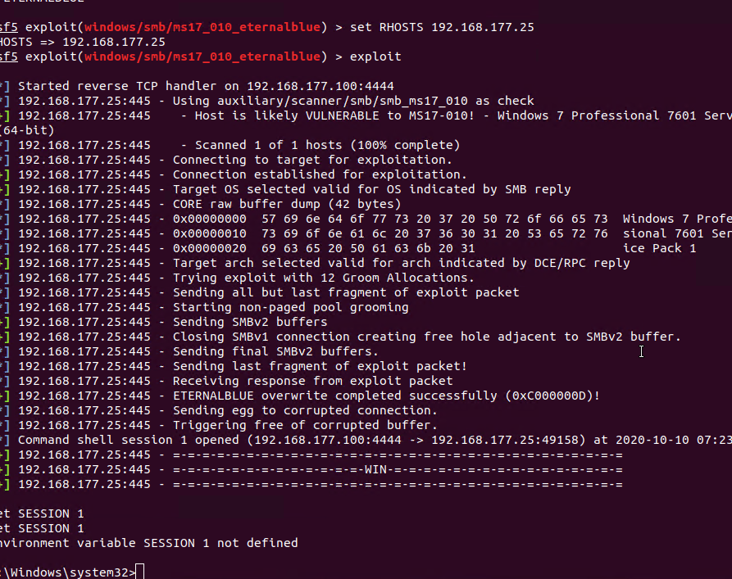
Vulnerability exploitation cont’d
Take a screenshot of the output in Part 4 Step 10.
It should show the C:\Windows\system32> prompt.

Slide 24
Module 6 Live Memory Analysis
These task are analysis on live memory on a virtual machine.

Slide 25
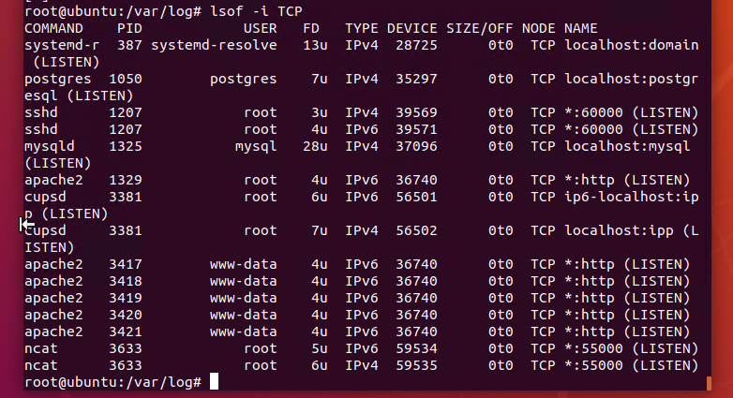
Linux Processes
Take a screenshot of the output in Part 1 Step 9.
It should show port 55000 open for both IPv4 and IPv6.

Slide 26
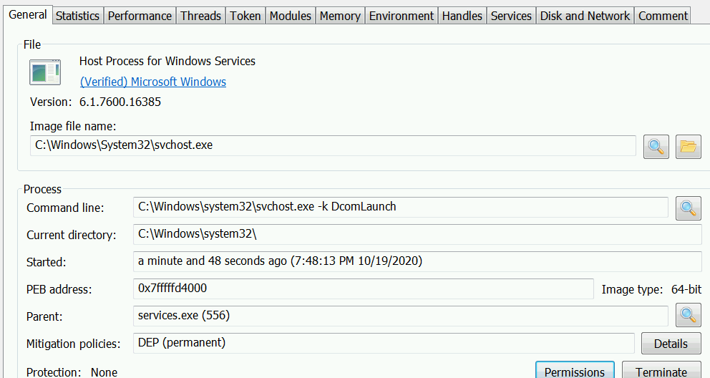
Process Hacker
Take a screenshot of the output in Part 2.
It should show properties of a chosen process.

Slide 27
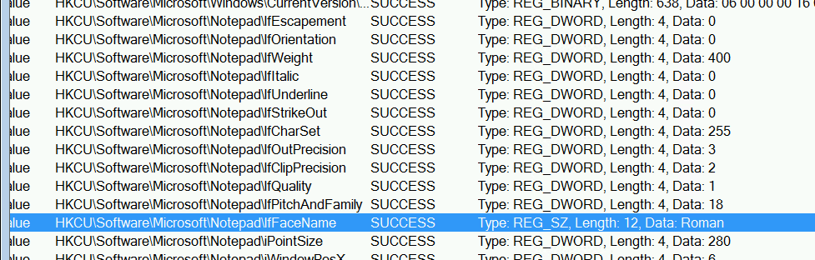
Process Monitor
Take a screenshot of the output in Part 3 Step 7.
It should show ifFaceName in the Path column and Data: Roman in the Detail column.

Slide 28
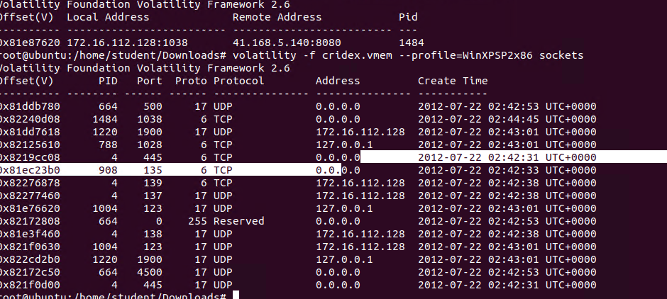
Volatility
Take a screenshot of the output in Part 4 Step 8.
It should show compromised network connections.

Slide 29
Challenges and lessons learned
Retracing steps to find issues
Troubleshooting
File pathways not detected
Azure easy to work

Slide 30
Conclusion
There are many ways a system can be attacked and multiple was that there can be vulnerabilities. This class has shown how to setup firewalls, analyze attacks, Snort testing and rules, Look for Vulnerabilities, and different tools across different systems to conduct these test.
It is crucial to check vulnerabilities and to make sure that systems and networks are secured. As there are multiple ways someone can attack and network.

