Slide 1

ECT315
Professor: Gusteau Duclos
By: Patrick Norris

Slide 2
Introduction
This PowerPoint is a collection of projects that were done in Industrial IoT. These project contains IoT device that are used to monitor water levels, temperatures, and gas. As well as being able to monitor them in real time and connecting with Thingspeak and Matlab to get live data read out.

Slide 3
Creating Thingspeak Account and adding Thingspeak Widgets

Slide 4
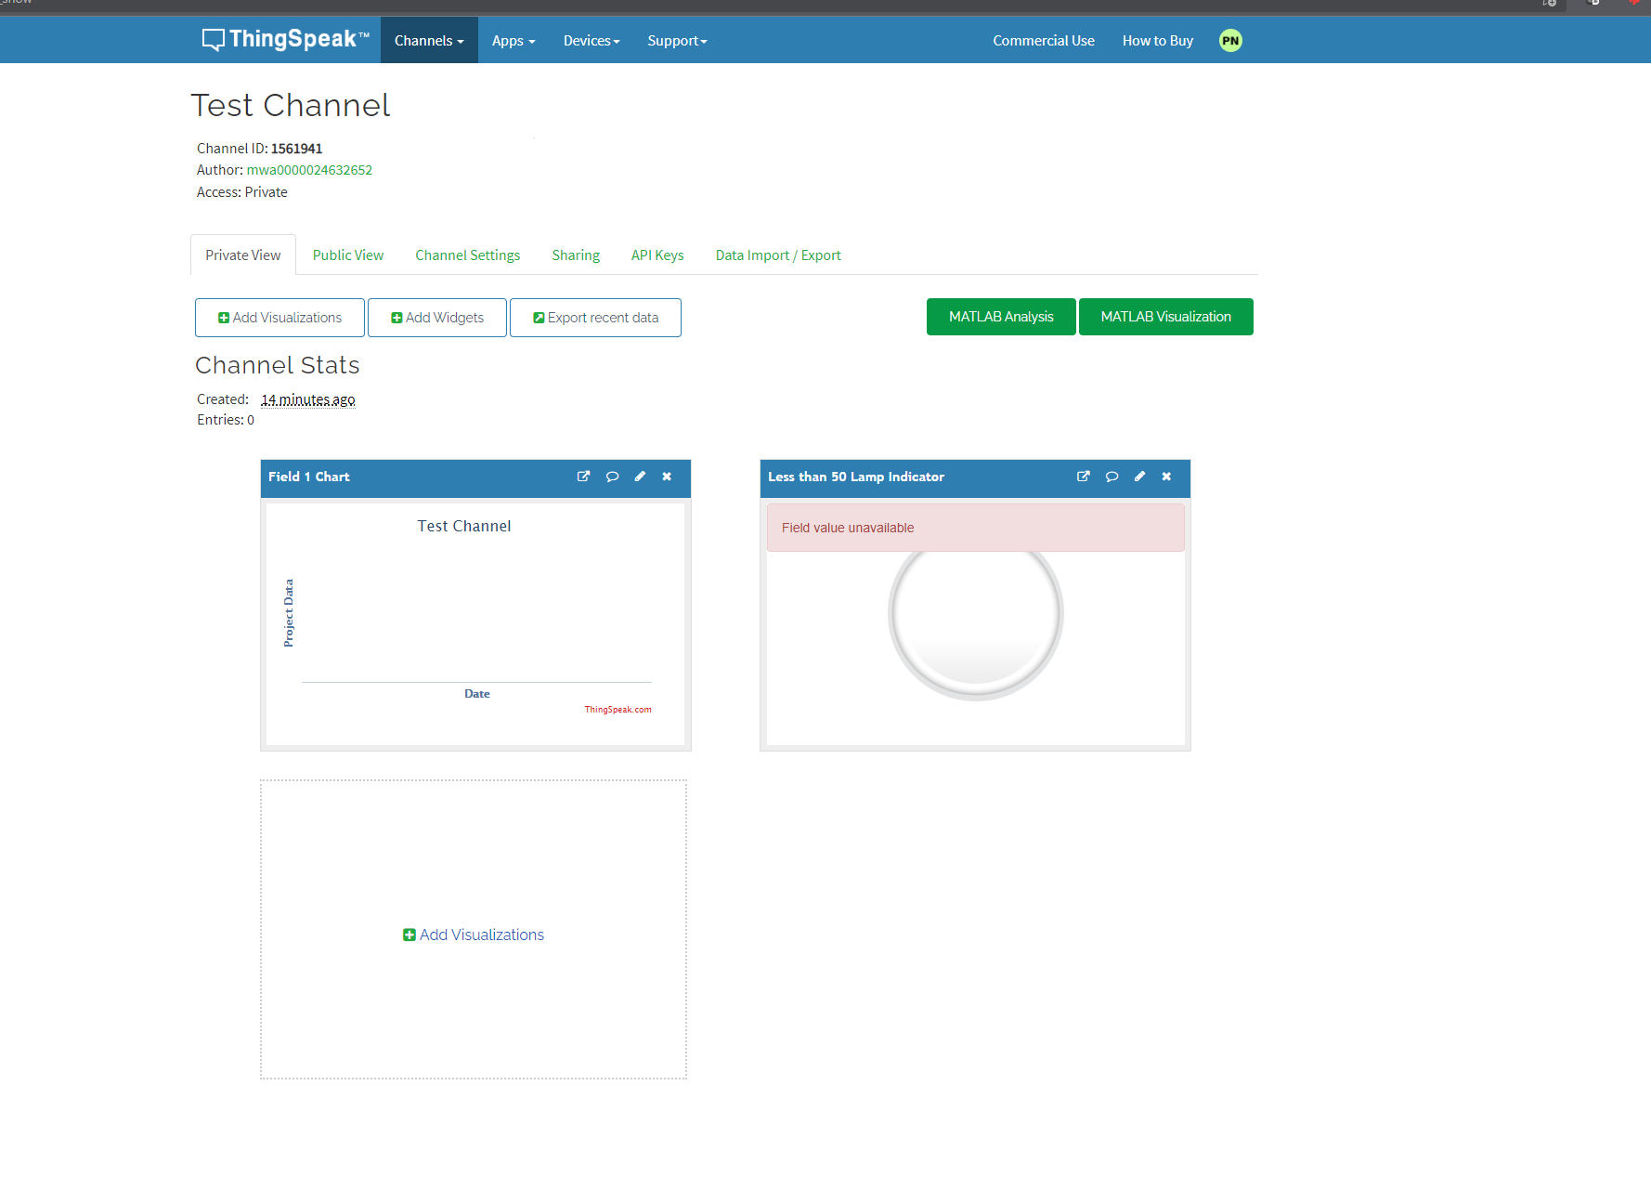
ThingSpeak Dashboard
This is the Thinkspeak dashboard with a lamp indicator and a chart.

Slide 5
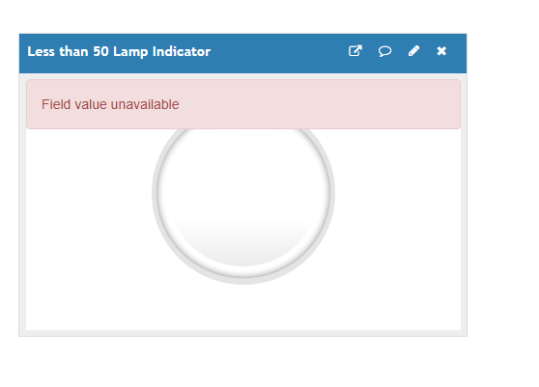
Lamp Widget
This is a lamp widget set to go off if the value is below 50.

Slide 6
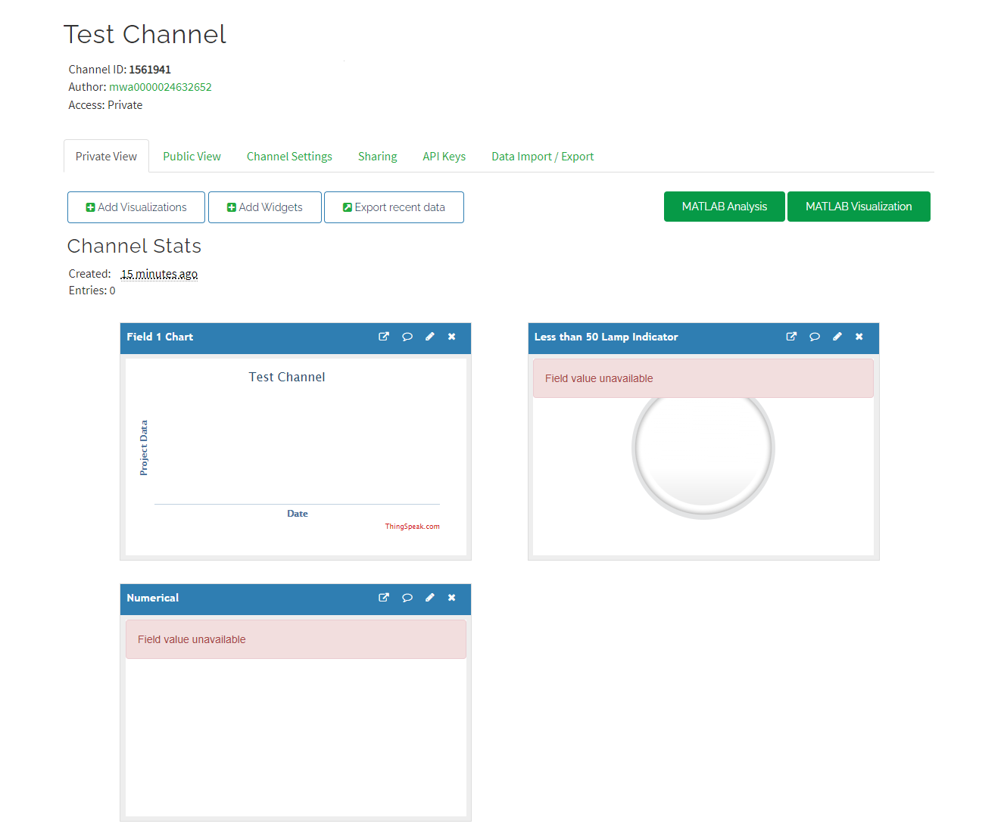
Numerical Widget

Slide 7
IOT Flood Monitoring Systems – Part I

Slide 8
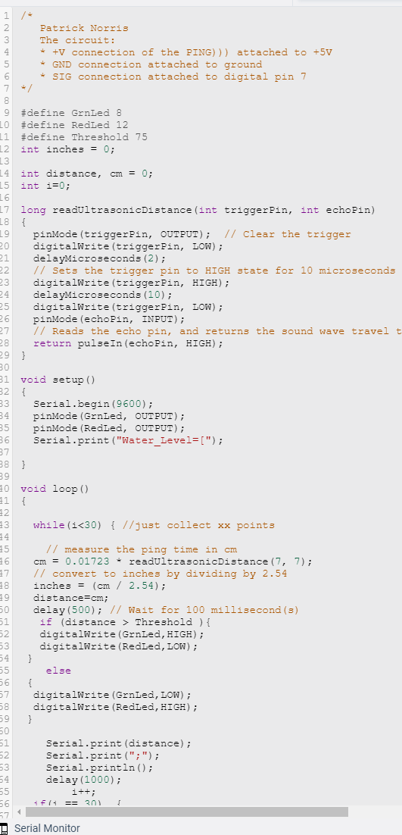
This is code is used to monitor water levels to warn of a flood happening.

Slide 9
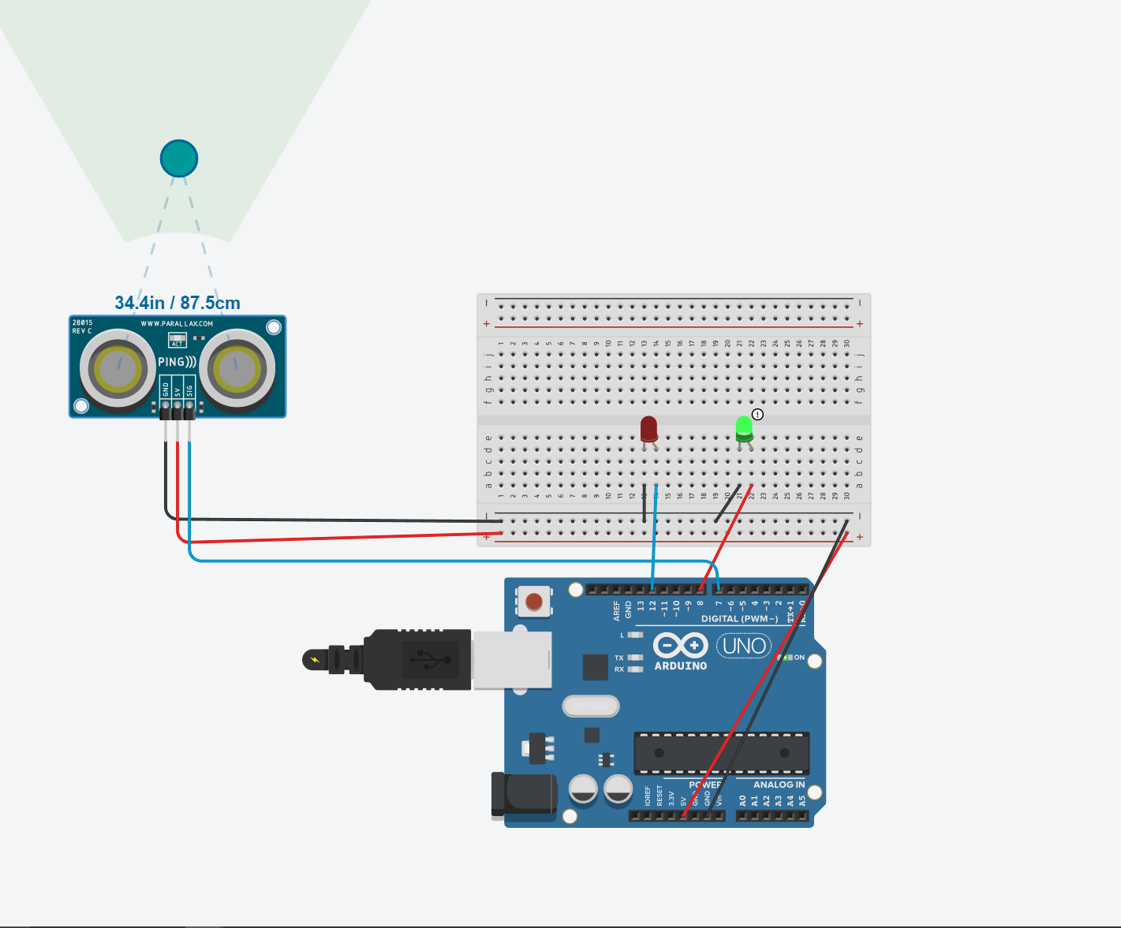
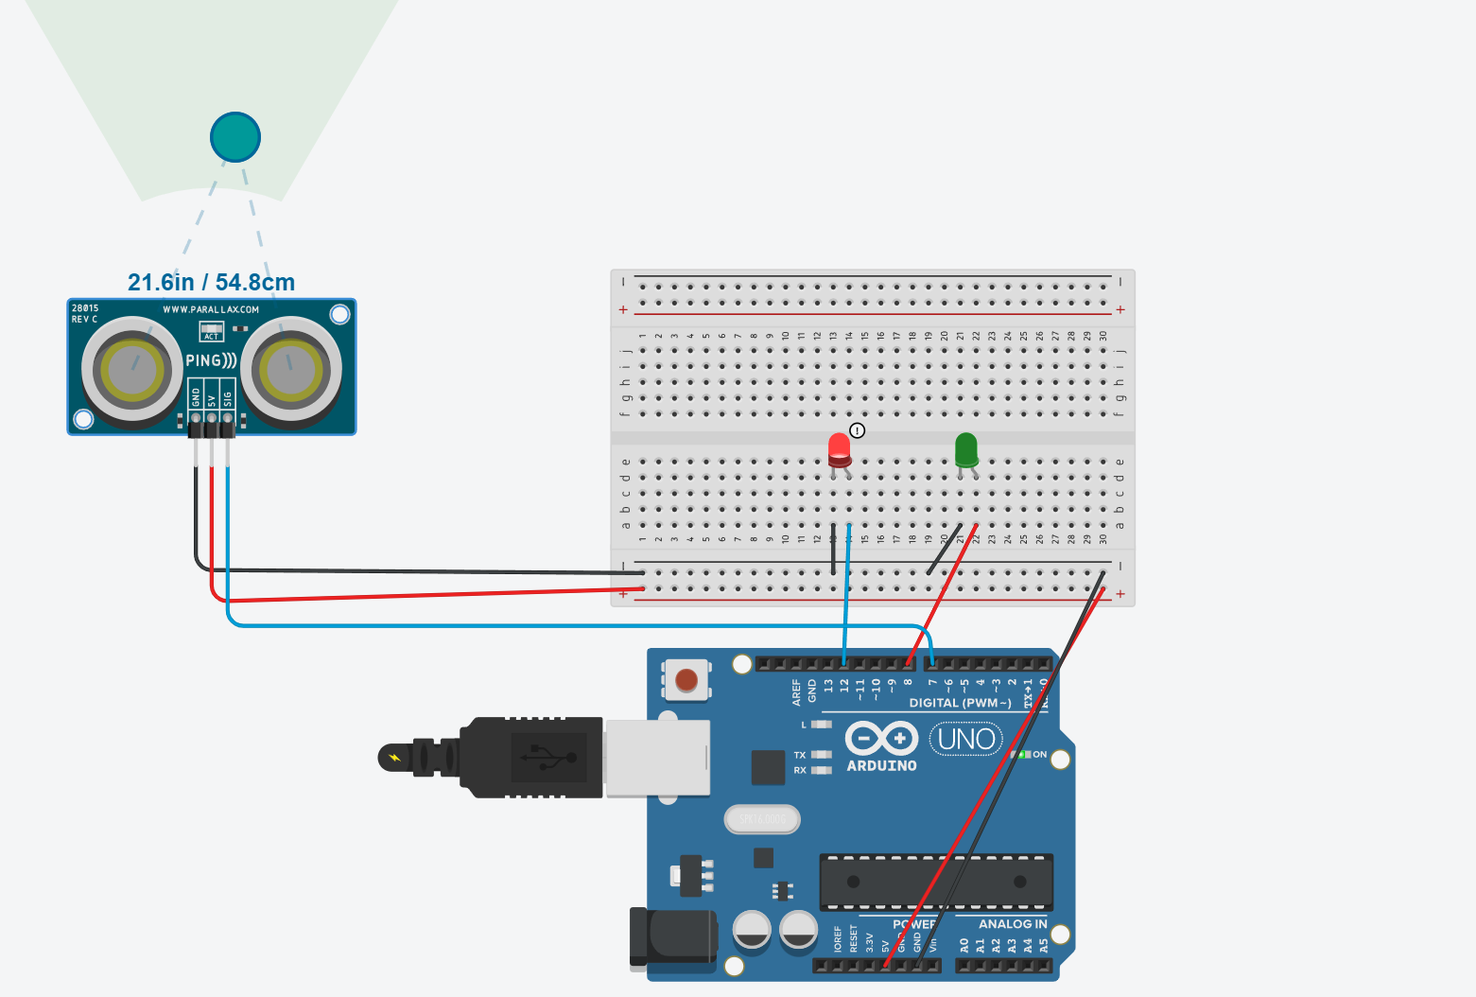
constructed circuit with Red LED is ON & Green Led is ON
The picture below is showing the red led active as the water level to high and the image on the right is clear with a green led active.

Slide 10
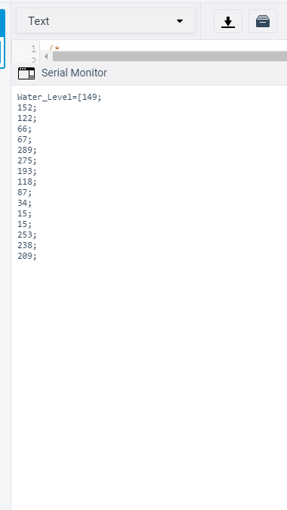
collected data
This is the data for the Arduino to show the water level.

Slide 11
IOT Flood Monitoring Systems – Part II

Slide 12
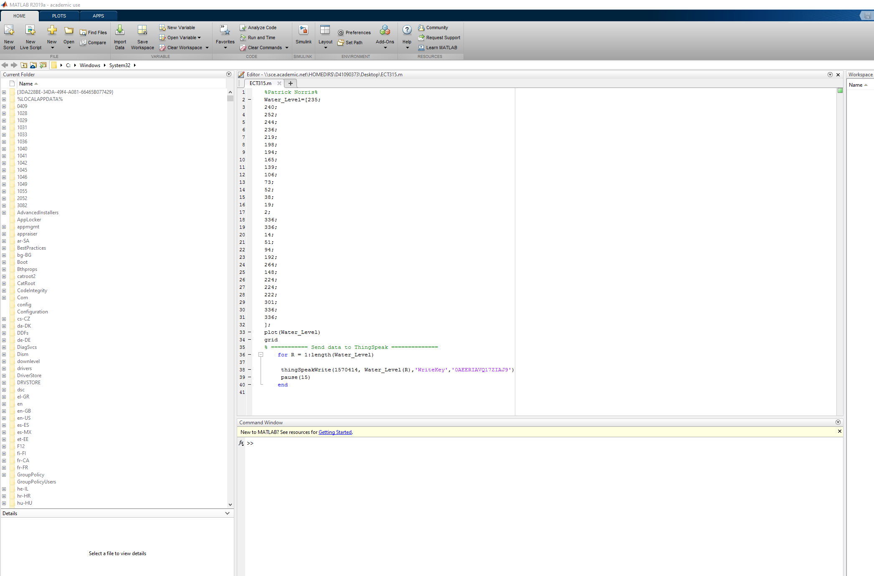
MATLAB code
This is part to of the flood monitoring system. The image to the right is the data from the Arduino.

Slide 13
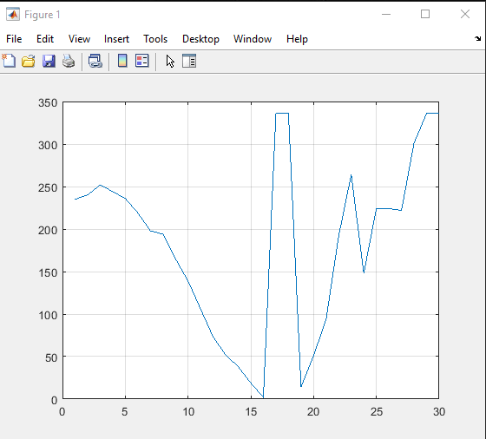
Matlab plot
The data put into Matlab gives us this graph.

Slide 14

collected data
This is the data that is put in to Matlab.

Slide 15
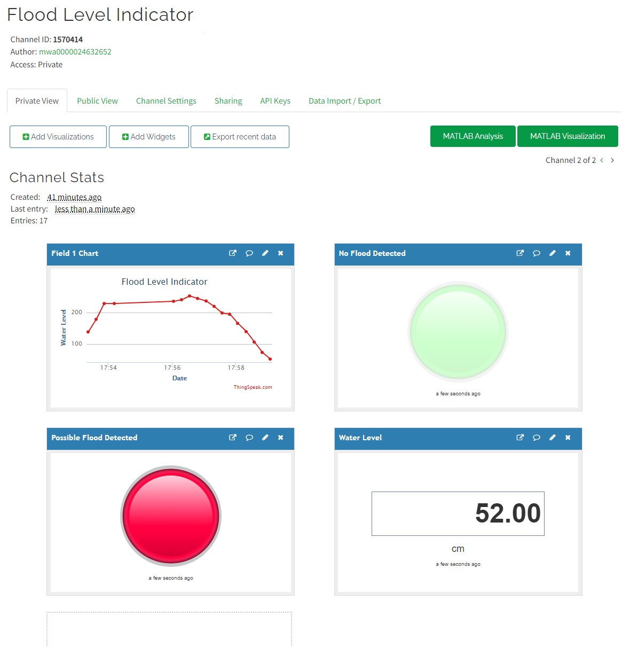
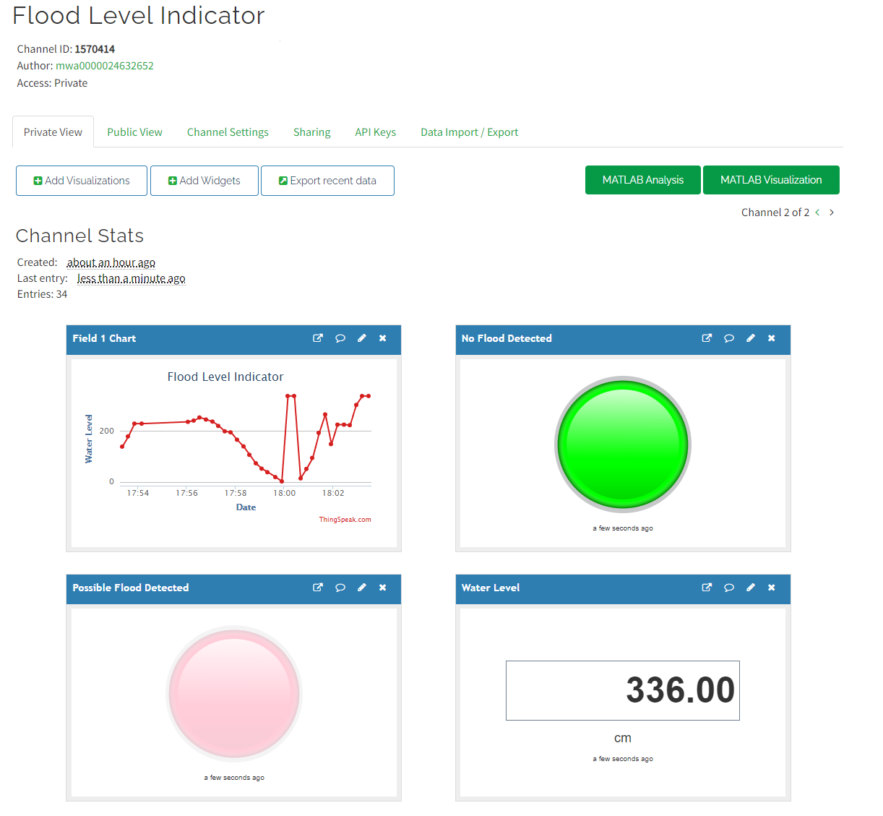
One dashboard
With that data in Matlab and linking Thingspeak, this dashboard is made in Thingspeak showing another graph of the data along with lamp indicators.

Slide 16
Factory Access Control System Using Keypad

Slide 17
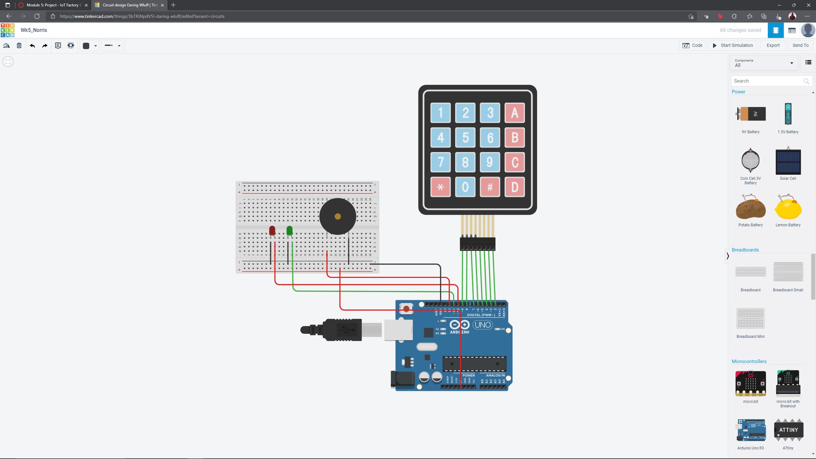
completed constructed circuit
This is a keypad with a code to unlock and lock with a buzzer and led light to show access granted or denied.

Slide 18
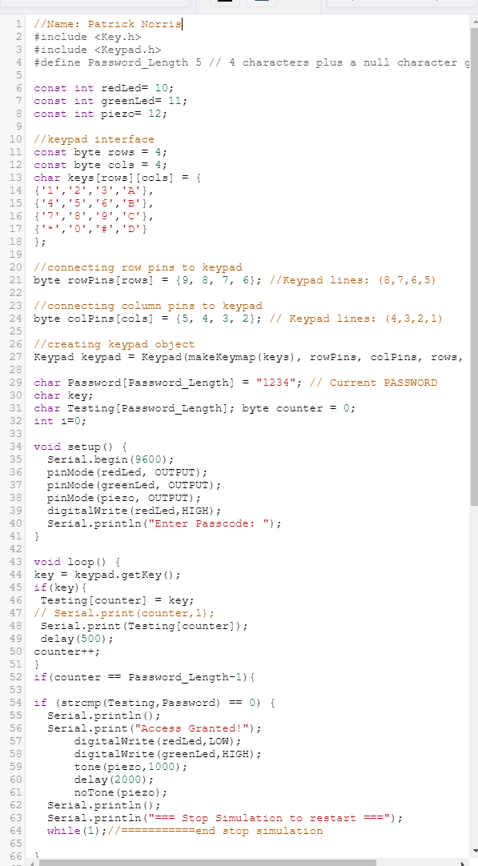
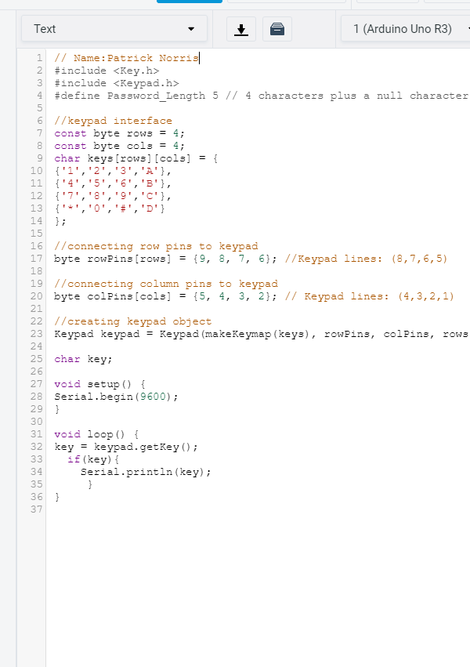
Code for tinkercad
This is the code for Arduino for the keypad.

Slide 19
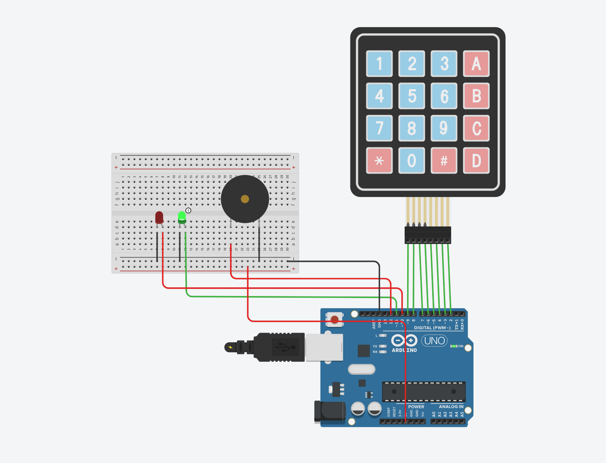
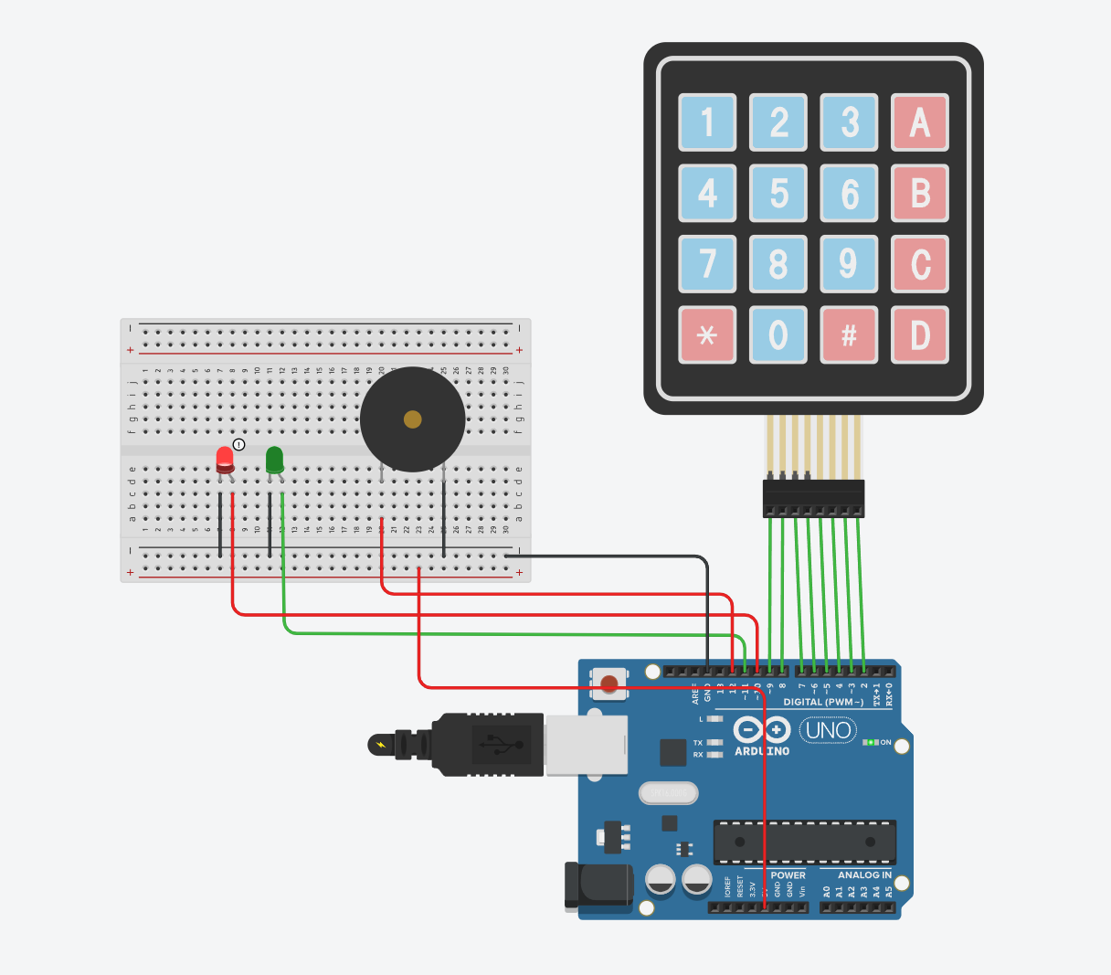
circuit showing Red leds is ON when access denied and Green leds is ON when access Granted

Slide 20
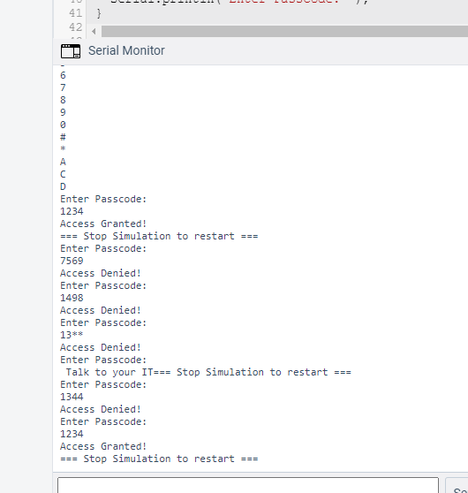
Serial Monitor screen shot with Access denied
This is a read out of the code being put in with the granted or denied status.

Slide 21
Temperature and Gas sensors in real time

Slide 22
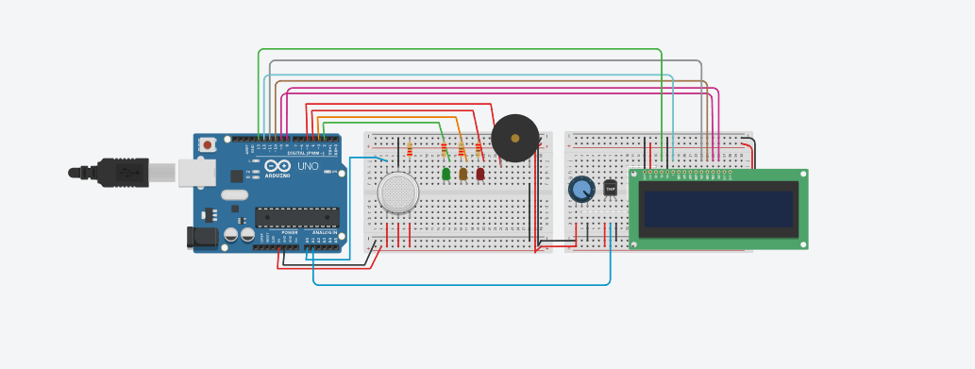
Construction of board

Slide 23
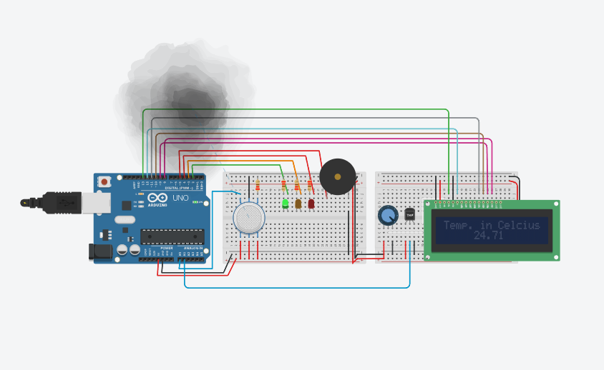
Gas sensor, buzzer, and Temp.
Gas sensor with smoke showing green light.

Slide 24
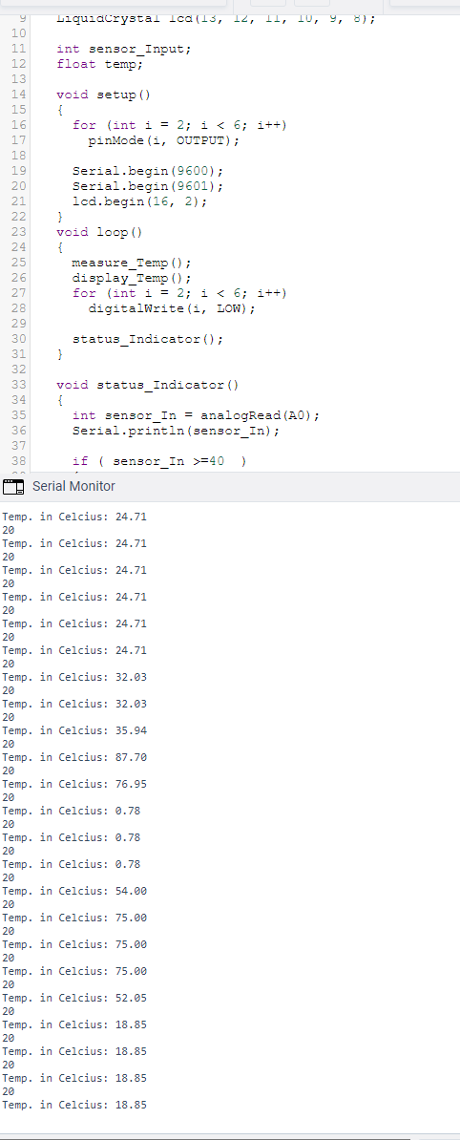
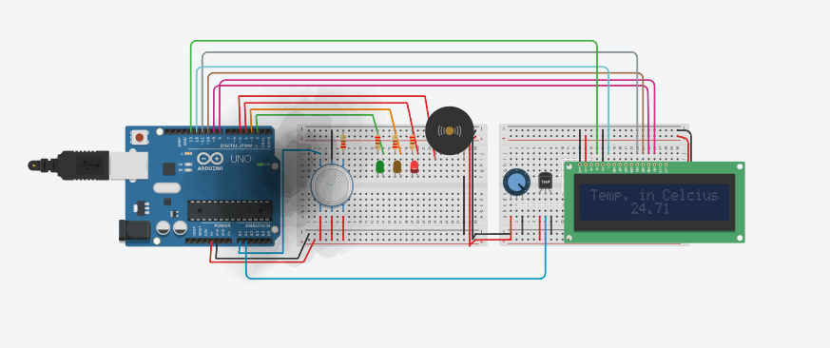
Gas sensor with smoke
Gas sensor with smoke causing buzzer and red light to be active.
To the right is the data read out that it is collecting.

Slide 25
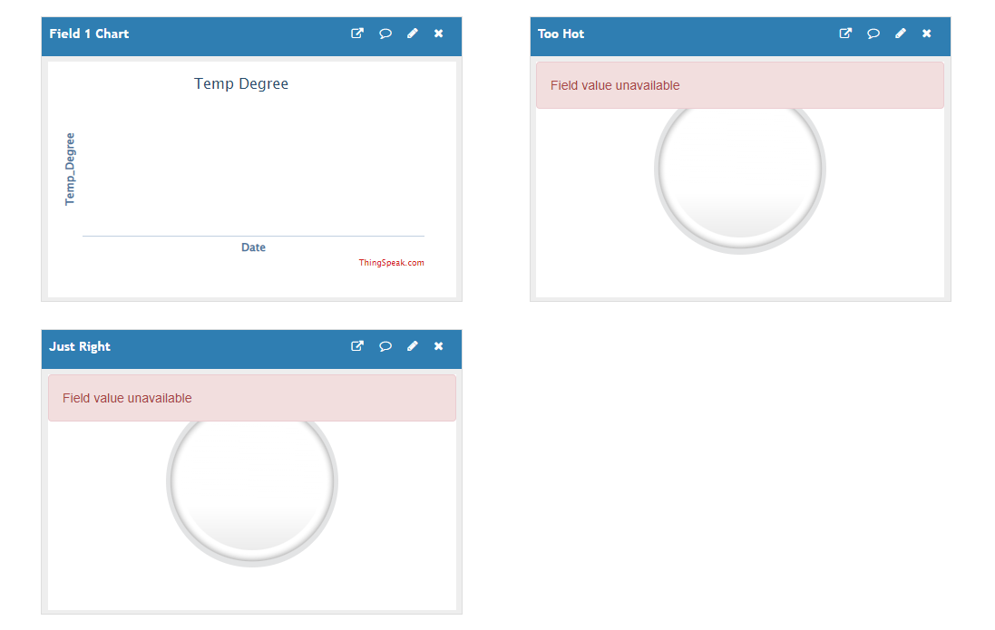
Thingspeak dashboard

Slide 26
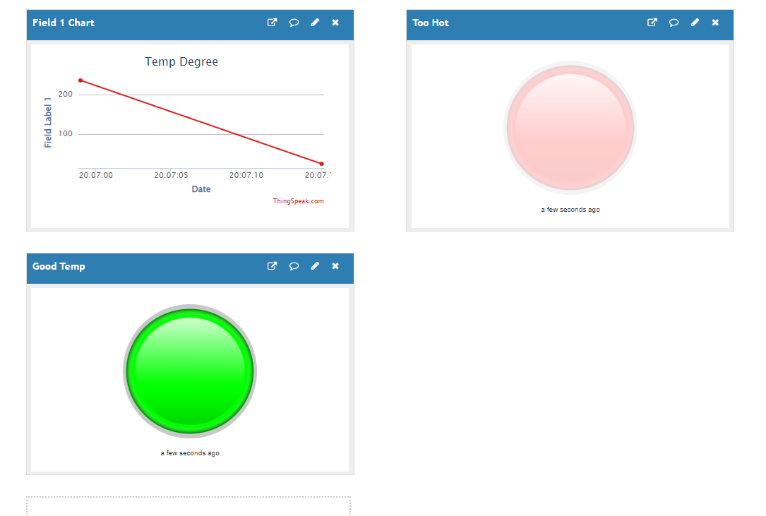
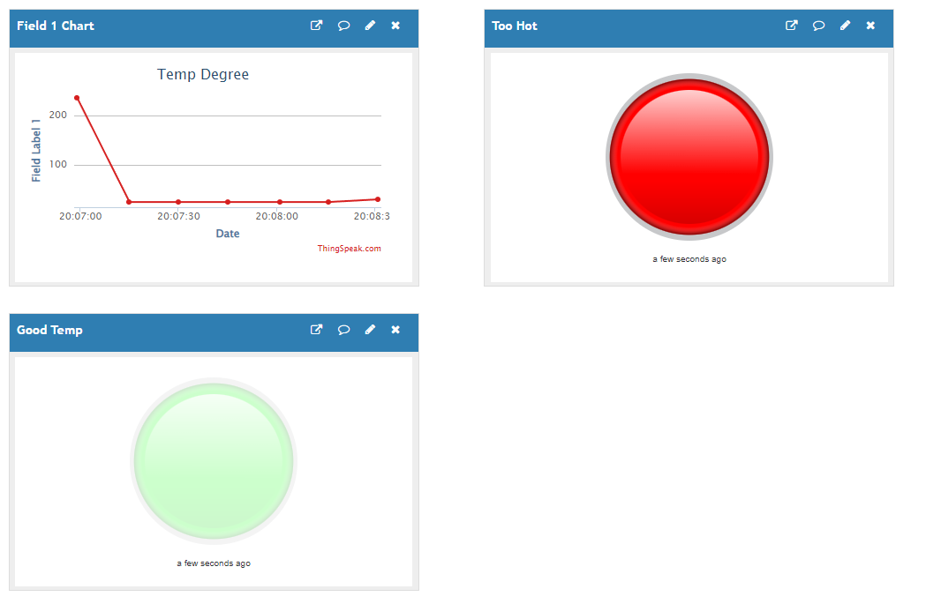
Thinkspeak dashboard with data from matlab
Data showing that the temp is below 28C
Data showing that it is above 28C

Slide 27
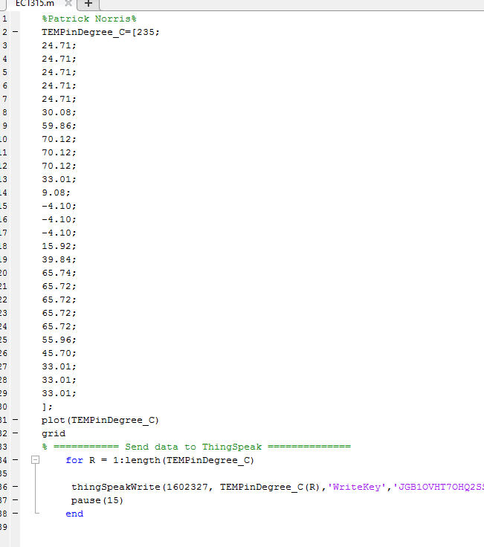
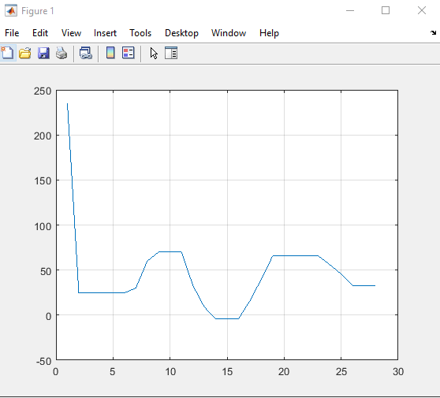
Data from Arduino and Matlab

Slide 28
Conclusion
Over the last eight week working on a project every week has built up the ability to build a device to monitor and detect an event and send the data to Matlab which then sends it to Thingspeak to get graphical data with a lamb to monitor the device remotely.

Slide 29
Challenges
Some challenges that I faced with this project was getting the display to read out temperatures, along with making the code for the devices.

Slide 30
Career skills obtained
Some career skills that I have obtained are:
Coding
Industrial IoT
Thingspeak
Using Cloud/Network with IoT

Slide 31
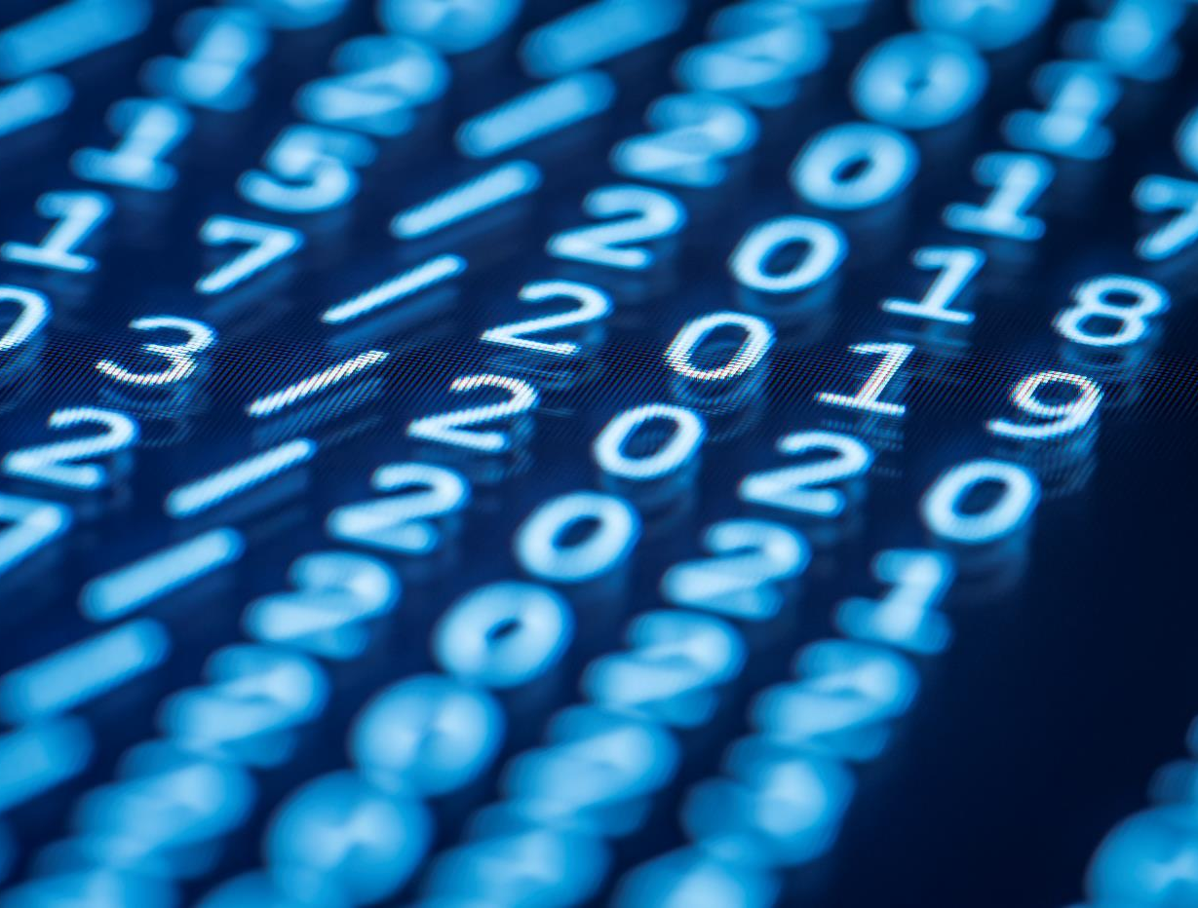
Thank You
Norrisjames11@yahoo.com

