Slide 1

Ceis490
By: Patrick Norris

Slide 2
Introduction
The following slides are using Amazon AWS and a personal computer as and IoT device
Using AWS to step up a communication path with a personal computer then setting up a push notification
This code and AWS feature will send a push notification when the ram usage of the personal computer hits a limit

Slide 3
IoT device registration
This section shows the registration of a device with Amazon AWS
Create an IoT client certificate
Create an IoT Core policy

Slide 4
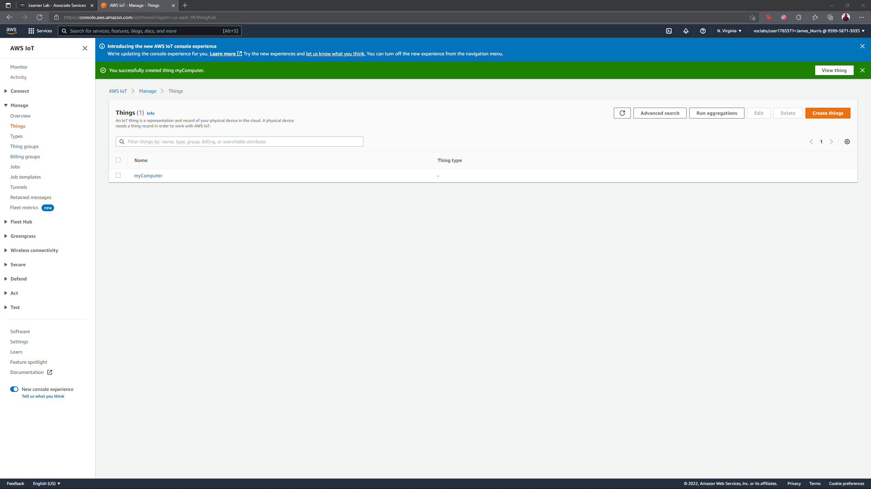
Register a device
This screenshot should show the myComputer page with the Thing ARN being displayed.

Slide 5
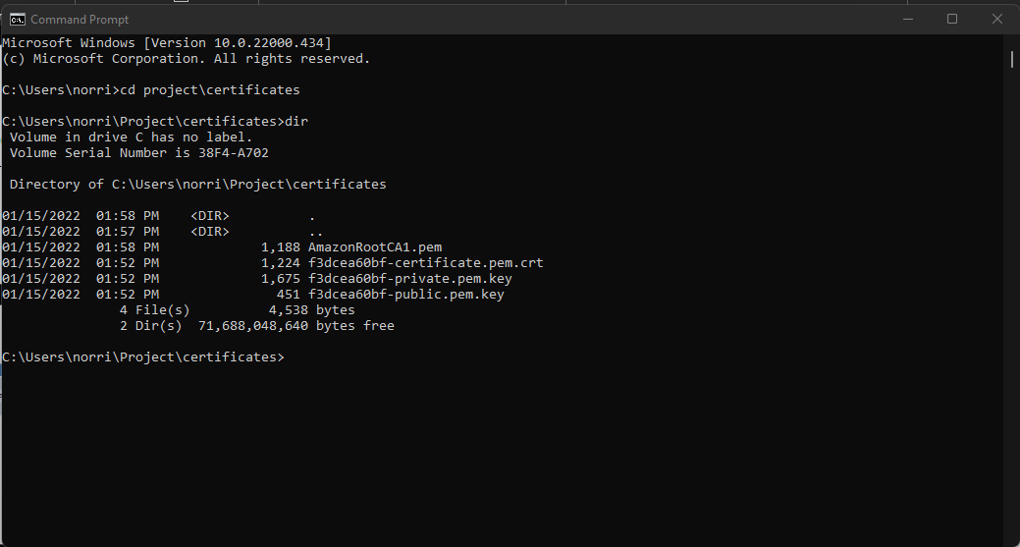
Create an
IoT client certificate
This screenshot should show the Command Prompt window showing the four files in the certificates directory.

Slide 6
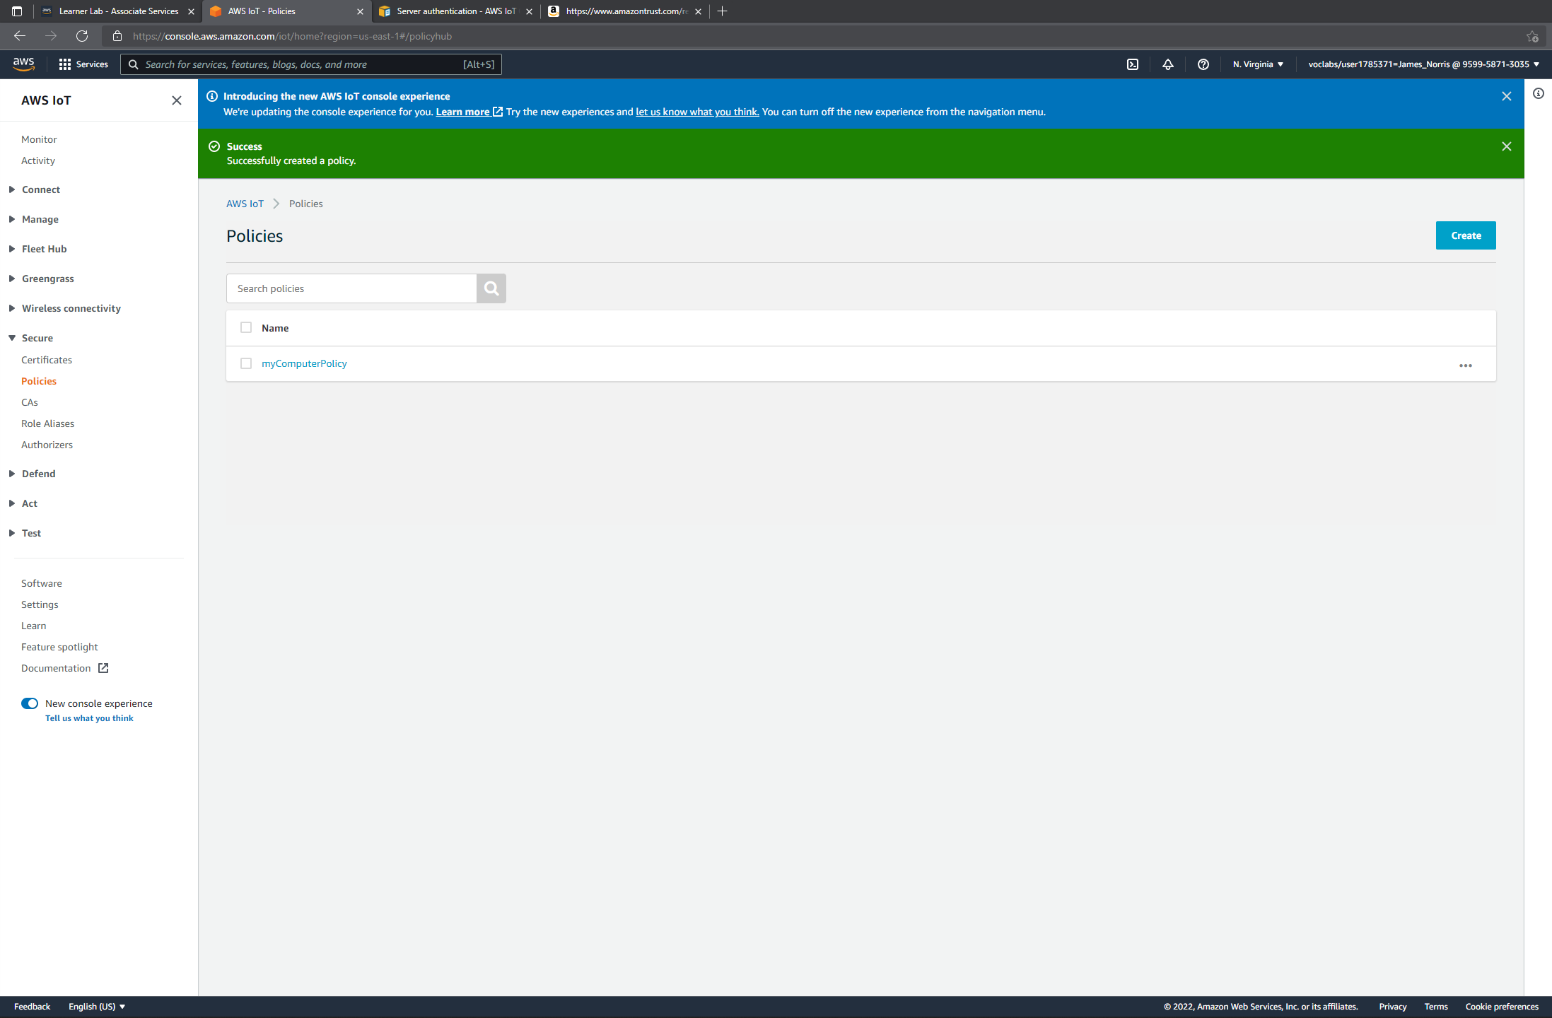
Create an IoT Core policy
This screenshot should show the myComputerPolicy page, including the policy ARN, date created, and policy document.

Slide 7
Connecting to the IoT message broker
Generate an MQTT message
Receive the MQTT message

Slide 8
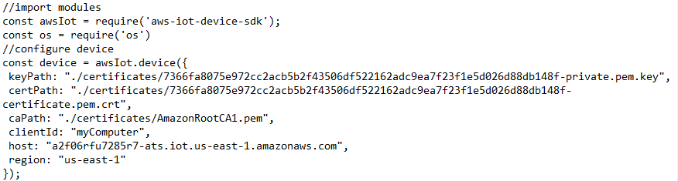
Generate MQTT messages
This screenshot should show the part of the thing.js code changed in Step 5, with the keyPath, certPath, caPath, ClientID, host, and region information.

Slide 9
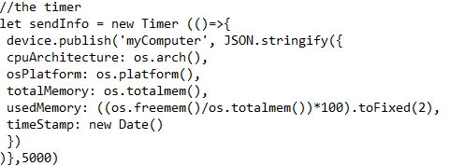
Questions
How frequently are these messages generated or published? Identify the part of the code in the thing.js program that specifies the frequency of these messages.
Below is the part of the code that is the timer, as for the time itself it is the 5000 which is 5000 milliseconds which is 5 seconds, so the information is gathered and sent every 5 seconds.

Slide 10
Push notifications via SNS
Create a topic and subscription
Create IoT Rule
Send push notifitcation

Slide 11
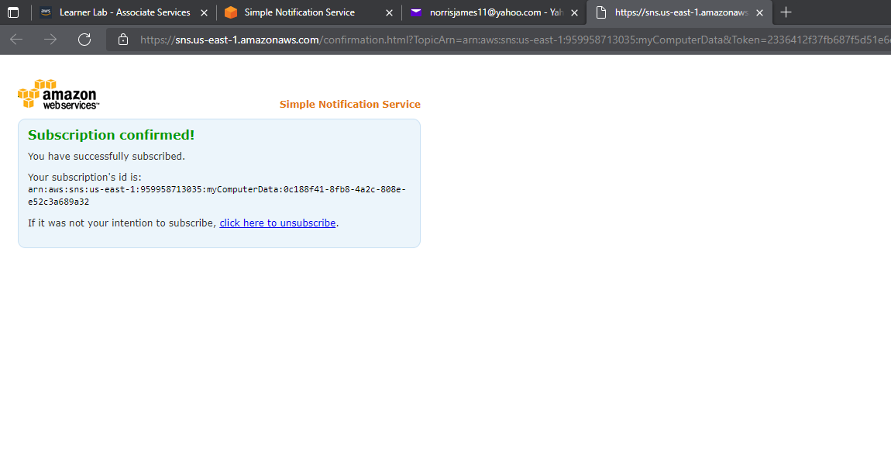
Create a topic and subscription
This screenshot should show the internet browser window with the “Subscription confirmed!” message.

Slide 12
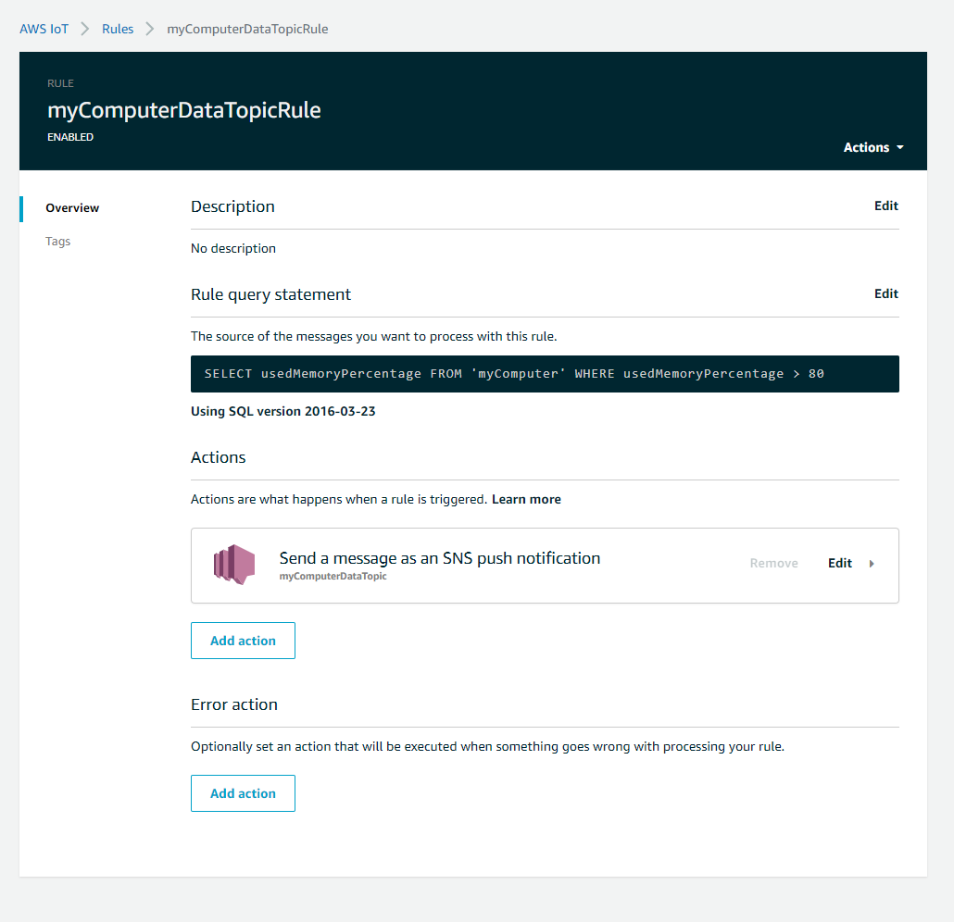
Create an
IoT rule
This screenshot should show the myComputerDataTopicRule page, with the enabled status, rule query statement, and actions being displayed.

Slide 13
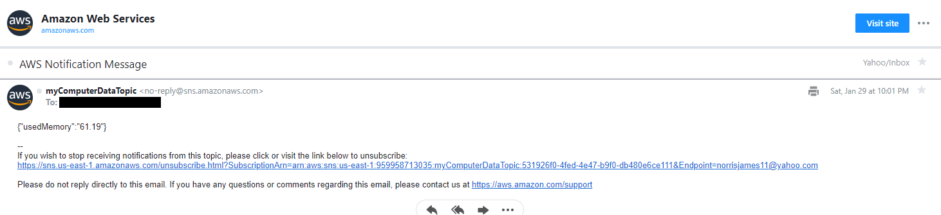
Send a push notification
This screenshot should show the AWS notification message, with the usedMemoryPercentage value that triggered the message being displayed.

Slide 14
IoT: Capabilities, Now and the Future
The following slides are from a paper about IoT history as well as the capabilities of its current status and where it can go.

Slide 15
Introduction with history
1832, the start was connecting two telegraphs for direct communication.
In 1980’s a group of local programmers used some micro-switches along with the use internet to see if a vending machine had drinks available or not.
Popularity of IoT it only start to take track in 2010 as there were about 12.5 billion devices connected.

Slide 16
What is IoT?
IoT is a device that is connected to another, that can be a sensor connected to a module that is connected to the internet to push the data the is being read out to an end point.
Ring Doorbell, Smart thermostats, Smart Cities, etc.

Slide 17
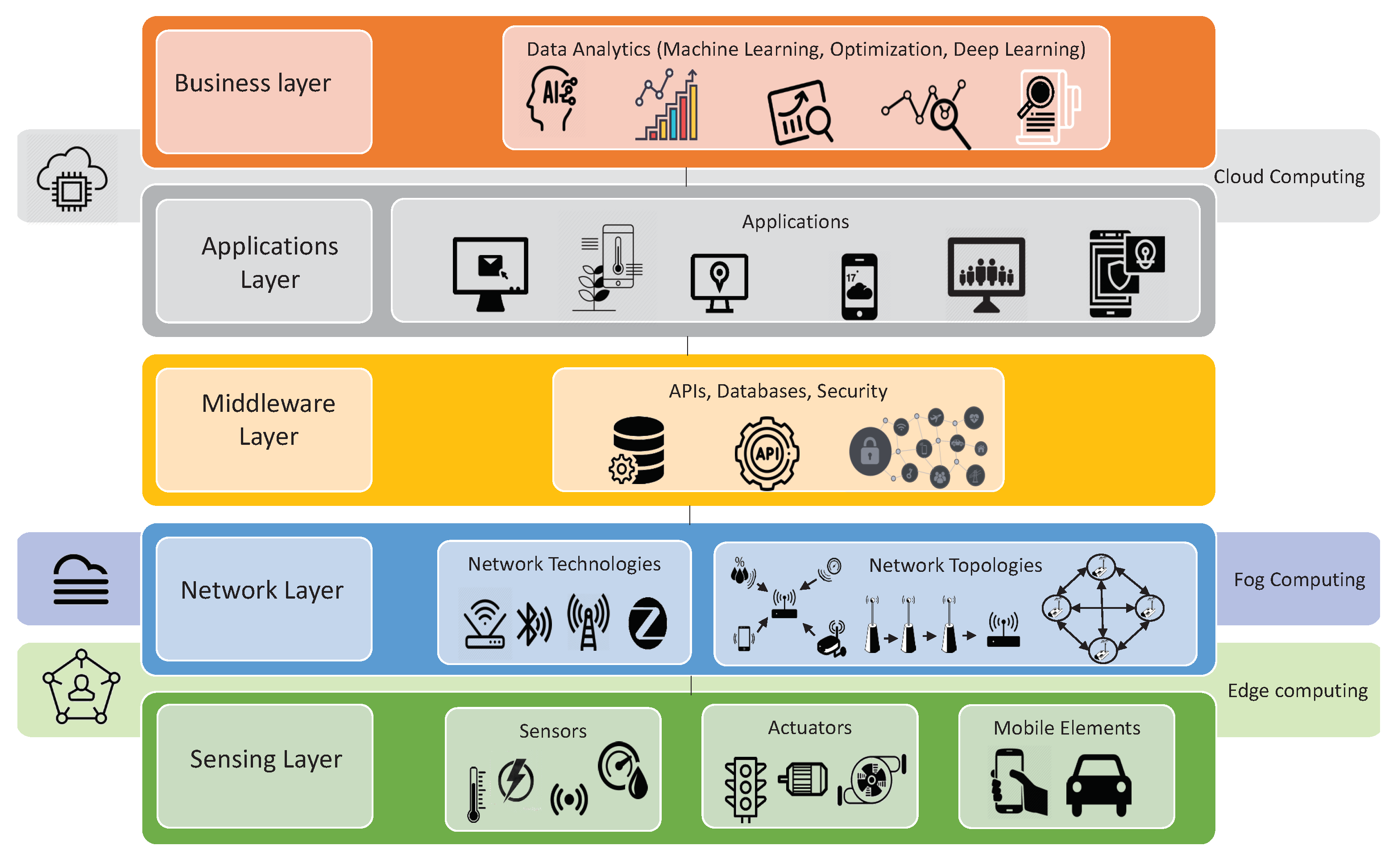
IoT layers
(Syed et al., 2021)

Slide 18
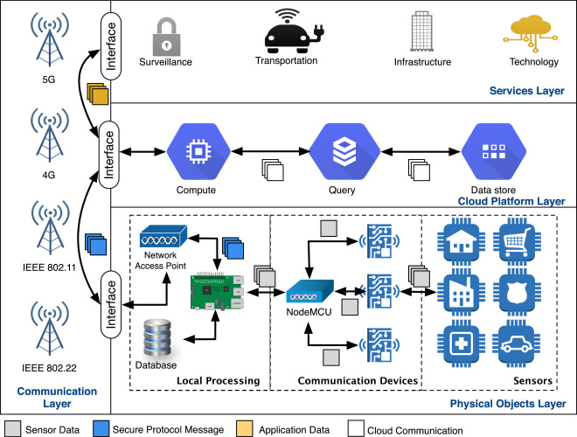
CONT.
IoT Smart City Layout
(Marques et al., 2018)

Slide 19
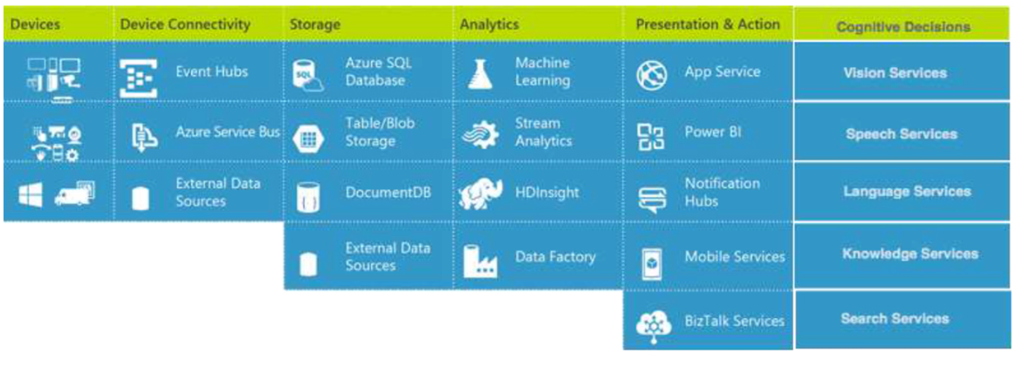
Industry particpation
GE (General Electric Company)
Cisco
Amazon (AWS)
Google
Microsoft
(Strukhoff et al., 2016)

Slide 20
The Future of Iot
ENDLESS!!

Slide 21
Challenges
Issue with code
Issue with AWS response
Understanding process

Slide 22
Career skills
IoT with AWS
Automation
Coding
IoT and IIoT Understanding
Report
Research and presentation

Slide 23
Conclusion
These projects have given me the understanding of AWS with IoT along with automation, coding, and all the abilities that IoT can hold and where it can go. As well as the ability to conduct a report and to be able to present the report. These projects have built the skills and abilities to needed in a career to be able to conduct presentations and papers.

Slide 24

Thank You
Norrisjames11@yahoo.com

Slide 25
References
Butaney, V. (2016, July 8). 3 ways Cisco is enhancing the industrial IOT. Cisco Blogs. Retrieved February 4, 2022, from https://blogs.cisco.com/digital/3-ways-cisco-is-enhancing-the-industrial-iot
Earthpledge Foundation. (2022, January 12). Overview of Amazon Web Services AWS Whitepaper. Amazon. Retrieved February 4, 2022, from https://docs.aws.amazon.com/whitepapers/latest/aws-overview/internet-of-things-services.html
Google. (2022). Google cloud IOT - fully managed IOT services. Google. Retrieved February 5, 2022, from https://cloud.google.com/solutions/iot

Slide 26
Industrial IOT (IIOT) and Automation Technology. Intel. (2022). Retrieved February 4, 2022, from https://www.intel.com/content/www/us/en/internet-of-things/industrial-iot/overview.html?cid=sem&source=sa360&campid=2022_q1_dpg_us_dpgle_dpgec_awa_text-link_generic_phrase_cd_E2C-IOT-Industry_3002145855_google_b2b_is_pbm_Intel&ad_group=generic_industry_b2b1&intel_term=industrial%2Biot&sa360id=43700068883322424&gclid=CjwKCAiAl-6PBhBCEiwAc2GOVF3HYx5mOJOEzlgyy_dxfuANEDpHOfwrj6zIw-Y-TwxlHlzOYGTnShoCsbkQAvD_BwE&gclsrc=aw.ds
Khvoynitskaya, S. (2019, November 25). The IoT history and future. Itransition. Retrieved February 3, 2022, from https://www.itransition.com/blog/iot-history

Slide 27
Marques, P., Manfroi, D., Deitos, E., Cegoni, J., Castilhos, R., Rochol, J., Pignaton, E., & Kunst, R. (2018, December 28). Ad Hoc Networks. Science Direct. Retrieved February 3, 2022, from https://www.sciencedirect.com/science/article/pii/S1570870518309533
Parris, C. (n.d.). What is the Industrial Internet of Things (IIOT)? Everything you need to know about IIoT | GE Digital. Retrieved February 4, 2022, from https://www.ge.com/digital/blog/what-industrial-internet-things-iiot
Strukhoff, R., Khizhniak, A., & Turol, S. (2016, August 17). A possible anatomy of a GE Predix app using Microsoft Iot Services. Altoros. Retrieved February 5, 2022, from https://www.altoros.com/blog/a-possible-anatomy-of-a-ge-predix-app-using-microsoft-iot-services/
Syed, A. S., Sierra-Sosa, D., Kumar, A., & Elmaghraby, A. (2021, March 30). IOT in Smart Cities: A Survey of Technologies, practices and challenges. MDPI. Retrieved February 3, 2022, from https://www.mdpi.com/2624-6511/4/2/24/htm

