Slide 1

NETW 320
Converged Network with Lab
By: Patrick Norris

Slide 2
Netw 320 Course Project
These project is intended for introduction to standards and protocols that support multimedia transmission on IP network. This project gives experience with integration of IoT technologies. The project involved implementation and experimentation of a multimedia application with audio and video codecs, Real-time Transport Protocol (RTP), Session Initiation Protocol (SIP), and the security implications.

Slide 3
NETW320 Course Project
Module 2
Audio and Video Codecs

Slide 4
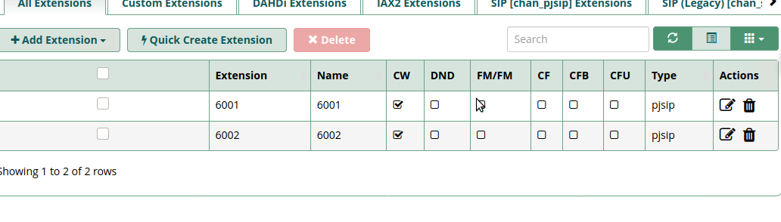
Create SIP Accounts
The screenshot shows the All Extension tab of the Asterisk Server A, with both extensions (6001 and 6002) being displayed.

Slide 5
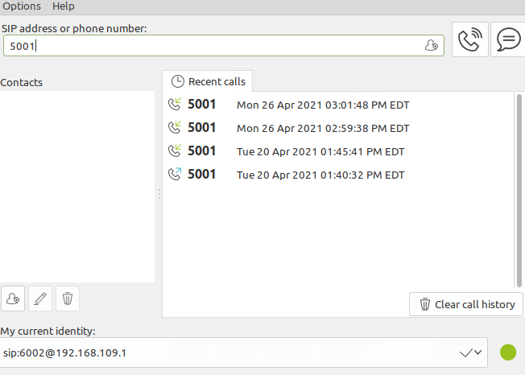
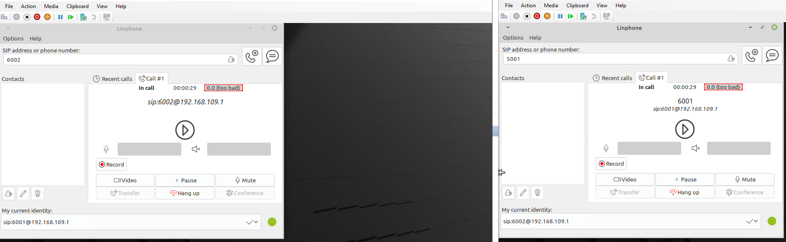
Register SIP Clients
This screenshot shows the Linphone window, with sip:6002@192.168.109.1 being displayed in the My current identity field.
This screenshot shows the Linphone window with the in call status and timer xx:xx:xx information.

Slide 6
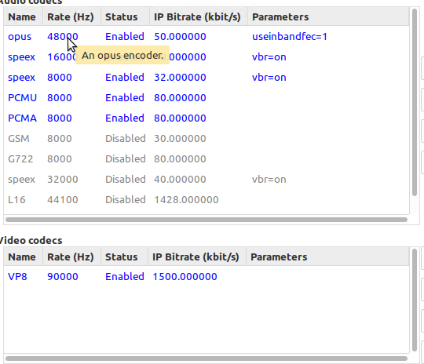
Audio and Video Codecs
The screenshot shows the Settings window of the Linphone, showing the audio codecs and video codecs.
Among the audio codecs enabled for the Linphone, which one requires the most bandwidth per call? Which one requires the least bandwidth per call?
Answer:
PCMU and PCMA have the highest Bandwidth with 80 kbit/s and speex having the lowest of 32 kbit/s.
Which video codec does the Linphone use? How much bandwidth would such a video session consume?
Answer: Linphone uses VP8 codec and would consume about 1500 kbit/s.

Slide 7
References
1. Azure Labs
2. Linphone
3. Barz, H. W., & Bassett, G. A. (2016). Multimedia networks: protocols, design and applications. Wiley & Sons.

Slide 8
NETW320 Course Project
Module 3
Real Time Protocol (RTP)

Slide 9
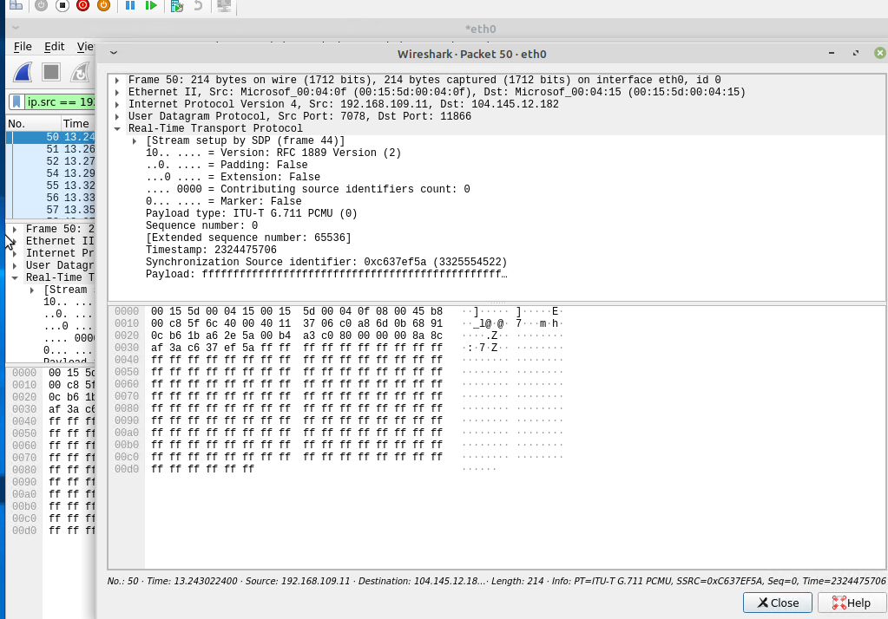
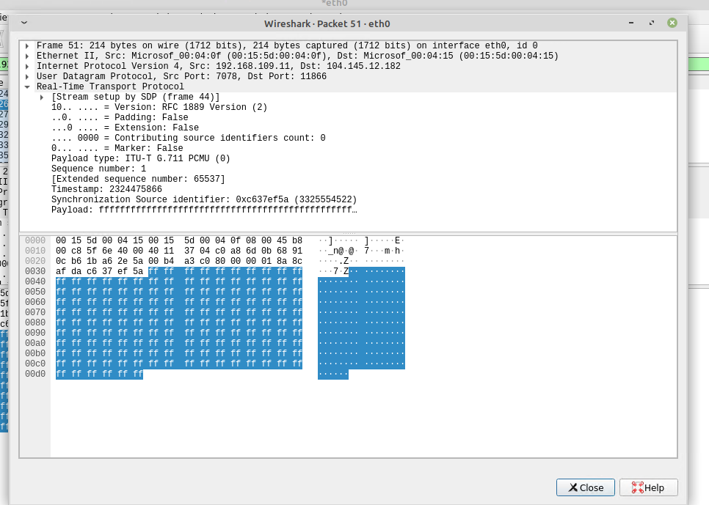
RTP Packet Payload Size
These screenshots shows the Tree View section of two consecutive RTP packets (the difference between their sequence numbers is 1), respectively. Make sure to capture the payload type, sequence number, and timestamp information.

Slide 10
RTP Packet Payload Size
1. If each increment of the RTP timestamp clock (i.e., one unit) represents 1/8,000 of a second, how many seconds or milliseconds of conversation are carried in each RTP packet? 0.02
2. Given the G. 711 codec bit rate as 64,000 bits per second, the payload size in seconds or milliseconds calculated above can also be represented in 1280 bits or 160 bytes.
3. Subtract from the Total length above: 20 bytes for IP header, 8 bits for UDP header, and 12 bytes for RTP header.
Payload length (in bytes) = Total length – 20 – 8 – 12 = 160 bytes
4. Does the payload length in bytes match the payload size in bytes in Step 11?
Answer: Yes, the payload length in bytes match the payload size in bytes; because it is carrying the same size of data.

Slide 11
References
1. Azure Labs
2. Linphone
3. Barz, H. W., & Bassett, G. A. (2016). Multimedia networks: protocols, design and applications. Wiley & Sons.

Slide 12
NETW320 Course Project
Module 4
Session Initiation Protocol (SIP)

Slide 13
SIP Messages
The INVITE – 200 OK – ACK message sequence you observed in Steps 2, 5, and 6 is the three-way handshake used to establish an SIP session. The following values are used to uniquely identify this call:
Tag value (the value that follows the From: field) from Step 2: Am8KEtoHd
Tag value (the value that follows the To: field) from Step 4: Am8KEtoHd
Call-ID value from steps 2, 3, 4, 5, and 6: hJpEYowFd1
Do the tag values and Call-ID value in the BYE – 200 OK – ACK sequence match?
Answer: From what I see that match as it is the conformation of the one saying bye then coming back with the ok and acknowledging what has happen.

Slide 14
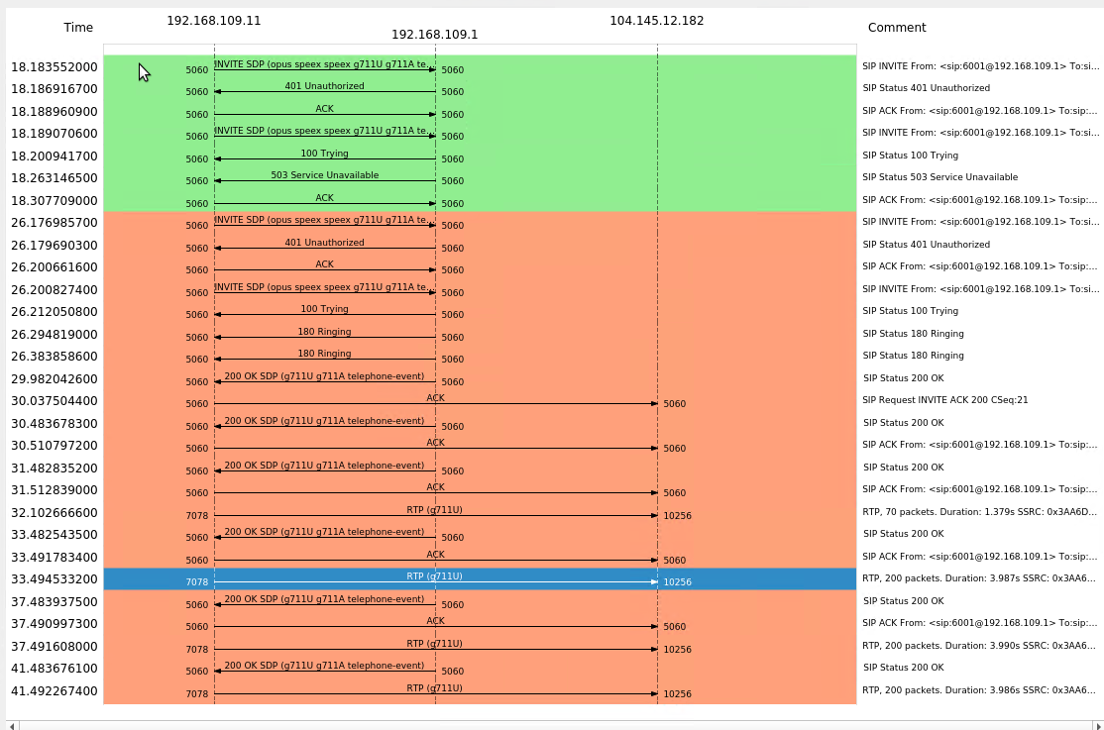
Protocol Sequence Diagram
The protocol sequence diagram should show a summary of messages exchanged among the SIP clients and SIP server during the SIP session setup and tear-down process.

Slide 15
References
1. Azure Labs
2. Linphone
3. Barz, H. W., & Bassett, G. A. (2016). Multimedia networks: protocols, design and applications. Wiley & Sons.

Slide 16
NETW320 Course Project
Module 4
RTP Security

Slide 17
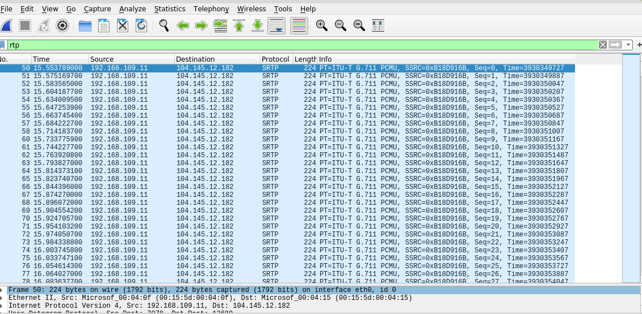
Secure Real-time Transport Protocol (SRTP)
This screenshot shows the Wireshark Packet View window, with the encrypted RTP or SRTP packets.
SCREENSHOT HERE

Slide 18
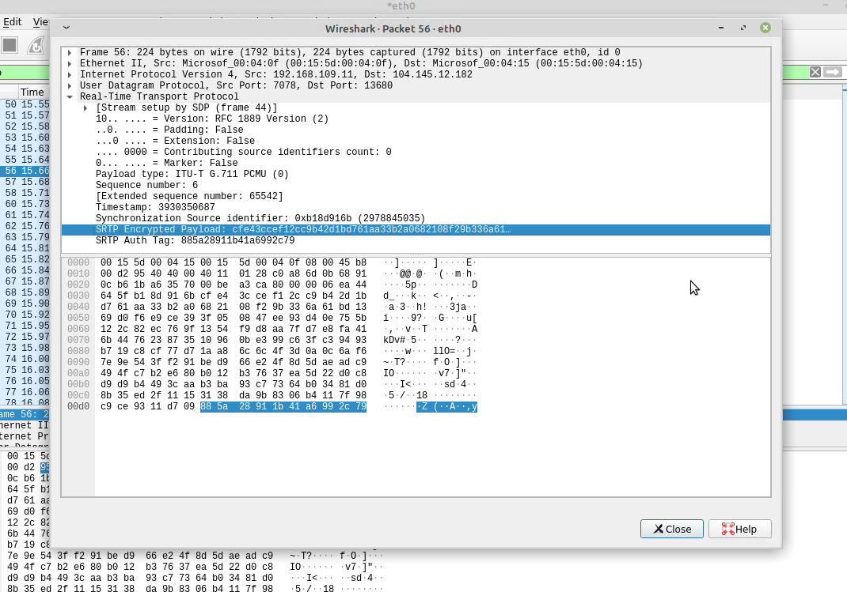
Secure Real-time Transport Protocol (SRTP)
This screenshot shows the Wireshark Tree View window, with the encrypted payload of a SRTP packet.
SCREENSHOT HERE

Slide 19
References
1. Azure Labs
2. Linphone
3. Barz, H. W., & Bassett, G. A. (2016). Multimedia networks: protocols, design and applications. Wiley & Sons.

Slide 20
NETW320 Course Project
Module 5
SIP Security

Slide 21
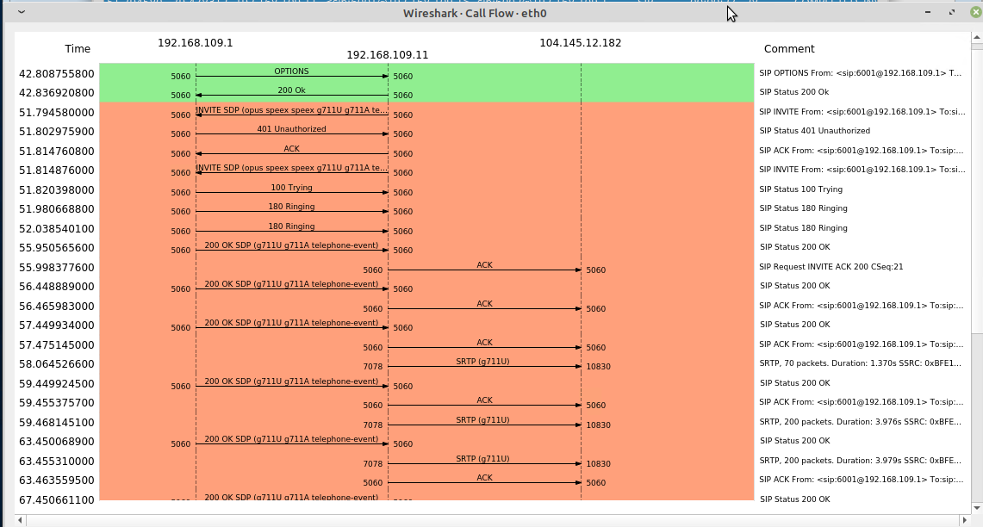
RTP Stream Decryption
This screenshot shows the protocol sequence diagram of SIP flows.

Slide 22
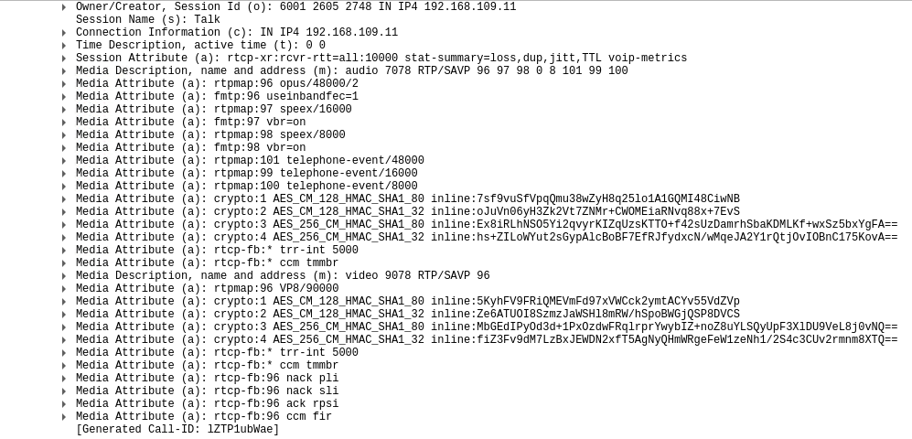
RTP Stream Decryption
This screenshot shows include the Wireshark Tree View section, showing the two groups/sets of crypto: entries.

Slide 23
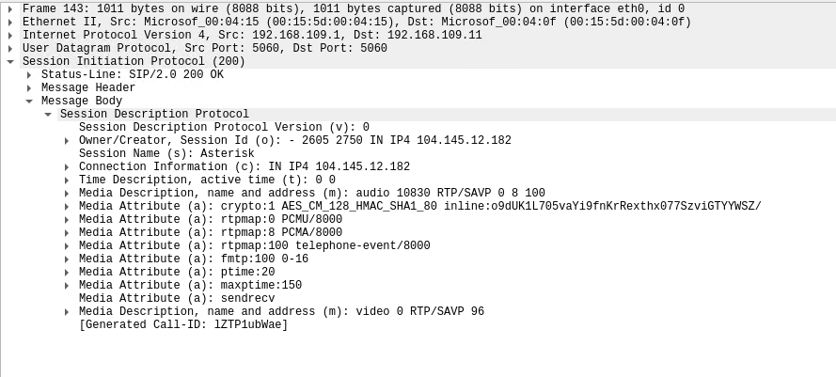
RTP Stream Decryption
This screenshot shows include the Wireshark Tree View section, showing the single crypto: entry used to encrypt messages from Asterisk Server to SIP Client 1.
In the crypo: entry name, AES_CM_128_HMAC_SHA1_80, what encryption algorithm, authentication method, and hashing algorithm could you identify?
Answer:
From AES_CM_128_HMAC_SHA1_80, we can tell that the encryption algorithm is AES in 128bits, as for the authentication it is SIP, and for the hashing algorithm it is HMAC SHA1.

Slide 24
References
1. Azure Labs
2. Linphone
3. Barz, H. W., & Bassett, G. A. (2016). Multimedia networks: protocols, design and applications. Wiley & Sons.

Slide 25

Thank You
https://norrisjames11.wixsite.com/pnorris
patrick6@my.devry.edu

