Slide 1

NETW 310
Professor: Burton Piper
By: Patrick Norris

Slide 2
Introduction
This PowerPoint is a collection of projects that were done in Network 310. These projects contain AM/FM signals, antenna gain and free space loss, cables and cabling, PCM and the line codes, and bit error rate of fading channels. These project helps build career skills and knowledge.

Slide 3
Baseband Signals and am/fm signals

Slide 4
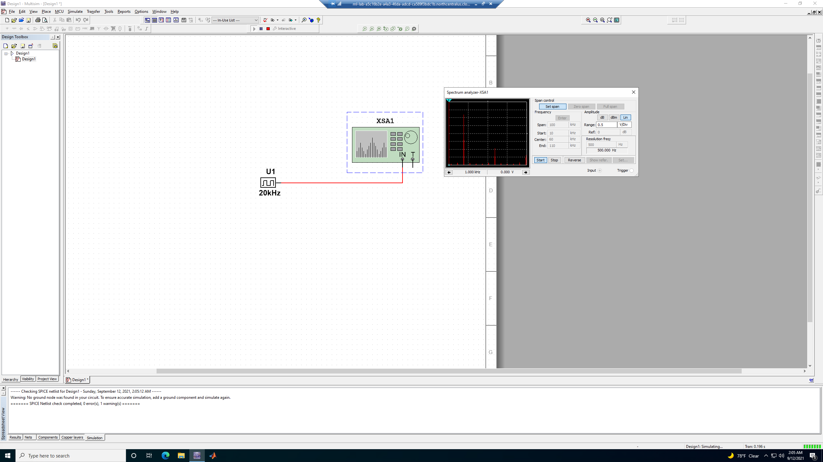
Baseband signals
Harmonic Frequency | Signal (Volts)
20 kHz | 3.131V
40 kHz | 0V
60 kHz | 868mV
80 kHz | 0V
100 kHz | 416mV

Slide 5
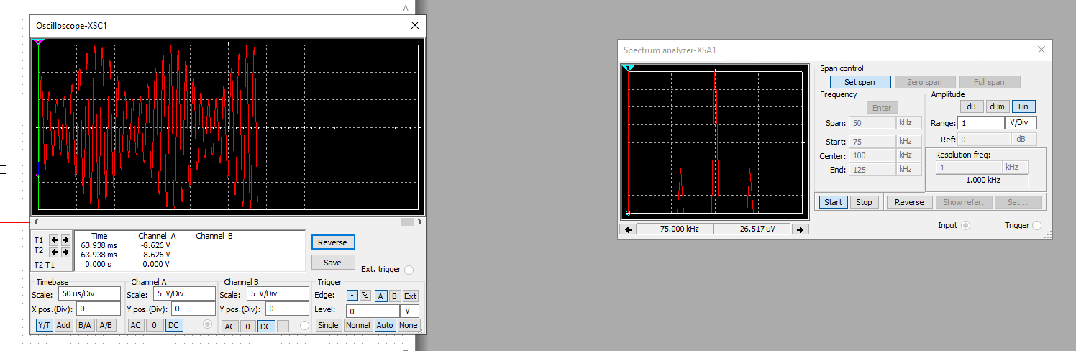
AM Signals
Oscilloscope screenshot
Spectrum Analyzer screenshot
AM Modulation | Frequency (kHz)
Lower side band | 90kHz
Carrier | 100kHz
Upper side band | 110kHz

Slide 6


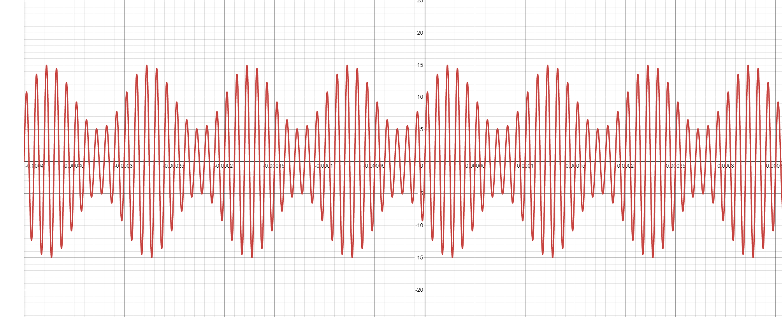
Am signal cont.
Equations for the carrier and modulating signals and plot the equation for the composite modulated signal V_{AM .}
Equations here:
Carrier -
Modulating-

Slide 7
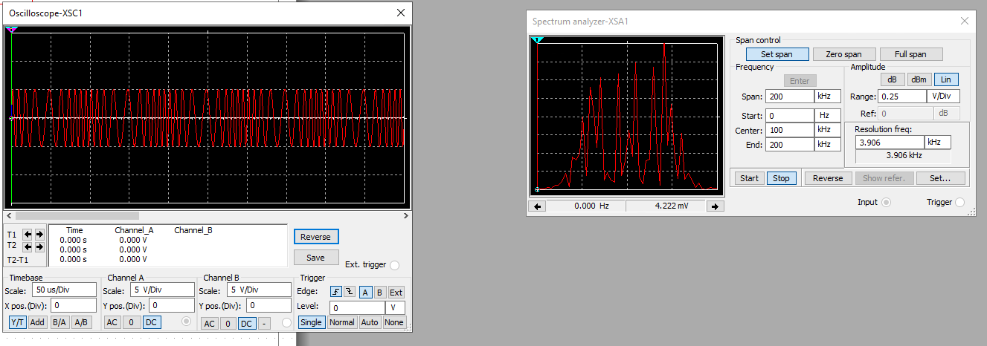
Fm signals
Oscilloscope
Spectrum Analyzer
What’s the carrier frequency?
The carrier frequency is 100kHz.

Slide 8
Pulse code modulation (pcm) and line codes

Slide 9
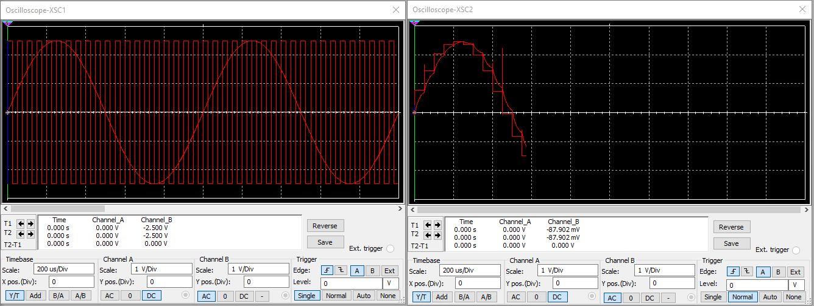
Pulse code modulation (PCM)
The first screenshot shows the Oscilloscope-XSC1 display with the analog input signal and sampling clock at the input to the ADC. The second screenshot shows the Oscilloscope-XSC2 display with the output of the DAC.

Slide 10
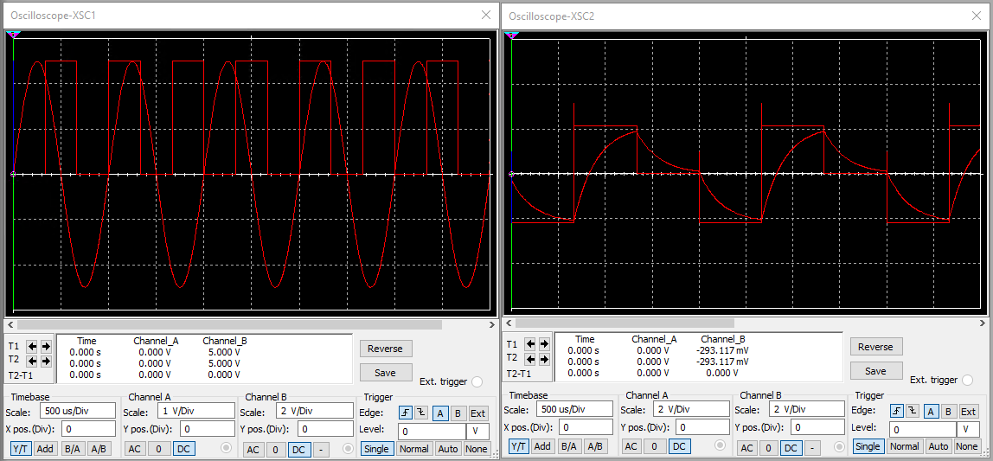
Pulse code modulation (PCM)
The first screenshot should show the Oscilloscope-XSC1 display with the analog input signal and sampling clock at the input to the ADC. The second screenshot should show the Oscilloscope-XSC2 display with the output of the DAC.
What are the effects of increasing or decreasing the sampling rate?
Answer: If you decrease the sample rate you are distorting the signal which makes it hard to reconstruct the signal. If you increase the sample rate you would have aliasing, which you make the signal more accurate.

Slide 11
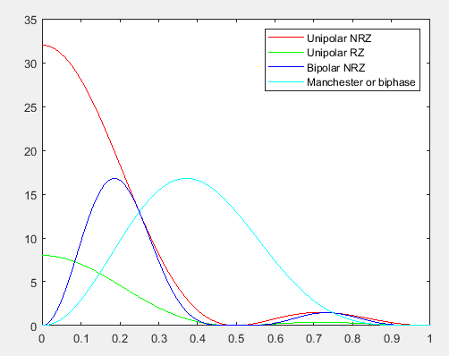
Line codes
This screenshot should show the power spectral densities of four-line codes: NRZ-Polar, NRZ-Unipolar, NRZ-Bipolar, and Manchester-Polar.
Compare the Unipolar-NRZ and Manchester polar codes in the diagram.
Which one requires more bandwidth?
Answer:
Manchester would require more bandwidth.
MATLAB Diagram Here

Slide 12
Cables and structured cabling

Slide 13
Cables and structured cabling questions
1. Why must the twisting in the individual wires be maintained in a UTP cable?
Answer: The twisting of the individual wires help reduces the electromagnetic interference that might occur.
2. How many inches should UTP cable be separated from 110 volts electrical cable?
Answer: UTP cable should be far away from EMI sources as possible, the cable should maintain a 12-inch separation.
3. Horizontal cabling connects what areas to each other?
Answer: Horizontal cabling connects telecommunications room to outlets; horizontal cable connects the telecommunications to the work area.
4. What is a plenum rated cable?
Answer: Plenum rated cable is NFPA-262 and UL-910 compliant. This cable is used for raised floors or to be next to air handling ducts as this cable is self extinguish and not re-ignite.
5. What is a riser tube used for?
Answer: Riser tube is used for vertical tray applications; runs between floors or elevator shafts.
6. Is the grounding of equipment mostly a safety or a performance concern?
Answer: Grounding of equipment is a safety concern not a performance concern. As to protect the equipment that is being used.

Slide 14
Antenna gain and free space path loss

Slide 15
Antenna Gain
What is the maximum theoretical antenna gain of a common dish antenna at the 2.4 GHz band?
Max theorical gain in dB is 22.379.
What is the maximum theoretical antenna gain of a common dish antenna at the 5 GHz band?
Max theorical gain in dB is 29.079.
Given the same sized reflector, which signals, high-frequency, or low-frequency, can be more efficiently focused by a common dish antenna (i.e., result in a higher antenna gain)?
The 5GHz which is high-frequency will give the higher gain.
What is the maximum theoretical antenna gain of the dish antenna used in the VLA radio telescopes in New Mexico at the 5 GHz band?
Max theorical gain in dB is 63.059.
Given the same signal frequency, which dish antennas, large-sized or small-sized, are more efficient at focusing the signal (i.e., result in a higher antenna gain)?
Large size antennas are more efficient given the last answer.

Slide 16
Free Space Path Loss
What is the free space path loss in dB at the 2.4 GHz band?
Free space path loss in dB is -80.4.
What is the free space path loss in dB at the 5 GHz band?
Free space path loss in dB is -87.2.
How does the free space path loss at a higher frequency (e.g., the 5 GHz band) compare with that at a lower frequency (e.g., the 2.4 GHz band)?
The higher frequency has a higher free space path loss.
What is the free space path loss in dB over 20 meters at the 2.4 GHz band?
Free space path loss in dB is -66.421.
What is the free space path loss in dB over 40 meters at the 2.4 GHz band?
Free space path loss in dB is -72.441.
What is the free space path loss in dB over 80 meters at the 2.4 GHz band?
Free space path loss in dB is -78.462.
When the distance doubles, how does free space path loss in dB change approximately? [5 points]
When the distance is doubled, we lose about 6dB.

Slide 17
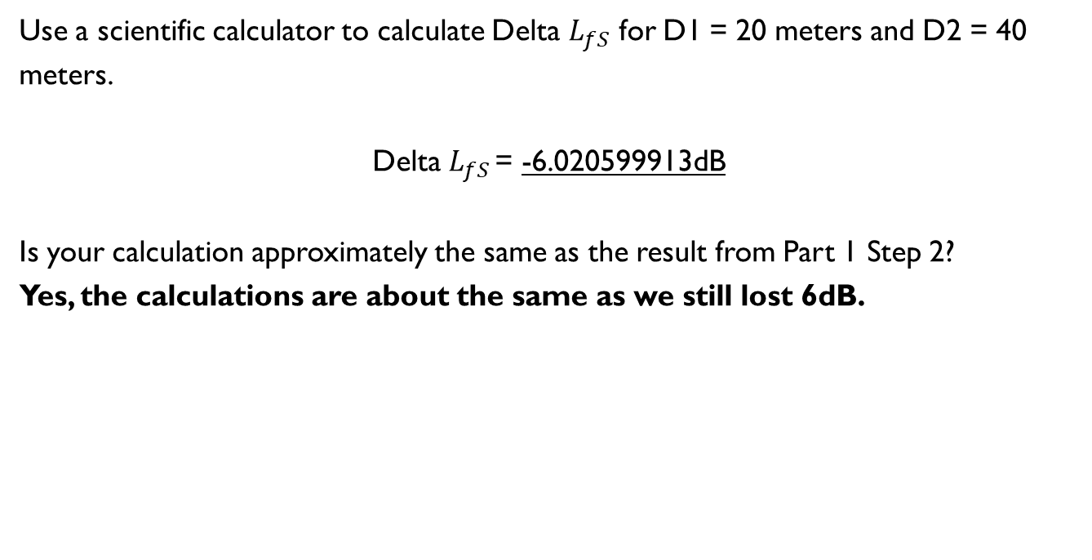
Free Space Path Loss Cont.
Use a scientific calculator to calculate Delta $L_{fS}$ for D1 = 20 meters and D2 = 40 meters.
Delta $L_{fS }$= -6.020599913dB
Is your calculation approximately the same as the result from Part 1 Step 2?
Yes, the calculations are about the same as we still lost 6dB.

Slide 18
Bit Error rate of fading channels

Slide 19
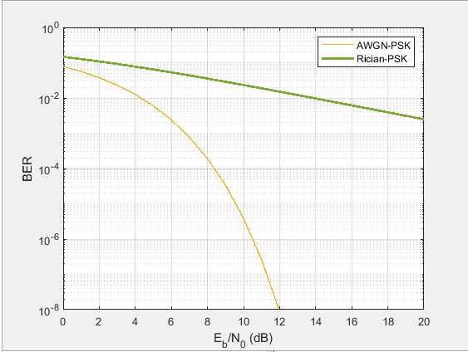
AWGN Channel and Rician Channel
This screenshot shows the bit rate error performance of both AWGN and Rician fading channels.

Slide 20
AWGN Channel and Rician Channel
Compare and contrast the BER performance of PSK over a noise limited (AWGN) transmission channel to the performance of PSK over a Rician channel at 5- and 10-dB Signal to Noise Ratio (E_{b}/N₀), respectively.
Is there a significant difference in BER performance of PSK between the AWGN channel and Rician channel?
Answer: Yes, at 2db the BER is about the same but as it goes farther the AWGN does get better where the Rician does not.

Slide 21
Challenges
One challenge I would say is working with the software (NI Multisim 14.2)
Another challenge is understanding different antennas and their capabilities

Slide 22
Career skills obtained
Different times of antennas
Different type of cabling
The sheathing of cable
Understanding of troubleshooting and electromagnetic interference testing

Slide 23
Conclusion
This class taught cabling and antennas; and how they work. As well as signal transmission and how different signals can interfere with signals. PCM and line codes, along with bit error rate of fading channels. These were some of the things that were taught over the course of the class.

Slide 24
References
Frenzel, L. E. (2016). Principles of Electronic Communication Systems. McGraw-Hill Education.

Slide 25

Thank You
norrisjames11.wixsite.com/pnorris

