Slide 1
CEIS 101
IoT Home Security System
By: Patrick Norris

Slide 2
Introduction
The Internet of Things is growing exponentially
This project combines all aspects of the IoT when developing a home security system

Slide 3
Inventory
Before developing the home security system, an inventory of material that is needed was done.
The following is a list of the items that were needed:
  Arduino Megaboard
  Resistor-220 ohm
  LED
  Breadboard
  Motion Sensor
  Wire(s)
  Buzzer
  Esp32 Board

Slide 4
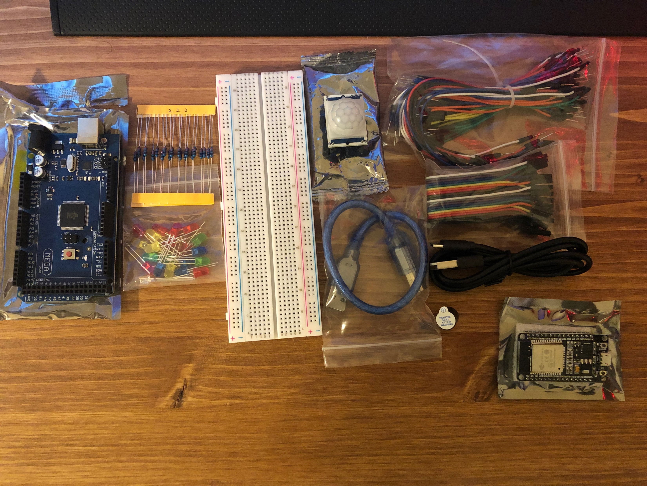
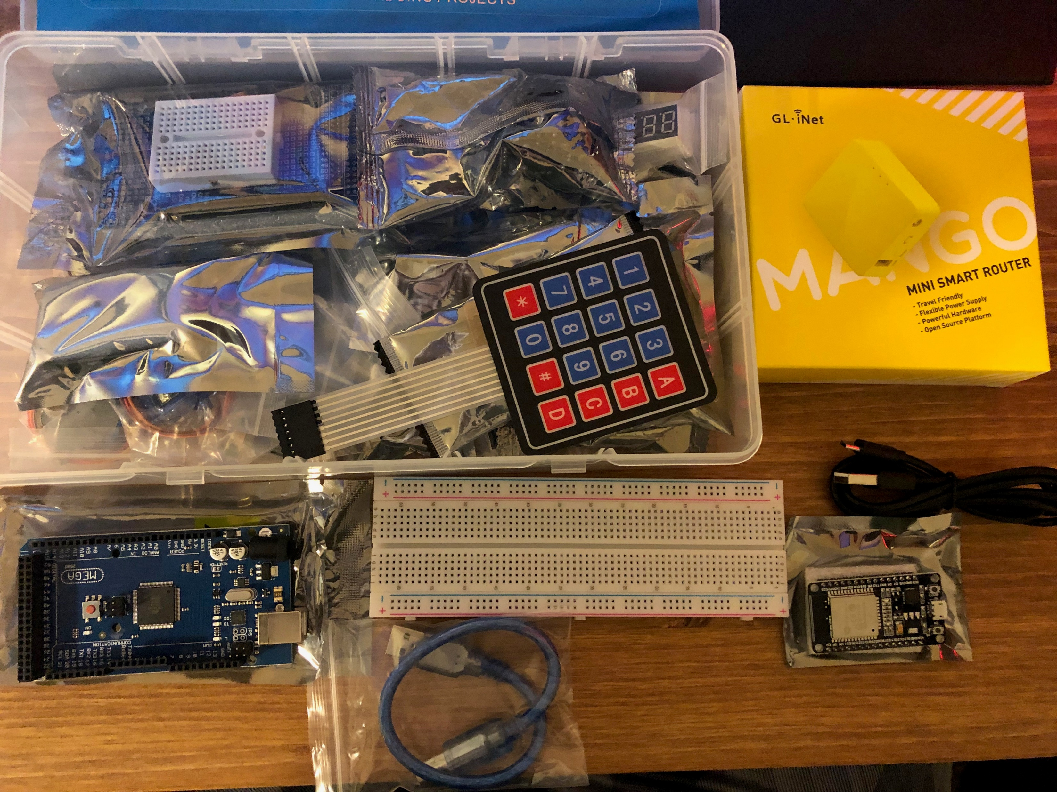
Inventory
Arduino Starter Kit
Mini-Smart Router
USB-microUSB Cable
Esp32 Board
Arduino Megaboard
Resistor - 220Ω
LED
Breadboard
Motion Sensor
Wire(s)
Buzzer
Esp32 Board

Slide 5
Planning and Design
When is comes to making an idea to come true there is a process that most companies do which. Companies make flow charts to show how the process will work.

Slide 6
Flow Chart
Start
Input
Motion
This is a flow chart of how the data will be processed and the order that it will be conducted.
Processing
Detect Motion
Output
Buzzer & Lights
Stop

Slide 7
Input – Processing - Output
Input | Process | Output
Motion | System waits till motion is detected. Once motion is found, system actives buzzer to alert user. | Buzzer/Noise/Light

Slide 8
Setting up the Arduino
After making a flow chart and producing a plan, the Arduino IDE software needed to be installed in order to program the Arduino Mega for the home security
To test the board and the program to make sure that everything works I conducted a blink test with a simple blink code

Slide 9
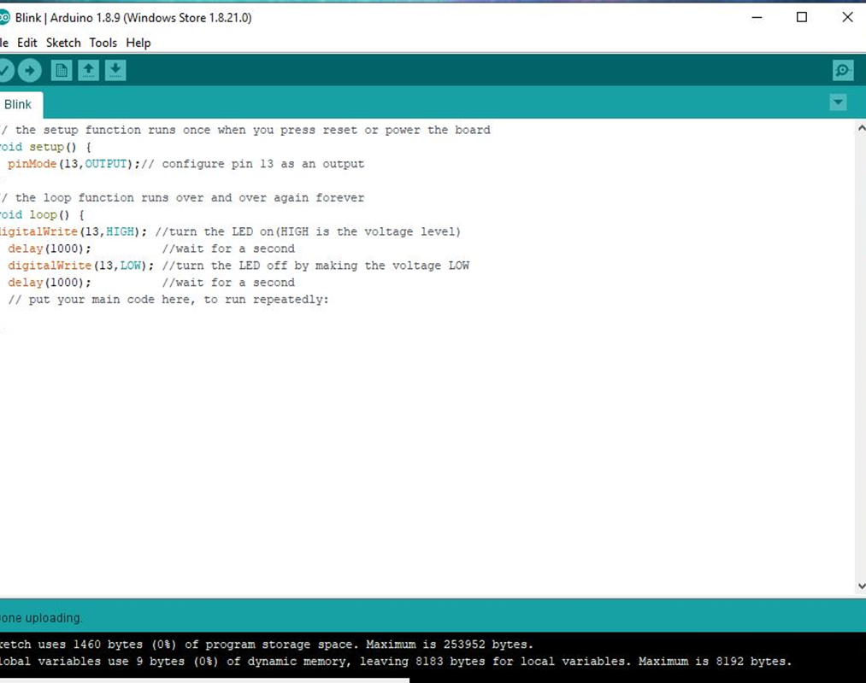
Arduino IDE
This is the IDE software with the blink code

Slide 10
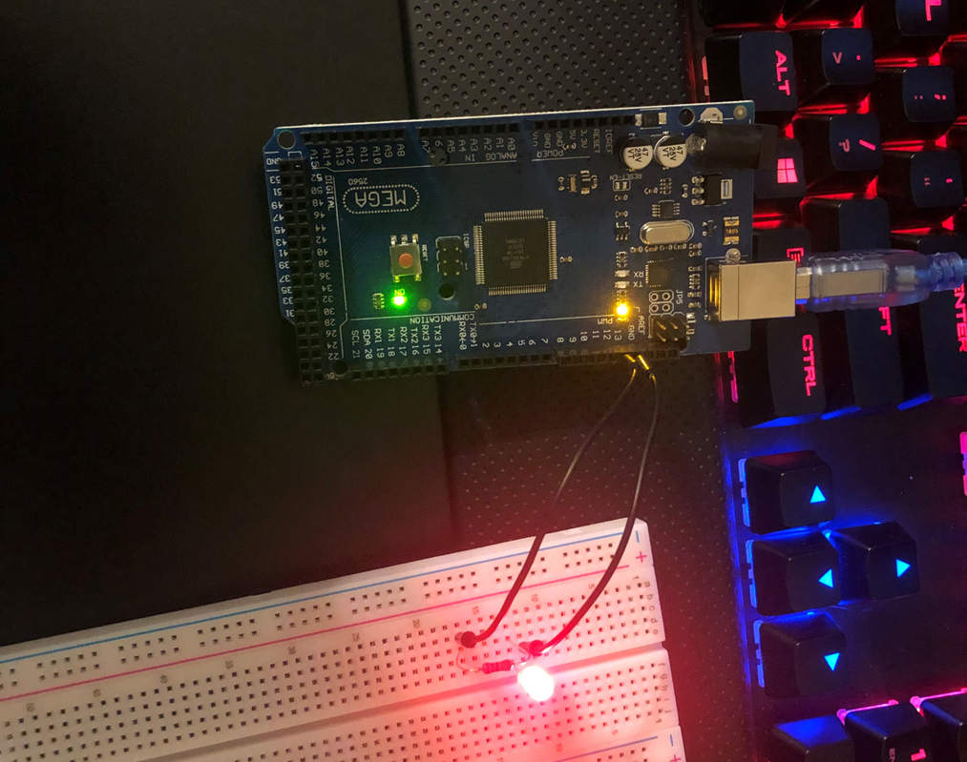
Arduino Circuit
This is the Arduino running the blink code

Slide 11
Adding Buzzer and Motion Detector
The next thing that was conducted was adding the buzzer and motion detector
With this the code had to be changed and updated
With the Arduino IDE setup() function, it tells the board what items are where and what to do; then runs on a loop.

Slide 12
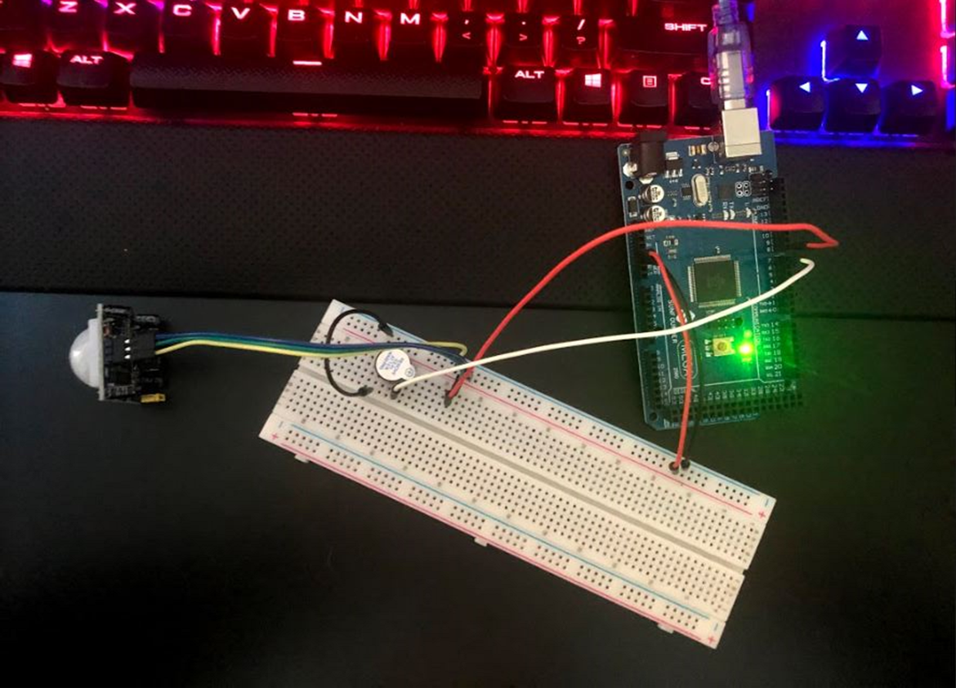
Circuit with Buzzer and Motion Detector

Slide 13
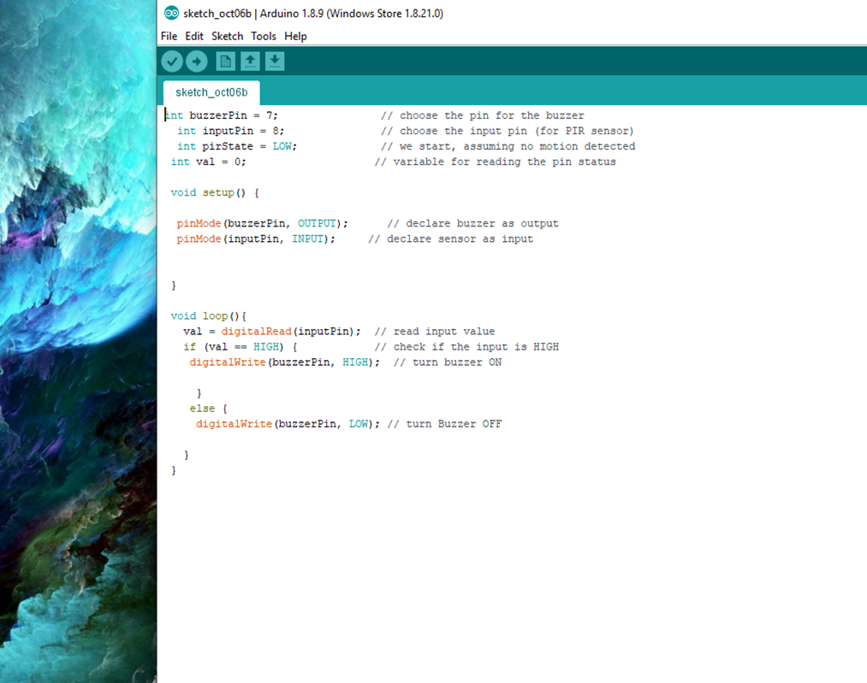
Code with Buzzer and Motion Detector

Slide 14
Code Explanation
The input pin is pin 8 (PIR sensor). The output pin is pin 7 (buzzer pin). This is known by the code that is written as the sensor is giving the input of motion or no motion the buzzer will give the output of noise or no noise depending on pin 8.
The setup function runs only one time to tell the board what is what and the loop is where it uses the setup to tell what to do if this or if that.

Slide 15
Data Display
Using the Serial Monitor on the Arduino IDE allows for the data to be displayed when the code is running
It is a simple message of “Motion Detected” in the serial monitor along with the amount of how many times the motion was detected; you can also add the date and time stamp which is a simple click at the bottom of the serial monitor

Slide 16
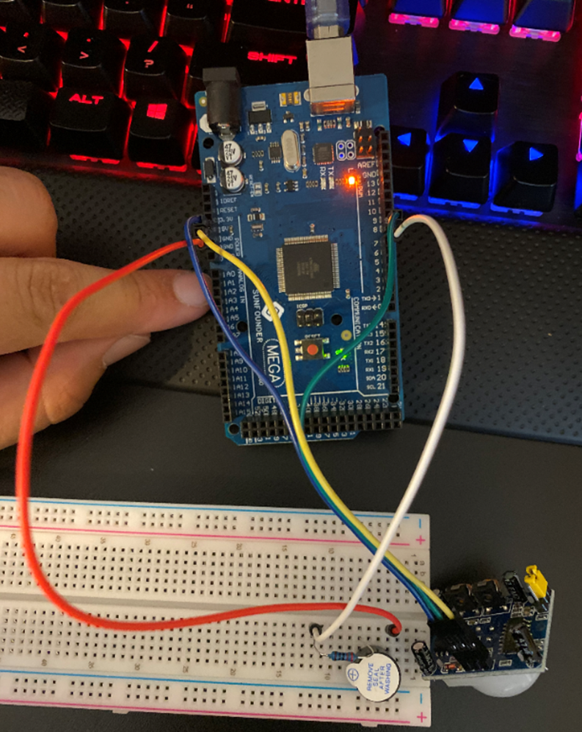
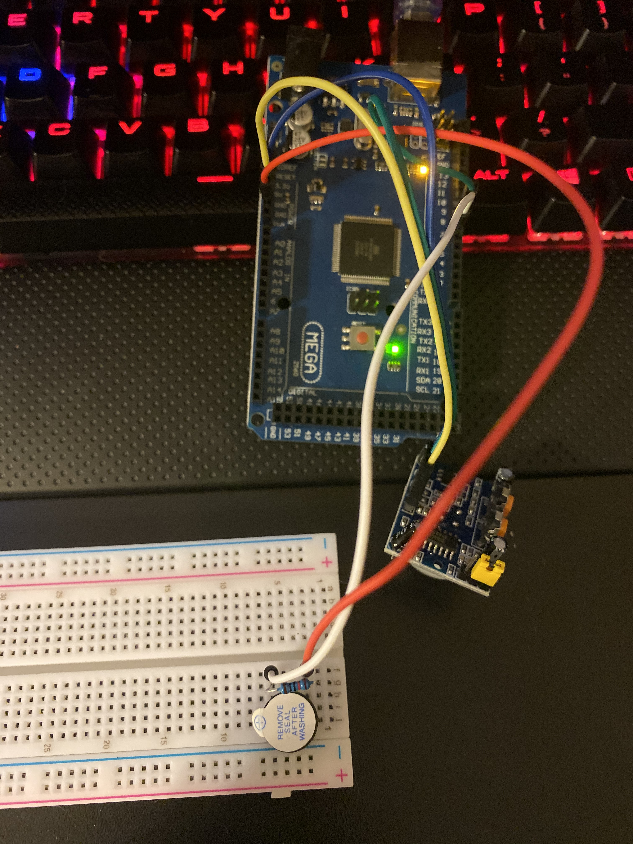
Circuit
Arduino with Motion Detector, buzzer, and resistor
220-ohm resistor
10k ohm resistor

Slide 17
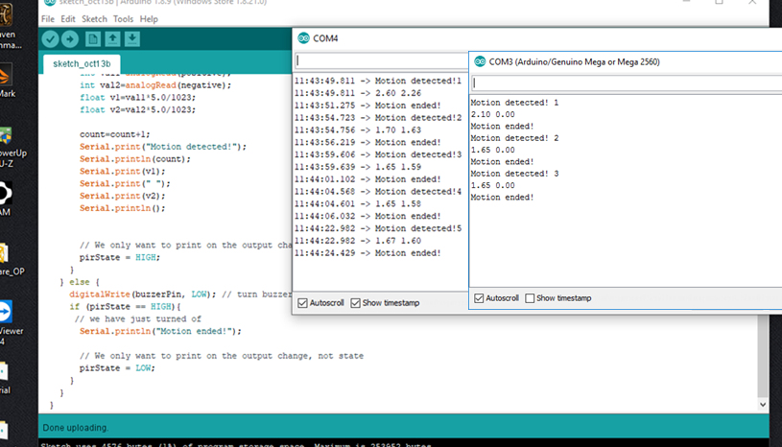
Serial Monitor
This is a screenshot of the serial monitor showing motion detected and ended, along with the voltage and time stamp

Slide 18
Using the Serial Monitor
When it comes to the serial monitor, the code (Serial.println(count)) must be in the code.
In Arduino IDE, once the code has been put in and the setting are taken care of you click on tools and then serial monitor. Here the information about the board will be shown.

Slide 19
Networking and Security
For networking, the home security system the ESP32 is used as it can connect to Wi-Fi
To set this up a mini router is needed along with the password and SSID of the router
Once the router is setup the ESP32 board is ran using Arduino IDE software, once setting are made of the board a quick test is done to make sure the board works
A locate web server was made using the ESP32 allowing for the control of a light to be turned on and off remotely
Addition to this I wired a motion sensor and the buzzer to make a full home security system

Slide 20
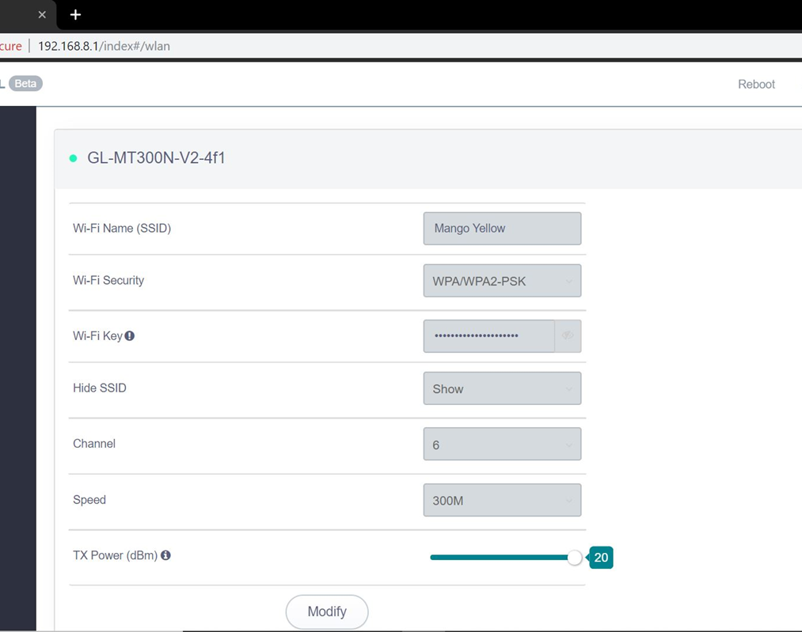
Router Setup
This shows the SSID and that a password has been set, along with the router setting being set on WPA/WPA2-PSK for Wi-Fi security

Slide 21
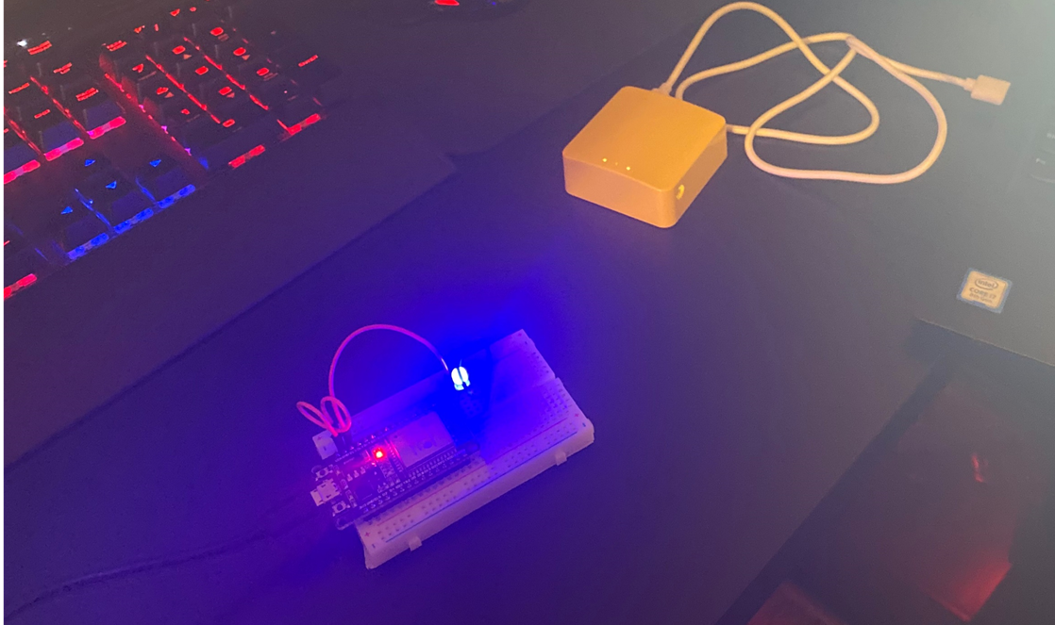
Circuit
This is a picture of the ESP32 board with the light turned on and the mini router being used

Slide 22
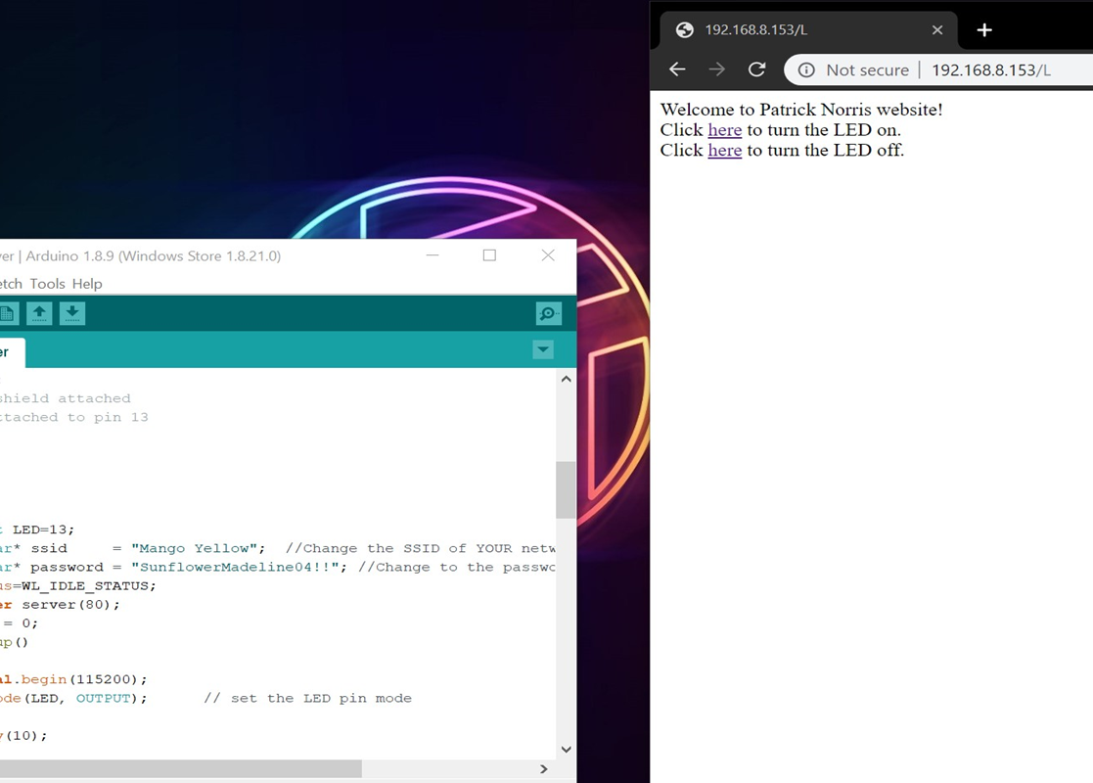
Locate Web Server
This is the locate web page the was made with the Arduino IDE software and the ESP32 board. As it show to turn on and off the LED light that was in the last slide.

Slide 23
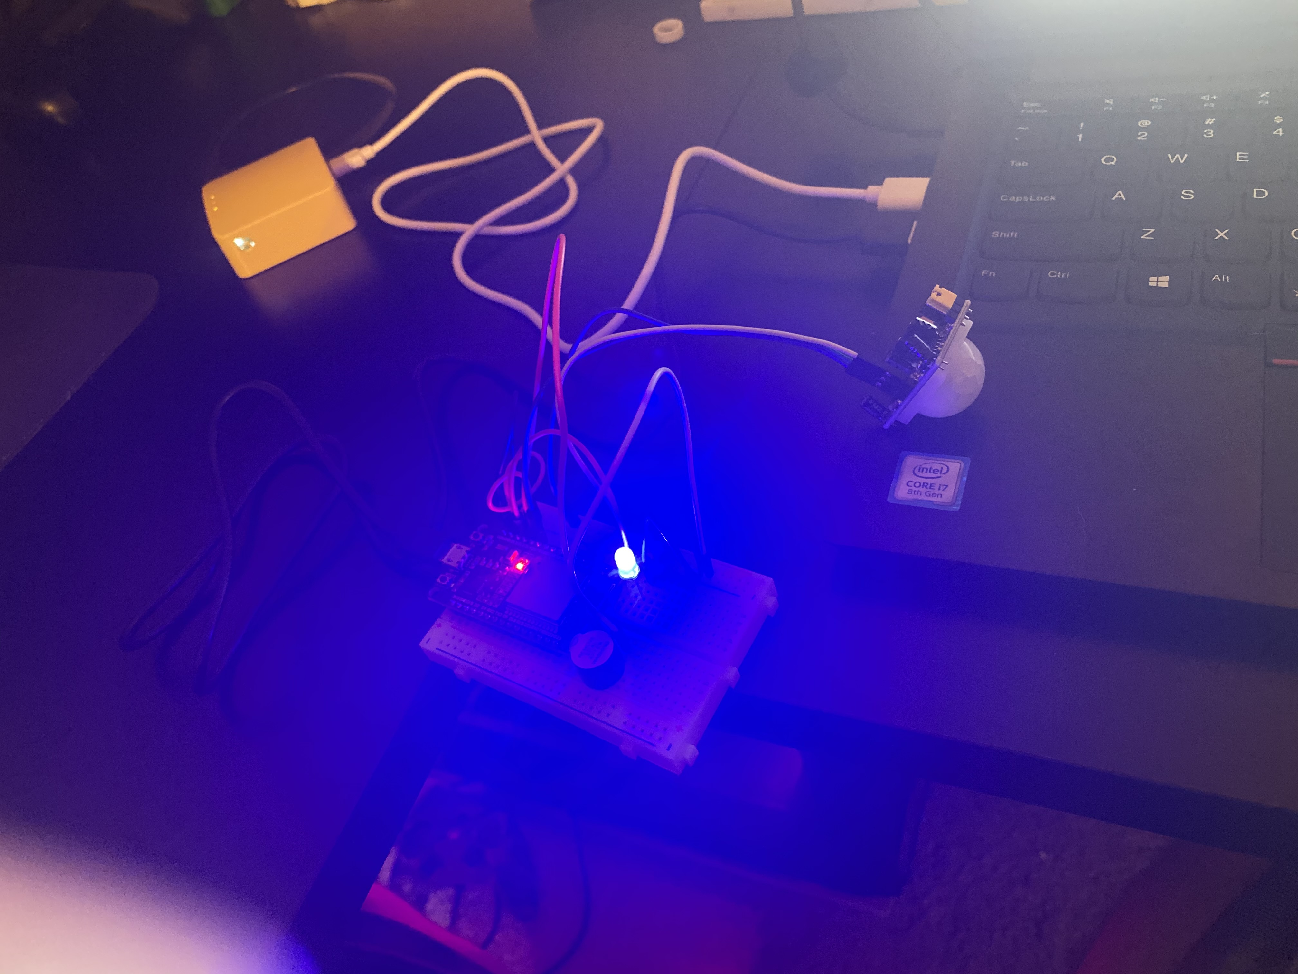
Connecting the Home Security System
In this picture you can see the home security system in action

Slide 24
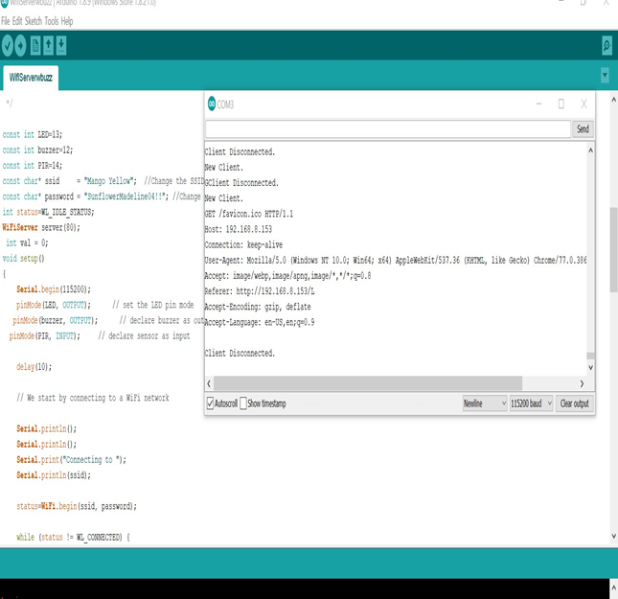
Connecting the Home Security System
In this picture you can see that the serial monitor was used to show who had connected to the board to turned on and off the light. When reading the output you can see it was connected to and Apple device which was my Iphone.

Slide 25
Challenges
One of the biggest challenges that I ran into as first was the senor, as I thought it was the light in the room that was making the senor go off, but it was the sensitively of the senor.
Initially the ESP32 board did not work as expected. The get command needed to run again for the files to download.

Slide 26
Career Skills
Several career skills are gained in this project:
  Communication – using flowcharts to show a plan and how it will be done
  Electronics (voltage, resistance, current) and working with the Arduino
  Programming using the Arduino IDE software
  Networking – setting up the router
  Security – setting the password on the router and setting the security for the router

Slide 27
Conclusion
This project covered the fundamentals of the Internet of Things by the creation of a home security system
Building a home security system, working with a circuit and an Arduino provided with hands on learning opportunity to put into practice as the IoT grows in the world we live in

